Slide 1
FULL manual review/tutorial on Wednesday, February 21 @ 5:30pm
Will cover the entire Golf Genius Manual (available on Interclub website under Captain’s Tools)
Answer any questions pertaining to the Captain’s Manual
Agenda Items
Getting signed up – NEW Captains
Accessing the Team Captain Menu
Uploading you TEAM roster
Setting match date(s)

Slide 2
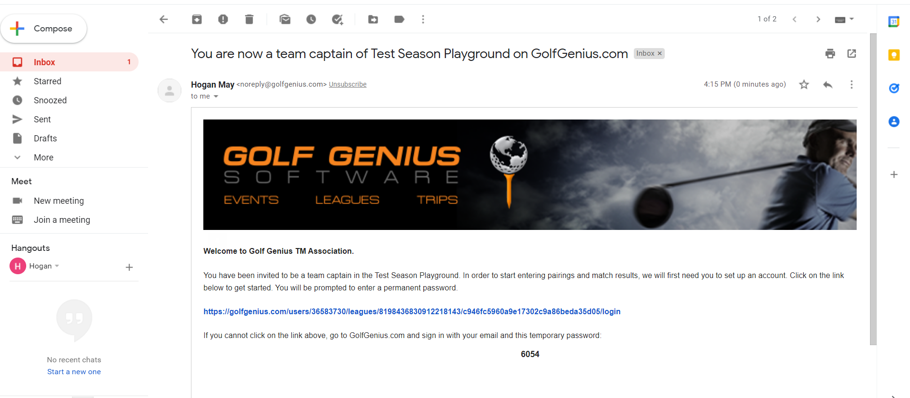
For anyone who hasn’t had a Golf Genius account, you will receive an email with a link to access.

Slide 3
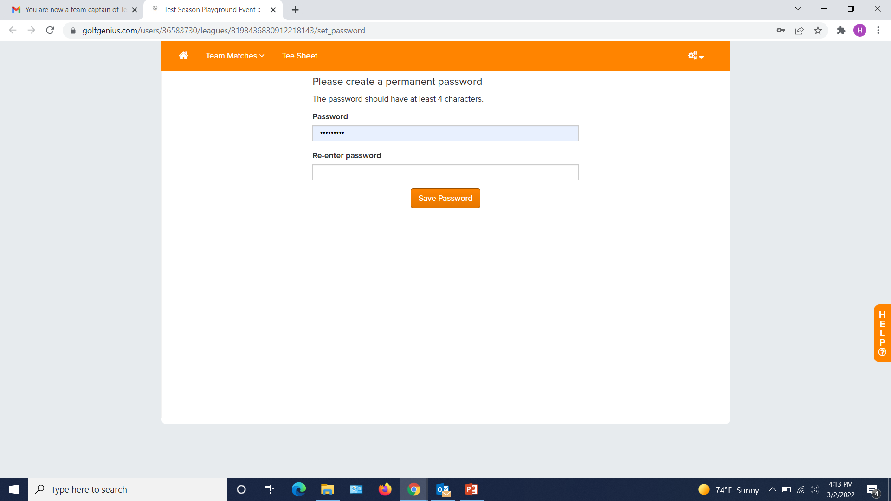
You will be asked to CREATE a password.
*TIP* - write your password and associated email down somewhere!!

Slide 4
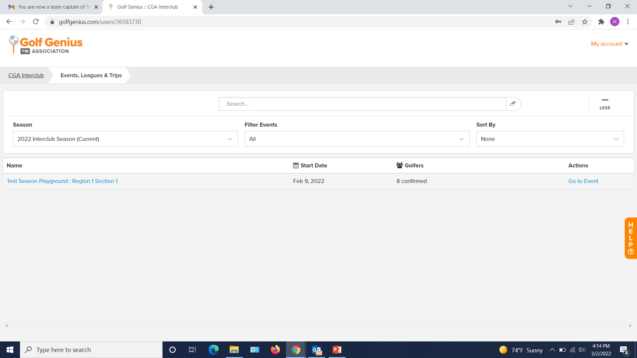
Once your password is created, you will be redirected to a page similar to this.

Slide 5
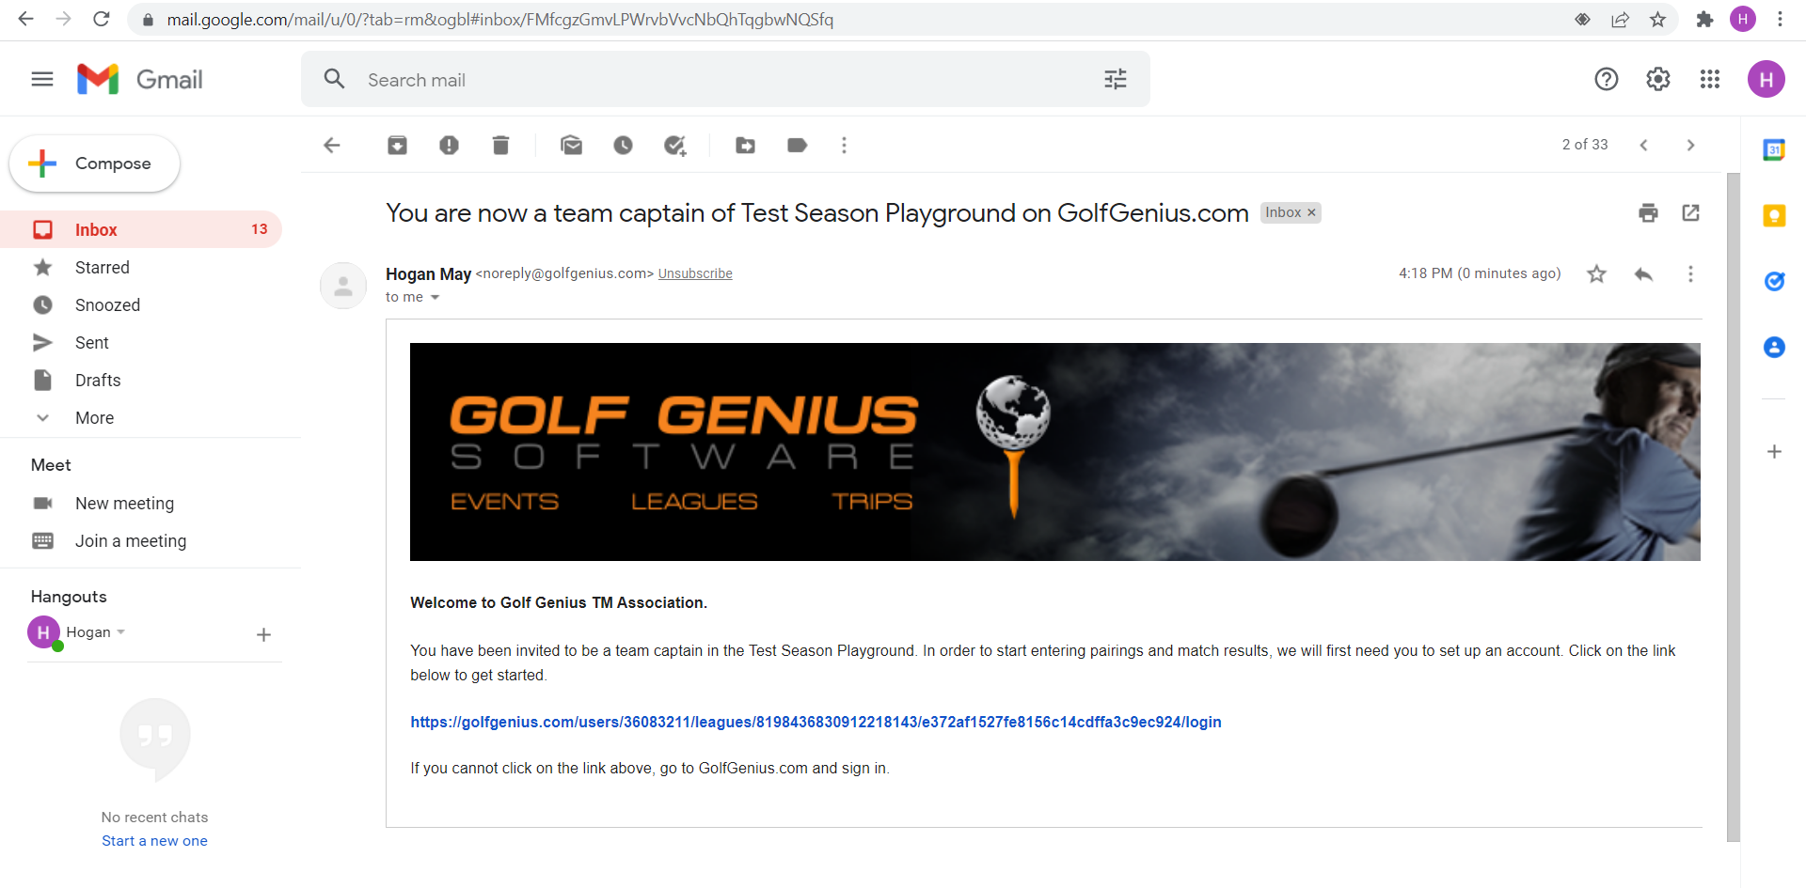
If you have previously logged into Golf Genius with the email provided, follow the link in the email you will receive

Slide 6
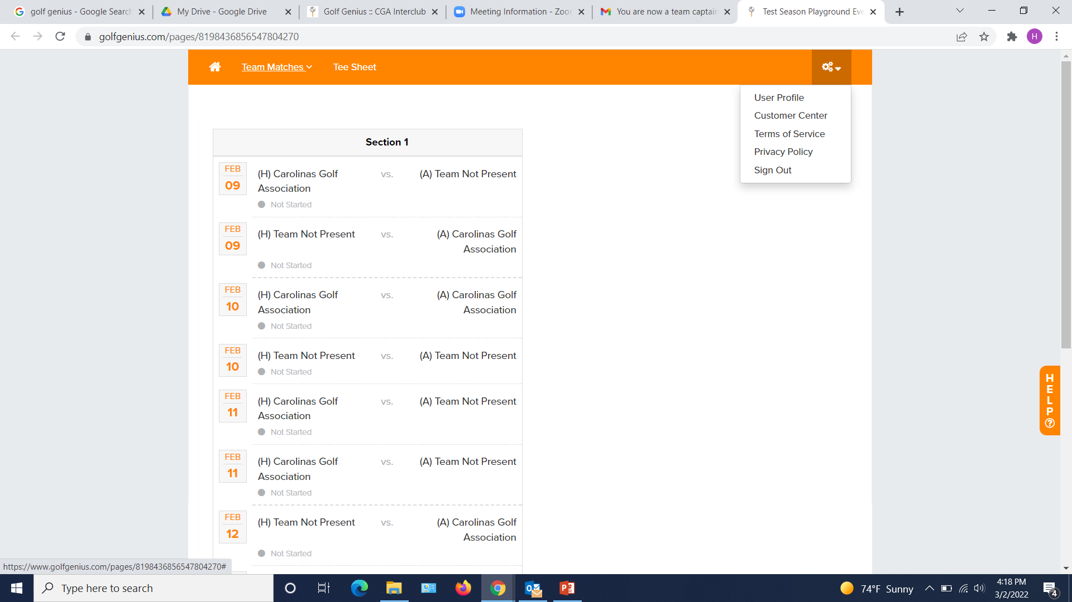
If you’re already logged in, you’ll be brought here. Click on the CUSTOMER CENTER in the settings dropdown in the TOP RIGHT CORNER

Slide 7
You will be redirected to a page similar to this.

Slide 8
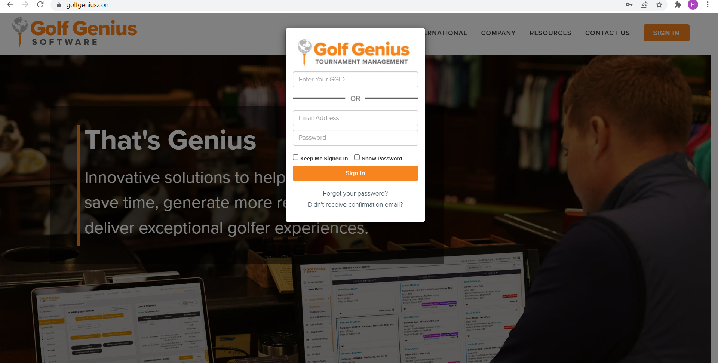
If you have used Golf Genius before, you will need to sign in using the email and password you used previously. If you don’t remember your password, click “Forgot your password?”

Slide 9
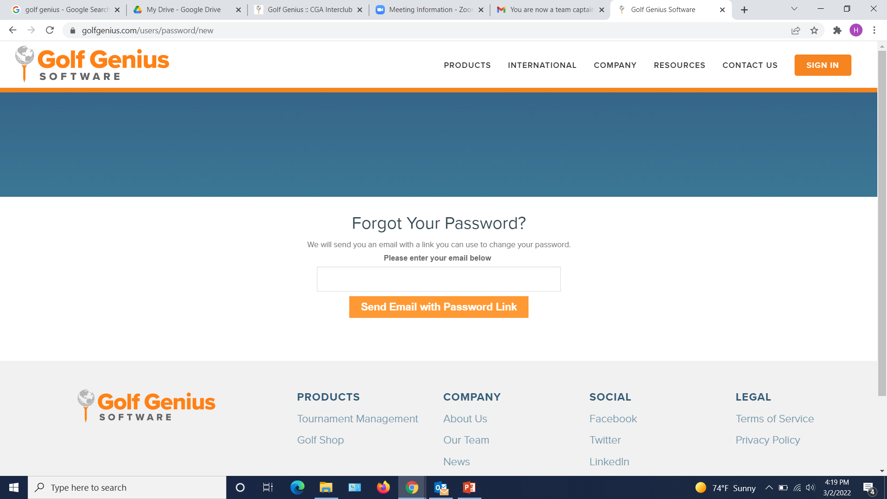

Slide 10
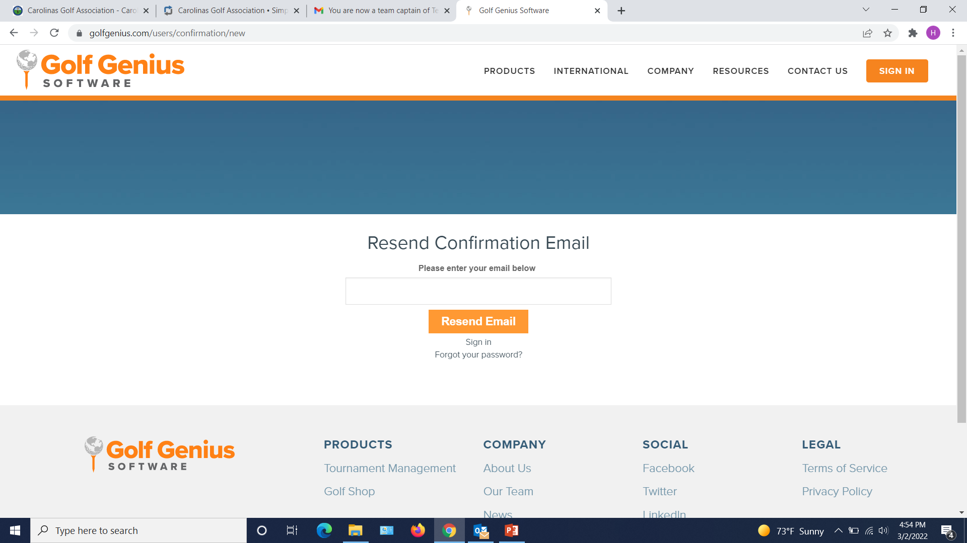

Slide 11
Once signed in and viewing this page, ensure the Season is either “All” or “2024 Interclub Season (Current)”
*TIP* - If you don’t see your pod listed, try switching the season

Slide 12
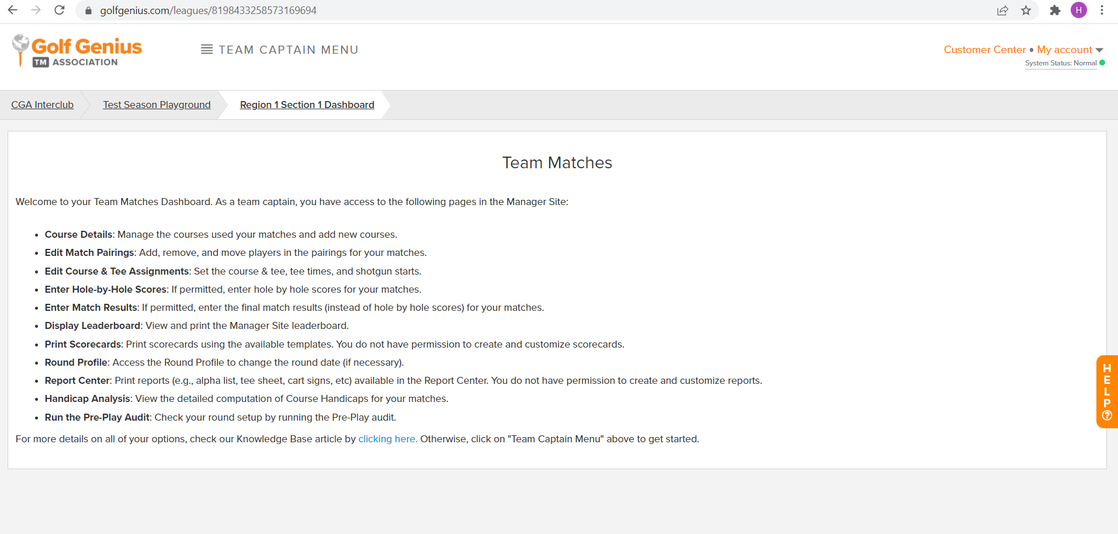

Slide 13
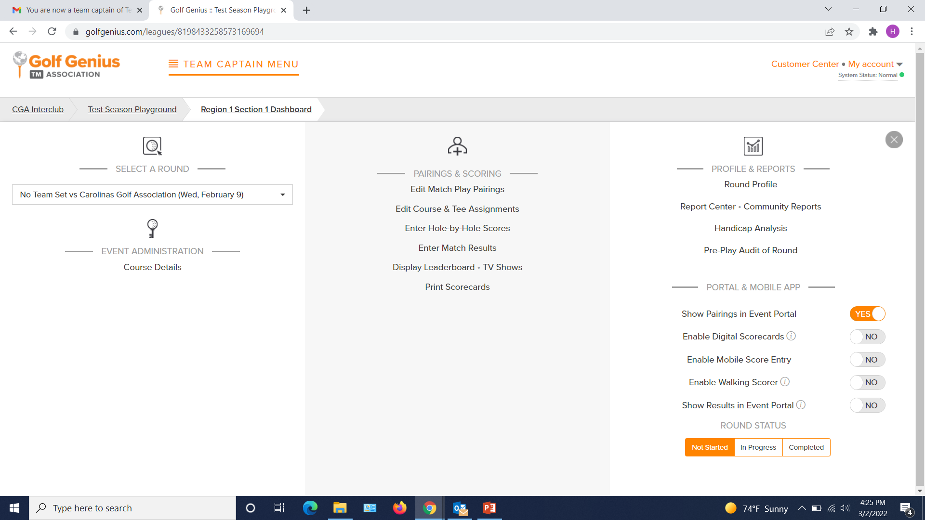
To input your TEAM ROSTER (not match roster), select “Edit Match Play Pairings” in the middle column of the Team Captain Menu

Slide 14
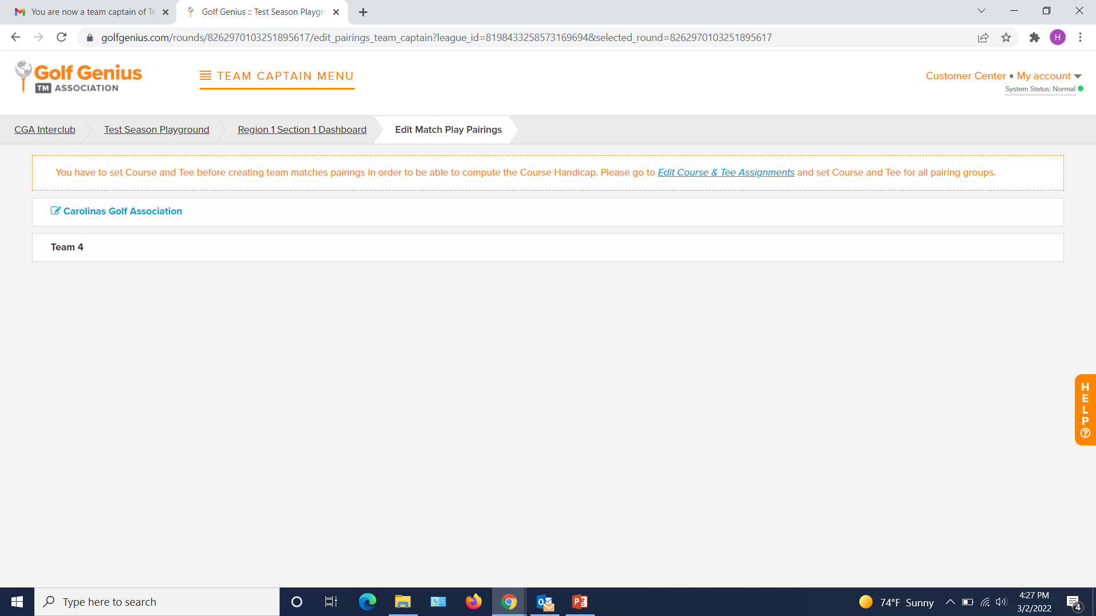
Select YOUR team

Slide 15
Click “Add New Player”
Search player’s name by Last Name then First Name, OR by GHIN number
Click add to add the appropriate player and repeat 1-3 for all players (ex. 15)
Click “Done”
ENSURE YOU CLICK “SAVE TEAM CHANGES” WHEN FINISHED
2
3
4
1
5

Slide 16
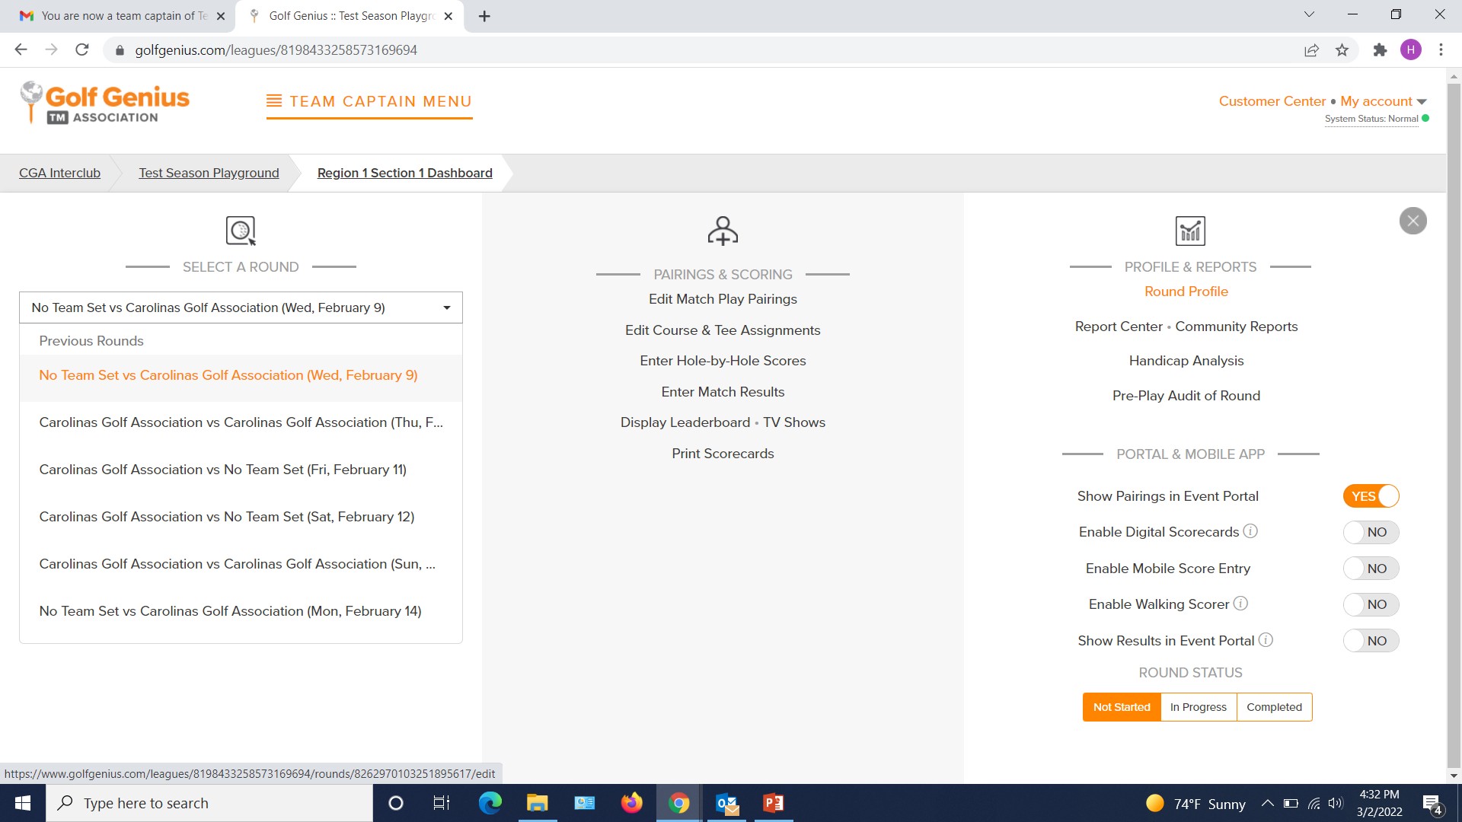
To set your HOME match dates, go to “Round Profile” in the right column of the Team Captain Menu
*Note – Ensure you are always in the CORRECT ROUND!
2
1

Slide 18
REMINDER
FULL manual review/tutorial on Wednesday, February 21 @ 5:30pm
Will cover the entire Golf Genius Manual (available on Interclub website under Captains’ Tools)
Answer any questions pertaining to the Captain’s Manual

