Slide 1

Welcome
CGA
Interclub Captains 2013

Slide 2
CGA Interclub Competition 2013
Staff
Rusty Harder – Tournament Director
Tom Thorpe – Interclub Administrator
Johnnie Gebhardt – Office Manager

Slide 3
CGA Interclub Competition 2013
Agenda
Objectives today
  Review Format & Rules of Play
  Discuss Captains Duties
  Learn TPP Steps (4)
  Preview 2013 Groups
  Begin Scheduling Matches

Slide 4
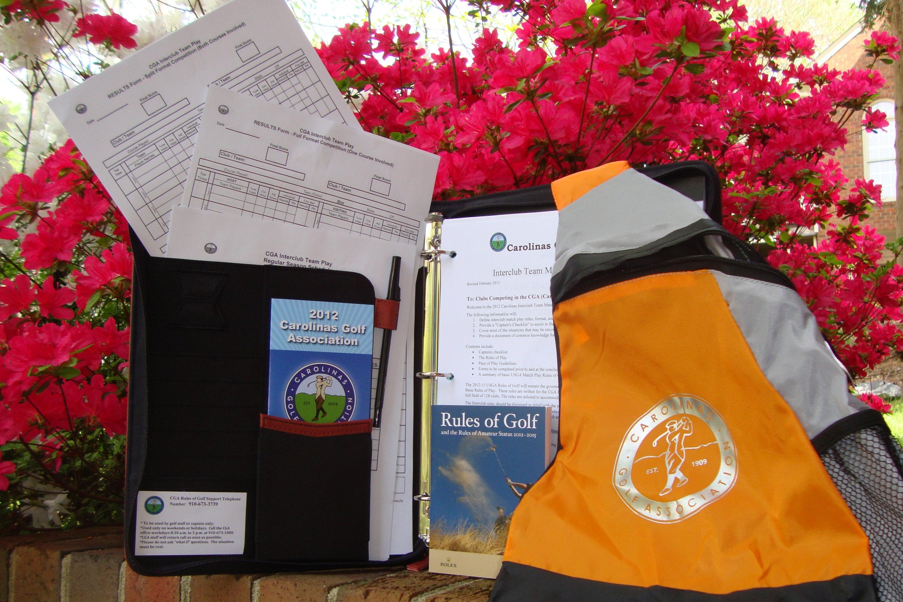
B
CGA Interclub Competition 2013
C
D
E
A
F

Slide 5

CGA Interclub Competition 2013
Ask questions anytime

Slide 6
Verify Contact Information
Group | Eastern Region | City, State | Captain Name | Captain email | Captain phone | Pro Name | Pro email | Pro phone
U | Birchwood CC | Nash, NC |  |  |  | Randy Davis | rdbwcc00@aol.com
U | Coharie CC | Clinton, NC | Jackie Parrish | pgaprofessional@embarqmail.com | 910-592-6772 | Dickie Walters | pgaprofessional@embarqmail.com | 910-592-2951
U | Southern Wayne CC | Mt. Olive, NC | Kevin Kornegay |  |  | Howard A. Hunt | csouthernwayne@nc.rr.com
U | Willow Springs CC | Wilson, NC |  |  |  | Jimmy Gurkin | willowspringscc@cocentral.com
V | Greenville CC | Greenville, NC |  |  |  | Brady Pinner | golfpro@greenvillecountryclub.com
V | Kinston CC | Kinston, NC |  |  |  | Burt Williams | bwilliams@kinstoncc.com
V | Morehead City CC | Morehead City, NC |  |  |  | Nick Eatman | neatman@moreheadcitycc.com
V | New Bern CC | New Bern, NC |  |  |  | Alan Ferebee | aferebee@suddenlink.net

Slide 7
CGA Interclub Competition 2013
Captains / Club Contact Info:
  Accessible on the web (www.carolinasgolf.org)
    Click on: Tournaments
      Click on: Interclub
        Click on: Captains Contact Information
  Password protected (Interclub)
  Send edits to: interclub@carolinasgolf.org

Slide 8
CGA Interclub Competition 2013
Rules of Play
      Interclub
      Match play

Slide 9
CGA Interclub Competition 2013
Rules of Play (2013 changes);
RULE#
22. PLAY-OFF MATCHES (REVISED)
H. CHAMPIONSHIP MATCH –
The final two teams will compete for the Championship over the same weekend at a neutral site designated by the CGA. The format will involve Four-Ball matches on Saturday followed by Individual/Singles matches on Sunday. Teams will consist of sixteen (16) players, plus two (2) alternates, from each club. Teams will compete for a total of 48 match points.

Slide 10
CGA Interclub Competition 2013
Rules of Play (2013 changes);
ADMINISTRATIVE PROCEDURES (NEW)
Captains will use TPP (Tournament Pairing Program) to:
Create Team Rosters
  Select tees for each match
    Prepare Match Rosters
      Submit/record match results and (ESC) scores

Slide 11
CGA Interclub Competition 2013
26 Interclub Rules of Play (TABLE OF CONTENTS)
PLAYER ELIGIBILITY |  | MATCH PLAY CLAIMS
SEASON |  | ADVICE
STARTING TIMES |  | GOLF CARTS AND CADDIES
DEFINITION OF TEAM |  | RAIN / WEATHER PROCEDURES, POSTPONED & SUSPENDED MATCHES
LESS THAN TWELVE (12) PLAYERS |  | WITHDRAWAL FROM TEAM PLAY
TEAM CAPTAINS' DUTIES |  | FORFEITURES
PRACTICE ROUNDS |  | PROTESTS
HOME TEAM ARRANGEMENTS |  | DETERMINING GROUP WINNERS
INDEXES / HANDICAPS & PAIRINGS |  | PLAY-OFF MATCHES
ORDER OF PLAY |  | POLICY FOR COURSE USAGE
TYPE OF COMPETITION AND SCORING |  | PACE OF PLAY
USGA RULES OF PLAY |  | CELLULAR PHONES and ELECTRONIC DEVICES
BALLS AND IMPLEMENTS |  | ETIQUETTE

Slide 12
CGA Interclub Competition 2013
Rules of Play
SEASON
  groups consist of 3 or 4 clubs in close proximity
  clubs will play 3 home and 3 away matches
  3 club groups will use split-format for 3rd match
  matches scheduled primarily on the weekends
  regular season starts May 1 but must end by August 31st
  group winners + advance to the play-offs (minimum 32 Teams)
  play-offs start 1st week-end of September
  Finals - November 16/17 or 23/24 in Pinehurst (course TBD)

Slide 13
CGA Interclub Competition 2013
Rules of Play
STARTING TIMES
  mutually agreed by BOTH team captains
  allow time to complete before daylight ends
  can start from 1st or 10th tees, or shotgun
    Note: adjust handicap holes if 10th tee start

Slide 14
CGA Interclub Competition 2013
Rules of Play
DEFINITION OF TEAM / MATCH ROSTERS
  Team Roster includes all eligible club players
  Match Roster is comprised of 12 players
    1 or 2 alternates are encouraged (optional)
  players must compete in a regular season match (player or alternate) to be eligible for the playoffs
  clubs may sponsor more than one team
    must have balanced rosters
    players must remain on same team after playing in first match

Slide 15
CGA Interclub Competition 2013
Rules of Play
LESS THAN TWELVE (12) PLAYERS
  Less than 12 players allowed
    “Singles Match”
      can be either opponent
      must declare before match begins
    “Four-Ball Match”
      one-man team vs two-man team in the
  Minimum of 6 players to be an official match

Slide 16
CGA Interclub Competition 2013
Rules of Play
CLUB / PLAYER ELIGIBILITY:
All Clubs:
must be members and in good standing with the Carolinas Golf Association (CGA)
must be licensed to offer USGA Handicaps
must be in compliance with the USGA Handicap Certification Program
must maintain or have access to an 18-hole regulation length golf course (minimum 6,000 yards)
All Players:
must be male members and in good standing with the CGA member club
must be an amateur golfer (with the exception of 1N)
must be listed on the club’s GolfNet handicap roster
must have a minimum of 10 posted scores within the past 12 months and two handicap revisions processed
must have a low index of 18.4 or less
must be at least 21 years of age
must not have played in CGA Interclub competition for another club in the current year
In addition:
Club staff/employees (with membership rights and who meet all other eligibility requirements) are eligible
Special circumstances may be considered by Interclub Director upon review of presented circumstances.
One member of the golf professional staff, that are full-time employees, that meet eligibility requirements G – K and comply with all other Interclub rules are eligible. Professional players are optional.

Slide 17
CGA Interclub Competition 2013
Rules of Play
TEAM CAPTAINS' DUTIES
  Create team roster on TPP
  Set tees to be used for each match on TPP
  Determine your team’s sign-up procedure for a match
  Educate your team on format and match play rules
  Prepare match roster on TPP
    review opponents lineup
    verify opponents LI
  Submit match results on TPP
  NOTE:
  LI’s, HDCP STROKES and OPPOSING PLAYER ELIGIBILITY MAY NOT BE QUESTIONED ONCE A MATCH HAS STARTED UNLESS INFORMATION GIVEN WAS DIFFERENT THAN THAT WAS APPROVED PRIOR TO THE START OF EACH MATCH.

Slide 18

CGA Interclub Competition 2013
Rules of Play
TEAM CAPTAINS' DUTIES (cont’d)
  course set-up (i.e. local rules, tee placement, etc.)
  know slope/course rating
Recommended course yardage:
  between 6,000 – 6,500 yards
  consider course conditions
  challenging but playable for all players

Slide 19
CGA Interclub Competition 2013
Rules of Play
TEAM CAPTAINS' DUTIES (cont’d)
  host team to submit match results (on TPP)
  ensure “adjusted” gross scores are posted following each match
  POSTING OF INDIVIDUAL SCORES –
    It remains the responsibility of the player to post or ensure his adjusted gross score is posted after each match
    The team captain is responsible for verifying that all Interclub match scores have been posted
    Note: Players scores not posted properly and timely will be subject to a suspension from future matches.

Slide 20
CGA Interclub Competition 2013
Rules of Play
PRACTICE ROUNDS
  regular season at the discretion of each club
  playoff practice rounds should be;
    pre-arranged by the captain
    scheduled at a date/time agreeable by host club
  not allowed on host course day of match

Slide 21
CGA Interclub Competition 2013
Rules of Play
HOME TEAM ARRANGEMENTS
  home team to host green fees
  carts/caddies equal availability (both teams)
  F&B available for purchase
  applies to regular season & play-off matches

Slide 22
CGA Interclub Competition 2013
Rules of Play
INDEXES / HANDICAPS & PAIRINGS
  INDEXES
    players play at 100% of their 12 month Low Index (LI)
    maximum LI is 18.4
    players may not play down to a Lower Index to become eligible
    multi-member players must use lowest index from any club

Slide 23
CGA Interclub Competition 2013
Rules of Play
INDEXES / HANDICAPS & PAIRINGS (cont’d)
  INDEXES
  HANDICAPS
    based on competition course ratings (regular season & finals)
    based on home course ratings (playoffs)
    strokes allotted off lowest handicap (four-ball & individual)

Slide 24
CGA Interclub Competition 2013
Rules of Play
INDEXES / HANDICAPS & PAIRINGS (cont’d)
  INDEXES
  HANDICAPS
  PAIRINGS (2 formats of play)
    “full team complement” (all players competing on same course)
    “split team" format (6 players from each team on 2 courses)
    equal handicaps may be paired in any sequence - captain’s choice
    1 player swap option to assist with travel issues (see rule 9.F)

Slide 25
CGA Interclub Competition 2012
Rules of Play
9. INDEXES / HANDICAPS & PAIRINGS (cont’d)
  PAIRINGS – (“Full Team Complement” -same course-)
  players paired in Competition Course Hdcp sequence - low to high
  lowest handicap players listed first
  the two lowest handicap players must be paired together
  followed by the next two lowest LI’s, etc.
  equal handicaps may be paired in any sequence - captain’s choice

Slide 26
CGA Interclub Competition 2013
Rules of Play
9. INDEXES / HANDICAPS & PAIRINGS (cont’d)
F. PAIRINGS – (“Split Format”)
    involves matches where 2 courses used - 6 play home / 6 play away
    teams will be designated as either “Club O” or “Club E” by the CGA
    teams 1, 3 and 5 will play at the “O” designated course
    teams 2, 4 and 6 will play at the “E” designated course
    rosters must be prepared in low to high order
    to assist captains with travel issues:
      captains can switch 1 player within each set of 4 players – no penalty
      this privilege exists for the next set of 4 players and the last set of 4 players
      players must then be paired in handicap sequence.

Slide 27
CGA Interclub Competition 2013
Rules of Play
9. INDEXES / HANDICAPS & PAIRINGS – (“Split Format”example):
players a b c d are the four lowest handicap players for “Club O”.
players a and b represent team #1 c and d team #2.
team #2 is scheduled to travel to “Club E”.
If either player “c” or “d” cannot travel, and no alternates are available, the captain can switch player “c” or “d” with player “a” or “b”.
Only one switch is allowed within this set of four players.
This privilege exists for the next set of four and the last set of four.
Additional changes will require players to play at the lowest LI of the players involved.
NOTE 1: In the event an alternate is needed at a Regular Season or Play-off match, he must be placed such that the correct competition course handicap order is maintained. If time does not permit a lineup adjustment, the alternate must play at the lower LI (his own or that of the player he is replacing) in order to compete in both matches.

Slide 28
CGA Interclub Competition 2013
Rules of Play
ORDER OF PLAY
  visiting teams shall have honors on first tee
  regular season (low to high) recommended
  playoffs (high to low) mandatory

Slide 29
CGA Interclub Competition 2013
Rules of Play
TYPE OF COMPETITION AND SCORING
  three matches played simultaneously in a group
    2 Individual Matches and 1 Four ball Match
  individual winners awarded 2 points (ties 1 pt each)
  four-ball winners awarded 2 points (ties 1 pt each)
  6 points available in each foursome
  36 points for the team match
  NOTE: Point accumulation important for playoff spots

Slide 30
CGA Interclub Competition 2013
Rules of Play
USGA RULES OF PLAY
  current USGA Rules of Golf will govern all matches
  host professional staff shall administer the rules
  the Rules of Golf shall NOT be waived at any time
  local rules must conform to the USGA Rules of Golf
  winter rules (if necessary) should be mutually agreed upon
  DMDs (distance measuring devices) are allowed

Slide 31
CGA Interclub Competition 2013
USGA MATCH PLAY RULES OF GOLF
2-4 CONCESSION OF MATCH, or HOLE can be made at any time
2-4 CONCESSION of OPPONENTS NEXT STROKE IN MATCH PLAY
    opponent’s ball must be at rest
    A's ball is the farthest from the hole with B's ball on the same line. Side C-D concedes B's next stroke for the four-ball match only, but B goes ahead and putts before A. In the four-ball match, A is disqualified for the hole (see Decision 2-4/6)
2-5 CLAIMS AND DISPUTES if a player makes a claim in a doubt or dispute and no rules official is available, the players must continue the match without delay. The Committee may consider a claim only if the player making the claim notifies his opponent (i) that he is making a claim, (ii) of the facts of the situation and (iii) that he wants a ruling. The claim must be made before any player in the match plays from the next teeing ground or, in the case of the last hole of the match, before all players in the match leave the putting green
2-6 GENERAL PENALTY Loss of hole

Slide 32
CGA Interclub Competition 2013
USGA MATCH PLAY RULES OF GOLF (cont’d)
  3-3 SECOND BALL
    not allowed in Match Play
  10-1 ORDER OF PLAY
    playing out of turn may constitute a replay

Slide 33
CGA Interclub Competition 2013
USGA MATCH PLAY RULES OF GOLF (cont’d)
  30-3. BEST-BALL AND FOUR-BALL MATCH PLAY
    REPRESENTATION OF SIDE - An absent partner may join a match between holes, but not during play of a hole
    ORDER OF PLAY Balls belonging to the same Side may be played in the order the Side considers best
    WRONG BALL Individual involved is DQ’d for that hole, not his partner
    PENALTY TO A SIDE for a breach of any of the following by any partner
      Rule 4 Clubs
      Rule 6-4 Caddie
    DISQUALIFICATION OF SIDE
      A side shall be disqualified for a breach of any of the following by any partner:
        Rule 1-3 Agreement to Waive Rules.
        Rule 4-1or 2 Clubs.
        Rule 5-1or 2 The Ball.
        Rule 6-2a Handicap (playing off higher handicap).
        Rule 6-4 Caddie.
        Rule 6-7 Undue Delay; Slow Play (repeated offense).
        Rule 14-3 Artificial Devices and Unusual Equipment.

Slide 34
CGA Interclub Competition 2013
Rules of Play
BALLS AND IMPLEMENTS
  must conform to USGA standards
  maximum 14 clubs
  “One Ball” rule not in effect
MATCH PLAY CLAIMS
  must be made before teeing off on next hole
  the privilege of playing a 2nd ball does not exist

Slide 35
CGA Interclub Competition 2013
Rules of Play
ADVICE
  when a four-ball match is closed out;
    players no longer remain partners
    players may no longer give each other advice
      except when one players individual match is closed and
      he becomes the only and a non-playing caddy to his partner
GOLF CARTS AND CADDIES
  equal caddy availability

Slide 36
CGA Interclub Competition 2013
Rules of Play
POSTPONED AND SUSPENDED MATCHES
  rescheduled by both captains if postponed
  suspended: ALL matches NOT completing 9 holes;
    entire match to be replayed at later date
  suspended: ALL matches COMPLETING 9 holes;
    all matches stand based on the last completed hole at the time play was suspended

Slide 37
CGA Interclub Competition 2013
Rules of Play
WITHDRAWAL FROM TEAM PLAY
  may result in ineligibility next year
FORFEITURES
  shall be scored as "no match“
  previous matches played will be considered as "no match" in determining the final group standings

Slide 38
CGA Interclub Competition 2013
Rules of Play
PROTESTS
  once the results form has been reviewed and agreed by both team Captains, the results of the match will be considered "official", unless a valid protest has been made
  subsequent protest shall not be considered unless it is based on facts previously unknown to the team making the claim
  must be made by the team Captain
  must be registered with the opponent's Captain
  must be submitted in writing (email accepted)

Slide 39
CGA Interclub Competition 2013
Rules of Play
GROUP WINNERS
  determined on “Record points” based on the Club’s won and lost record
    three (3) points for a win
    one (1) point for a tie
    zero (0) points for a loss
  accumulated match points used to break ties

Slide 40
CGA Interclub Competition 2013
Rules of Play
PLAY-OFF MATCHES
  Minimum of 32 teams qualify for play-offs (group winners +)
  single elimination pairings made by the CGA
  1st round will avoid same group match-ups
  split format first three rounds (6 players at home and 6 away)
  players must have participated in one regular season match
    as a competitor
    or as an alternate

Slide 41
CGA Interclub Competition 2013
Rules of Play
PLAY-OFF MATCHES (cont’d)
  INDEXES
    eligible players play at 100% of their 12 month Low Index
    maximum LI is 18.4
    multi-member players must use lowest index from any club
  HANDICAPS
    based on home course handicap (excluding “final-four”)
    strokes allotted off lowest handicap (four-ball & individual)

Slide 42
CGA Interclub Competition 2013
Rules of Play
PLAY-OFF MATCHES (cont’d)
  PAIRINGS
    paired in sequence from low to high
    lowest handicaps must tee off last
    CGA will designate club “O” and club “E”
      (“O” = teams 1, 3, 5 and “E” = teams 2, 4, 6)
    1 player swap option to assist with travel issues (see rule 9.F)
    alternates play at the lowest LI if no time to re-arrange lineup
    two-man team may be represented by one player
    joining a match in progress allowed with restrictions
    alternates not allowed for players that started a match but W/D

Slide 43
CGA Interclub Competition 2013
Rules of Play
PLAY-OFF MATCHES (cont’d)
  ties broken by sudden-death
    beginning on hole #1 at each course
    involves only the # 1 teams from each club
    eligible players unavailable due to injury or an emergency leave ONLY, the team Captain may select the next lowest handicap player (except alternates) and he must play at the lower LI (his or that of the player he is replacing)
  “Finals”
    sixteen (16) players & two (2) alternates
    competing for 48 match points

Slide 44
CGA Interclub Competition 2013
Rules of Play
POLICY for COURSE USAGE
  available for all scheduled matches
    regular season
    postponed or suspended matches
    play-off matches
  If host course unavailable, play the match at an alternate site
  captains must strive to reschedule cancelled matches to avoid forfeiture
PACE OF PLAY:
    play without undue delay (USGA Rule 6-7 )
    penalty for breach of Rule 6-7 is loss of hole
USE OF PORTABLE PHONES:
    except in emergency situations, use of cell phones, pagers, beepers or similar audible devices is prohibited
    penalty – 1st offense = warning. 2nd offense = disqualification
ETIQUETTE:
    See USGA Rule 33-7

Slide 45
Any Questions ?

Slide 46
CGA Interclub Competition 2013
Captains Duties
Checklist
  Before the season begins
  Before each match
  After each match

Slide 47
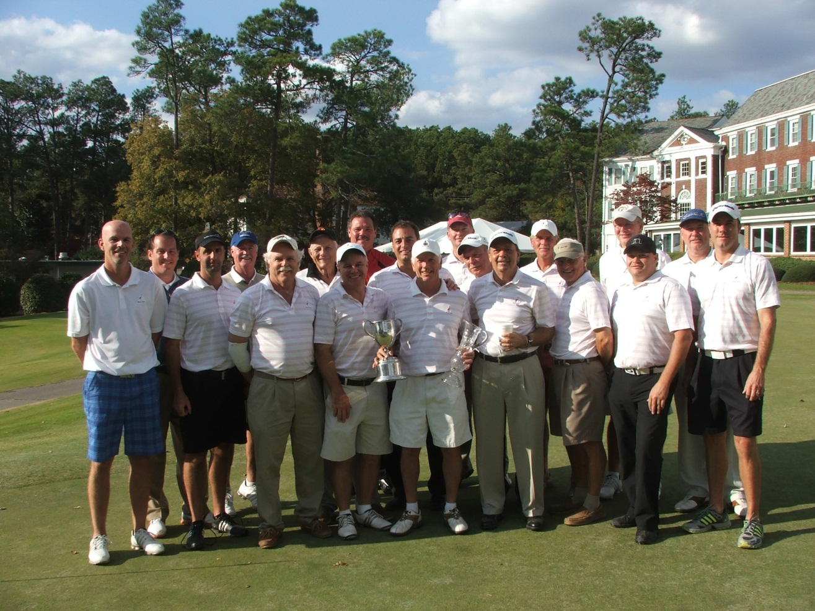
CGA Interclub Competition 2013
Captains 1st Duty - Assemble your Team
2012
Interclub
Champions
River Hills CC
Lake Wylie, SC

Slide 48
CGA Interclub Competition 2013
Captains Duties (Checklist)
Before Season
  Assemble your Team
    Create Team Roster on TPP
    No limit to the number of players listed
    Players cannot be added after your last regular season match
    Must meet all eligibility requirements (Rule 1)

Slide 49
CGA Interclub Competition 2013
Captains Duties (Checklist)
Before Season
  Assemble your Team
  Contact opposing Captains
    discuss fees and social plans
    generate regular season schedules
      email to: interclub@carolinasgolf.org

Slide 50
CGA Interclub Competition 2013
CGA Carolinas Interclub Team Play
Schedule
Group No.
Team 1:
Team 2:
Team 3:
Team 4:
HOST CLUB | GUEST CLUB | DATE | T-TIME

Slide 51
CGA Interclub Competition 2013
Captains Duties (Checklist)
Before Season
  Assemble your Team
  Submit regular season schedule to CGA
  Hold Team meeting
    discuss interclub rules and format
    review match play rules

Slide 52
CGA Interclub Competition 2013
Captains Duties (Checklist)
1 Week Before a Match
  Confirm the schedule (date and tee times)
  NOTE: must inform the CGA of a re-scheduled match

Slide 53
CGA Interclub Competition 2013
Captains Duties (Checklist)
1 Week Before a Match
  Confirm the schedule (date and tee times)
  Confirm set of tees to be used (in TPP)
    Slope
    Course Rating

Slide 54
CGA Interclub Competition 2013
Captains Duties (Checklist)
5 Days before the match, both Captains should;
  Prepare a 12 man match roster (on TPP)
    list players in order (low to high)
    Exchange rosters (via email)
    Review/verify opponents players LI and course hdcp
    LI questions/issues ? Notify the CGA for resolution
    Print 2 copies of match/results form

Slide 55

Results Forms – (one course Vs two courses)
CGA Interclub Team Play
RESULTS Form - Split Format Competition (Both Courses Involved)
Date |  | 9/19/08
 |  |  |  | Final Score |  |  |  |  |  |  |  |  | Final Score
 |  |  |  | 18 |  |  |  |  |  |  |  |  | 18
 |  | Club / Team: | Firethorne |  |  |  |  |  |  |  | Club / Team: | Verdict Ridge
 |  | Course Played: | Firethorne |  |  |  |  | Tees (Color): |  |  | Blue |  | Slope | 128 | CR | 71.0
Tee Time |  | Team | *Low Index | Crs Hdcp | Adj Gross | Individual |  | Four Ball |  |  | Team | *Low Index | Crs Hdcp | Adj Gross | Individual |  | Four Ball
 |  | Player Names |  |  |  | Results | Pts | Results | Pts |  | Player Names |  |  |  | Results | Pts | Results | Pts
9:00 AM | Team 1 | Anthony Carpenter | 2 | 2 | 76 | 2 & 1 | 2 | 2 & 1 | 2 | Team 1 | Dave Stevens | 0.9 | 1 | 81 |  | 0 |  | 0
 |  | Scott Dobberstein | 3.2 | 4 | 75 | 4 & 2 | 2 |  |  |  | Ralph Bozzini | 1.5 | 2 | 82 |  | 0
9:10 AM | Team 2 | Ben Wrigley | 4.2 | 5 | 86 |  | 0 |  | 0 | Team 2 | Pat Foley | 4.3 | 5 | 82 | 2 & 1 | 2 | 3 & 1 | 2
 |  | Tom Robertson | 5.2 | 6 | 86 |  | 0 |  |  |  | Glenn Carter | 4.5 | 5 | 78 | 3 & 1 | 2
9:20 AM | Team 3 | Jamie Lein | 7.1 | 9 | 87 |  | 0 | e | 1 | Team 3 | Brian Holsinger | 9 | 11 | 91 | 1 up | 2 | e | 1
 |  | John Reynolds | 7.3 | 9 | 93 |  | 0 |  |  |  | Steve Jones | 9.3 | 11 | 90 | 1 up | 2
 |  |  |  | sub-totals |  |  | 4 |  | 3 |  |  |  | sub-totals |  |  | 8 |  | 3
 |  | Course Played: | Verdict Ridge |  |  |  |  | Tees (Color): |  |  | White |  | Slope | 124 | CR | 70.2
Tee Time |  | Team | *Low Index | Crs Hdcp | Adj Gross | Individual |  | Four Ball |  |  | Team | *Low Index | Crs Hdcp | Adj Gross | Individual |  | Four Ball
 |  | Player Names |  |  |  | Results | Pts | Results | Pts |  | Player Names |  |  |  | Results | Pts | Results | Pts
9:00 AM | Team 1 | Derek Pederson | 3.8 | 5 | 78 | 3 & 2 | 2 | 3 & 2 | 2 | Team 1 | Mike Weber | 2.2 | 3 | 84 |  | 0 |  | 0
 |  | Pat Neel | 4.5 | 5 | 79 | e | 1 |  |  |  | Mike Stolzenbach | 4.1 | 5 | 78 | e | 1
9:10 AM | Team 2 | Kevin Carnell | 5.6 | 7 | 79 |  | 0 |  | 0 | Team 2 | Marc Luce | 4.2 | 5 | 73 | 1 up | 2 | 1 up | 2
 |  | Dave Hilfiger | 6.2 | 7 | 85 | e | 1 |  |  |  | Nick Kaylor | 5.9 | 7 | 86 | e | 1
9:20 AM | Team 3 | Ken Marino | 7.7 | 9 | 85 | 3 & 1 | 2 | 3 & 1 | 2 | Team 3 | Randy Banks | 9.7 | 12 | 100 |  | 0 |  | 0
 |  | Tom Nicolosi | 11.1 | 13 | 88 | e | 1 |  |  |  | Ken Koval | 10.2 | 12 | 89 | e | 1
 |  |  |  | sub-totals |  |  | 7 |  | 4 |  |  |  | sub-totals |  |  | 5 |  | 2
 |  |  |  | Totals |  |  | 11 |  | 7 |  |  |  | Totals |  |  | 13 |  | 5
 |  | Captain: | John Reynolds |  |  |  |  |  |  |  | Captain: | Marc Luce
Match Highlights / Notes:
* LOWEST INDEX in the last 12 months (This information may be found in the Club's Handicap History Report). Both Captains must verify the results and the Host Captain must email to (interclub@carolinasgolf.org), or fax to (910.673.1001) or mail to (CGA -
Captains - remind players to record adjusted gross scores for each match/round played

Slide 56
CGA Interclub Competition 2013
Captains Duties (Checklist)
Two Days Before the Match, the Host Captain;
  Coordinate all activities with the host pro:
    discuss any local rules (document/prepare copies for both teams)
    ensure the set of tees for the competition have been set correctly
    ensure the set up of any social festivities following play
    provide staff with pairings for scoreboard, cart name tags
  Generate scorecards for each foursome
    mark dots in black where strokes fall in the two individual matches
    mark dots in red where strokes fall in the four-ball match.

Slide 57
Individuals Scorecard
 | Par | 4 | 4 | 3 | 5 | 4 | 4 | 5 | 3 | 4 | 36 | 5 | 3 | 4 | 4 | 4 | 3 | 4 | 4 | 5 | 36 | 72
 | Hole | 1 | 2 | 3 | 4 | 5 | 6 | 7 | 8 | 9 | Out | 10 | 11 | 12 | 13 | 14 | 15 | 16 | 17 | 18 | In | Total
 | Hdcp | 7 | 11 | 1 | 5 | 9 | 17 | 15 | 13 | 3 |  | 10 | 16 | 8 | 18 | 6 | 12 | 4 | 14 | 2
 | Coharie CC Player1 3hdcp - net 2 |  |  | . |  |  |  |  |  |  |  |  |  |  |  |  |  |  |  | .
 | Fort Mill CC Player2 1hdcp - net 0
 | Coharie CC Player 2 2hdcp – net 0
 | Fort Mill CC Player2 5hdcp – net 3 |  |  | . |  |  |  |  |  | . |  |  |  |  |  |  |  |  |  | .

Slide 58
Four Ball Scorecard
 | Par | 4 | 4 | 3 | 5 | 4 | 4 | 5 | 3 | 4 | 36 | 5 | 3 | 4 | 4 | 4 | 3 | 4 | 4 | 5 | 36 | 72
 | Hole | 1 | 2 | 3 | 4 | 5 | 6 | 7 | 8 | 9 | Out | 10 | 11 | 12 | 13 | 14 | 15 | 16 | 17 | 18 | In | Total
 | Hdcp | 7 | 11 | 1 | 5 | 9 | 17 | 15 | 13 | 3 |  | 10 | 16 | 8 | 18 | 6 | 12 | 4 | 14 | 2
 | Coharie CC Player1 3hdcp - 2 |  |  | . |  |  |  |  |  |  |  |  |  |  |  |  |  |  |  | .
 | Coharie CC Player2 5hdcp - 4 |  |  | . |  |  |  |  |  | . |  |  |  |  |  |  |  | . |  | .
 | Fort Mill CC Player1 1hdcp - 0
 | Fort Mill CC Player2 3hdcp - 2 |  |  | . |  |  |  |  |  |  |  |  |  |  |  |  |  |  |  | .

Slide 59
CGA Interclub Competition 2013
Captains Duties (Checklist)
Day of the Match
  re-confirm both rosters for any last minute changes
  communicate local rules to all players
  complete the Results Form in TPP
    adjusted gross scores (remind players to post a hole by hole score)

Slide 60
Scoreboard
Carolinas Golf Association
InterClub Match: |  |  |  | June 3, 2010
Host Club |  |  |  | Visiting Club
Tanglewood |  |  |  | Forest Oaks
Captain: M. Hartson |  |  |  | Captain: G. Gupton
Individual & Team Results |  |  | Cumulative Points |  | Individual & Team Results
J. Nieters | 1up | 2 | 5 | 1 | 0 |  | G. Sexton
T. Payne | e | 1 |  |  | 1 | e | M. Daniel
Four Ball | 2up | 2 |  |  | 0 |  | Four Ball
G. Howard |  | 0 | 6 | 6 | 2 | 3up | R. Long
R. Morgan | e | 1 |  |  | 1 | e | B. McNally
Four Ball |  | 0 |  |  | 2 | 2up | Four Ball
M. Pask |  | 0 | 10 | 8 | 2 | 2up | D. Turner
J. Blevins | 1up | 2 |  |  | 0 |  | C. Marion
Four Ball | 2up | 2 |  |  | 0 |  | Four Ball

Slide 61
CGA Interclub Competition 2013
Captains Duties (Checklist)
After Each Match
  Host captain submits match results (in TPP)

Slide 62
CGA Interclub Competition 2013
Captains Duties (Checklist)
After Each Match
  host captain submits match results (in TPP)
  Retain scorecards for 1 week

Slide 63
CGA Interclub Competition 2013
Captains Duties (Checklist)
After Each Match
  host captain submits match results (in TPP)
  retain scorecards for 1 week
  Verify that adjusted gross scores are posted

Slide 64
CGA Interclub Competition 2013
Captains Duties (Checklist)
After Each Match
  host captain submits match results (in TPP)
  retain scorecards for 1 week
  verify that adjusted gross scores are posted
  Include match results in clubs’ newsletter

Slide 65
CGA Interclub Competition 2013
2013 Groups
  NOTE: Groups are subject to change

Slide 66
Southern Region
Cabarrus CC, Concord, NC Carolina GC, Charlotte, NC Providence CC, Charlotte, NC River Run CC #1, Davidson, NC | The Club @ Longview, Waxhaw, NC Gaston CC, Gastonia, NC River Run CC #2, Davidson, NC TPC @ Piper Glen, Charlotte, NC
Cedarwood CC, Charlotte, NC River Hills CC, Lake Wylie, SC Rolling Hills CC, Monroe, NC Raintree CC #2, Charlotte, NC | Lincoln CC, Lincolnton, NC Northstone CC, Huntersville, NC Pine Island CC, Charlotte, NC Verdict Ridge G & CC, Denver, NC
The Creek GA, Charlotte, NC Fort Mill GC, Fort Mill, SC Larkhaven CC, Charlotte, NC Olde Sycamore GP, Charlotte, NC | Members Club @ Woodcreek & Wildewood The Links @ Stoney Point, Greenwood, SC Waterford/Rock Hill GA, Rock Hill, SC
Firethorne CC, Waxhaw, NC Palisades CC #1, Charlotte, NC Raintree CC #1, Charlotte, NC Tega Cay, Tega Cay, SC

Slide 67
North Region
Pine Brook CC, Winston-Salem, NC Salem Glen CC, Clemmons, NC Forest Oaks CC, Greensboro, NC | Oakwoods CC, Wilkesboro, NC Lenoir GC, Lenoir, NC Tanglewood GC, Clemmons, NC
1 Group with two three team divisions
PBCC will play OCC, SGCC will play LGC and FOCC will play T’Wood to complete their 6 regular season matches.

Slide 68
Central / Eastern Regions
Anderson Creek GC, Spring Lake, NC Pine Hollow CC, Clayton, NC River Ridge GC, Raleigh, NC Stoney Creek GC, Stoney Creek, NC | Coharie CC, Clinton, NC Willow Springs CC, Wilson, NC Wildwood Green GC, Raleigh, NC Kings Grant, Fayetteville, NC
Bentwinds CC, Fuquay-Varina , NC The Crossings GC, Raleigh, NC Devil's Ridge GC, Holly Springs, NC The Preserve @ Jordan Lake, Chapel Hill, NC | Riverwood Golf & AC, Clayton, NC Siler City CC, Siler City, NC
Chapel Hill CC, Chapel Hill, NC Hope Valley CC, Durham, NC Mill Creek GC, Mebane, NC Umstead Pines @ Willowhaven CC, Durham, NC

Slide 69
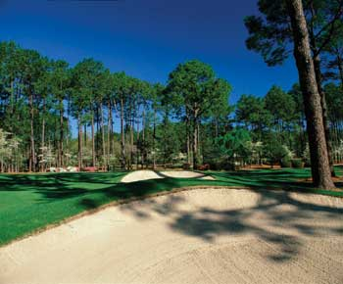
CGA Interclub Competition 2013
2013
Finals
????
Pinehurst, NC
Four-Ball Matches
Sat Nov 16th or 23rd
Individual Matches
Sun Nov 17th or 24th

Slide 70
CGA INTERCLUB
TPP Instructions
Captains will:
Set TEAM Rosters
Set HOME Tees
Prepare MATCH Rosters
Submit MATCH Results with Player Scores

Slide 71
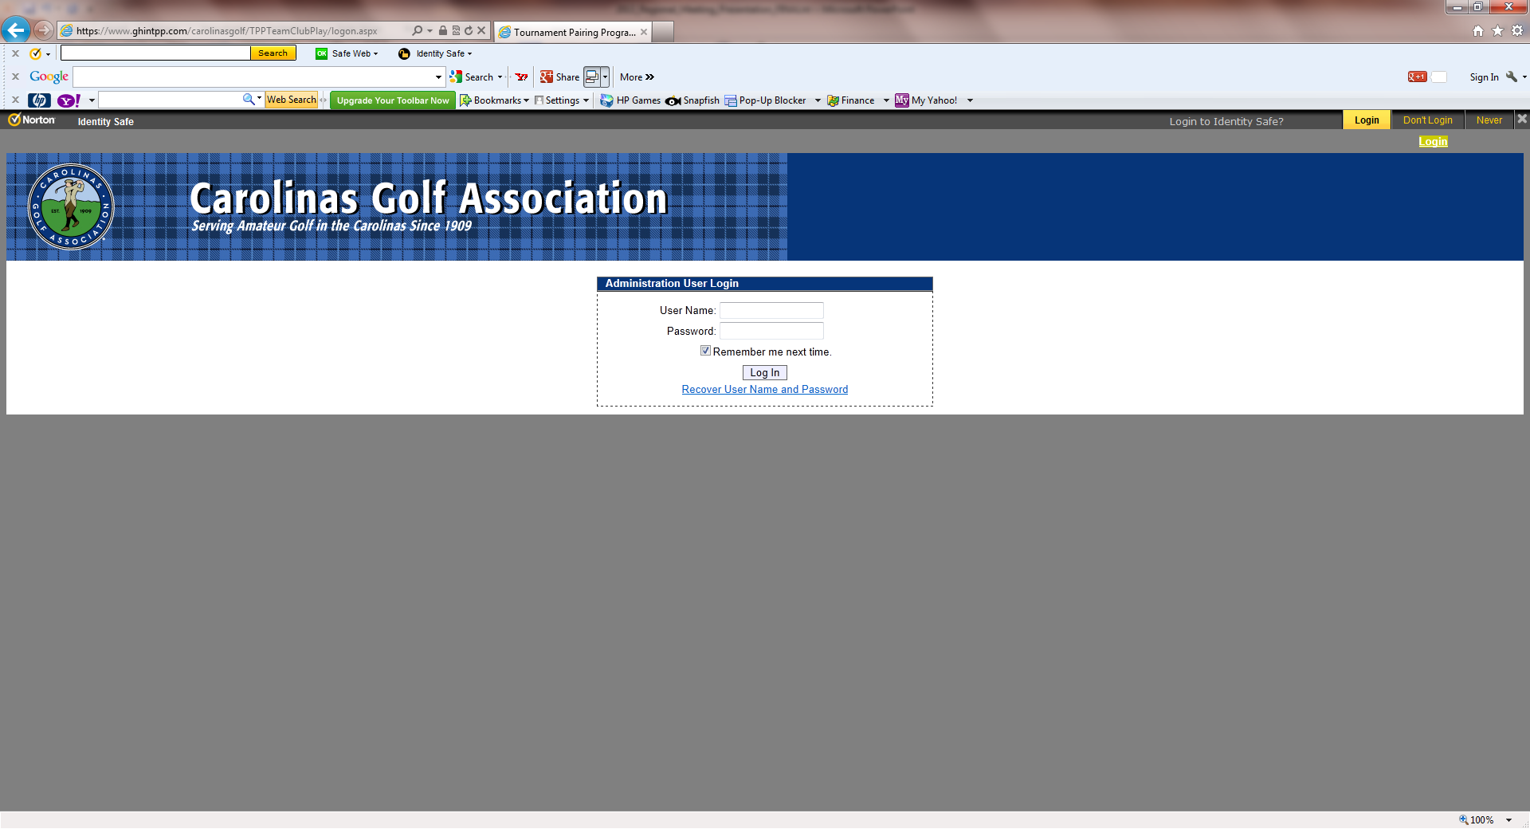
CGA INTERCLUB TPP Instructions
Captains will log into: https://www.ghintpp.com/carolinasgolf/TPPTeamClubPlay/logon.aspx
The CGA will email a Login and Password following this meeting:

Slide 72
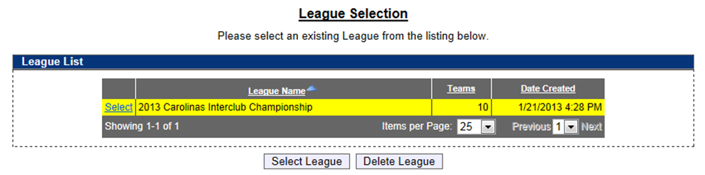
HOW TO SET TEAM ROSTERS
Once you login, click on the Select League icon, the Carolinas Interclub Championship will be the only one available.

Slide 73
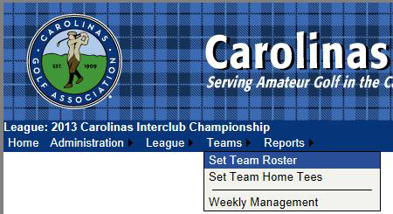
HOW TO SET TEAM ROSTERS
Under the Teams tab in the top left, select Set Team Roster.

Slide 74
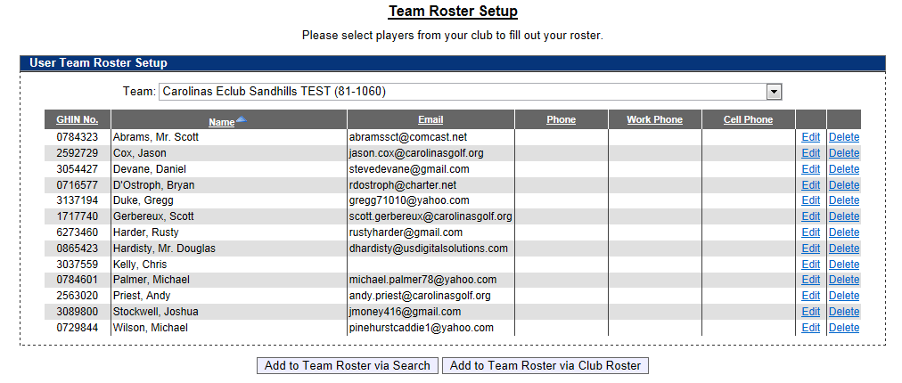
HOW TO SET TEAM ROSTERS
Select Add to Team Roster via Club Roster to bring up your club’s entire handicap roster.

Slide 75
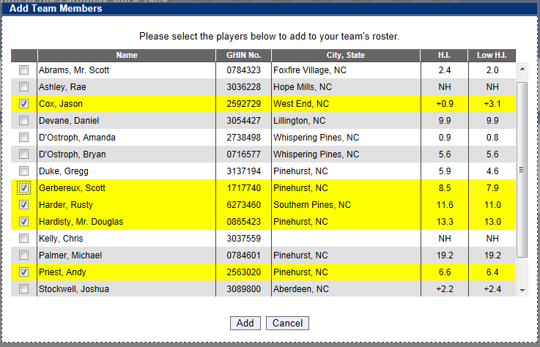
HOW TO SET TEAM ROSTERS
Select all players that you wish to participate during the season. Players are listed in alphabetical order.
You can choose all eligible players on your club’s roster, or a recommended minimum of 20.
You can add players from this list throughout the season; you do not need to put all players on your team immediately.
Remember, their low index must be no more than 18.4.
Click Add to add players to team roster.

Slide 76
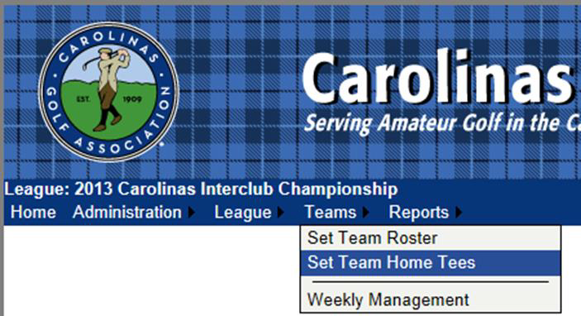
HOW TO SET HOME TEES
Under the Teams tab, select Set Team Home Tees

Slide 77
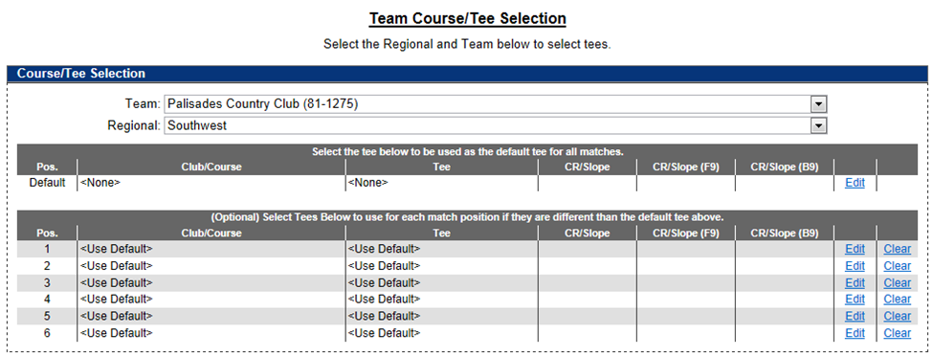
HOW TO SET HOME TEES
To set default tee for all matches, click Edit under the header “Select the tee below to be used as the default tee for all matches”.

Slide 78
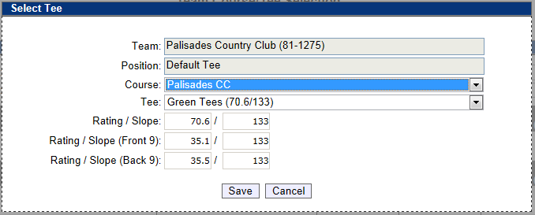
HOW TO SET HOME TEES
Select the Course name and then select the tee to be played for all matches. Click save once correct tee is selected. As per interclub rules, each player will play from this tee in all matches.

Slide 79
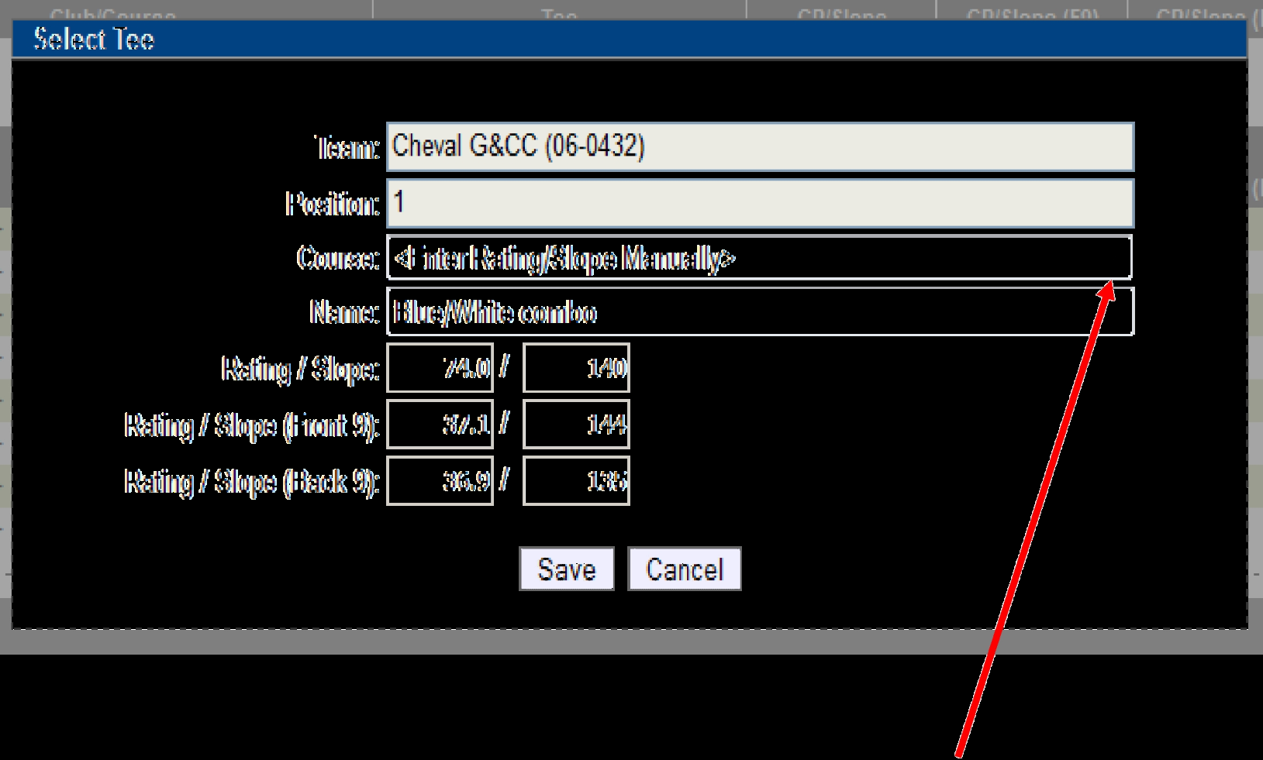
HOW TO SET HOME TEES
If you are using a combination tee that is not listed, you can manually enter the course rating and slope to better reflect the appropriate tee.
When you are finished, “Use default tee” should be selected for each position. Any tees that are not set will be set to the default tee.

Slide 80
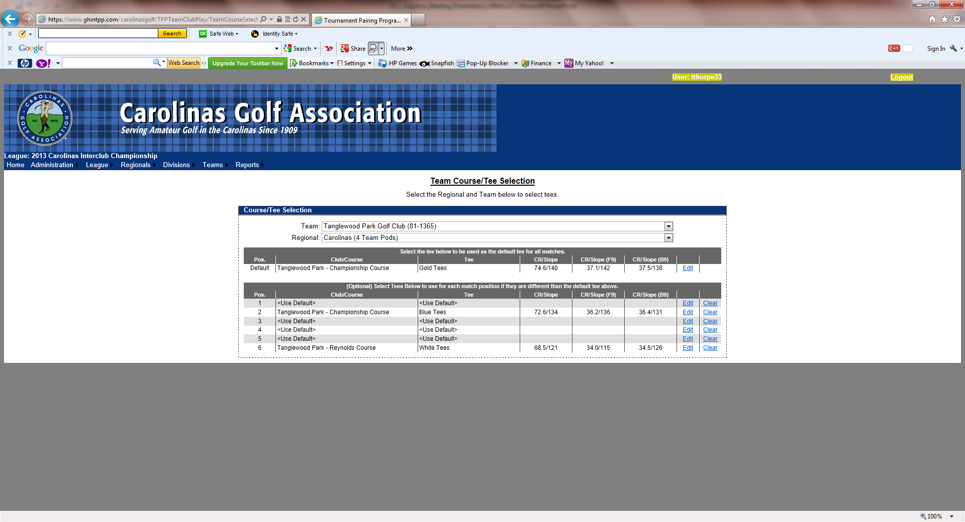
HOW TO SET HOME TEES
If you are using a combination tee that is not listed, you can manually enter the course rating and slope to better reflect the appropriate tee.
When you are finished, “Use default tee” should be selected for each position. Any tees that are not set will be set to the default tee.

Slide 81
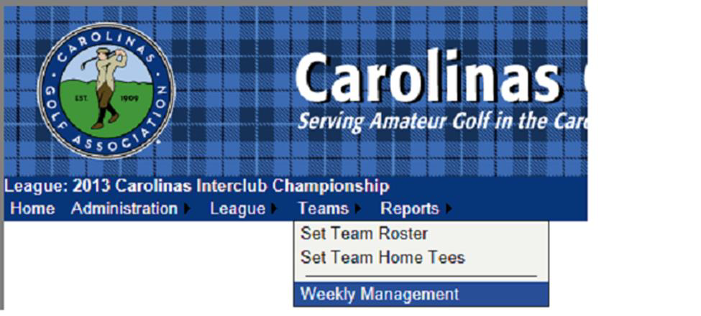
HOW TO SET YOUR MATCH ROSTER
Under the Teams tab, select Weekly Management.

Slide 82
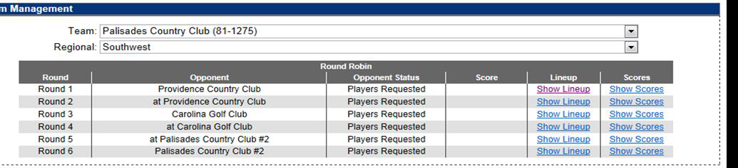
HOW TO SET YOUR MATCH ROSTER
The Team Management menu shows your regular season schedule, from here you can select your match lineup, and input scores for matches.
To select players for a match, click on Show Lineup.

Slide 83
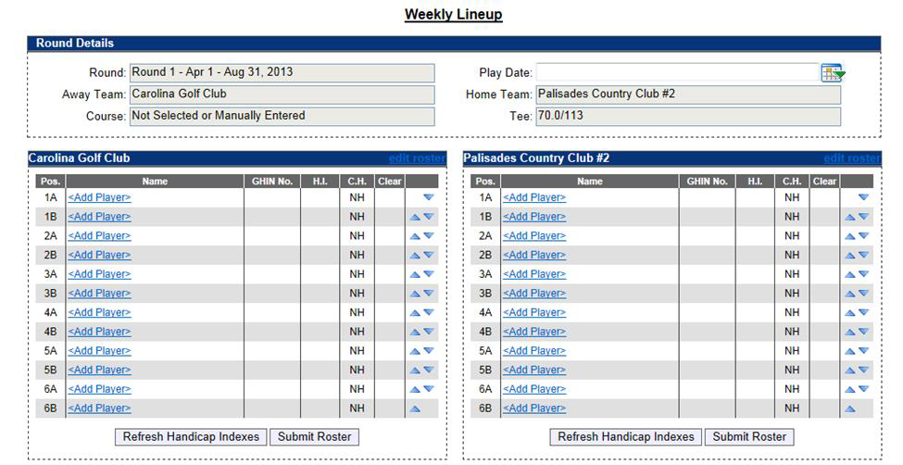
HOW TO SET YOUR MATCH ROSTER
Click on Add Player to select a player from your roster to play in the match.

Slide 84
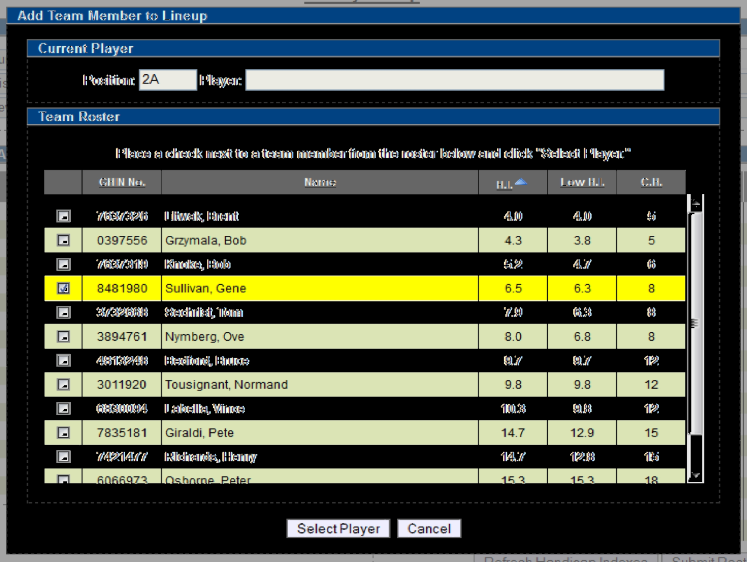
HOW TO SET YOUR MATCH ROSTER
Select whichever player you want
Players can be sorted alphabetically, by handicap index, course handicap, or GHIN number by clicking on the category header.
Players must be selected one at a time.

Slide 85
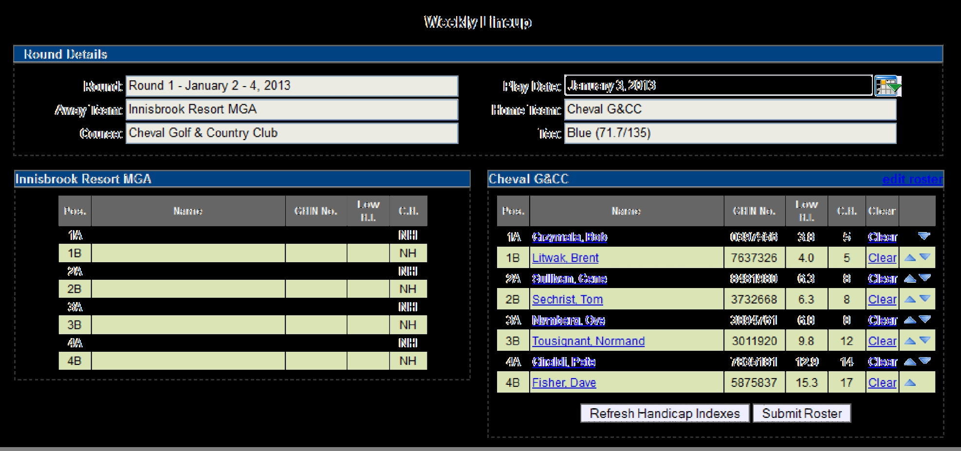
HOW TO SET YOUR MATCH ROSTER
Players need to be listed in handicap order, use the arrows on the right of the screen to put them in the correct order.
The Player in position 1A will play four-ball with the player in position 1B and so forth.
Make sure to click Submit Roster when you finish.

Slide 86
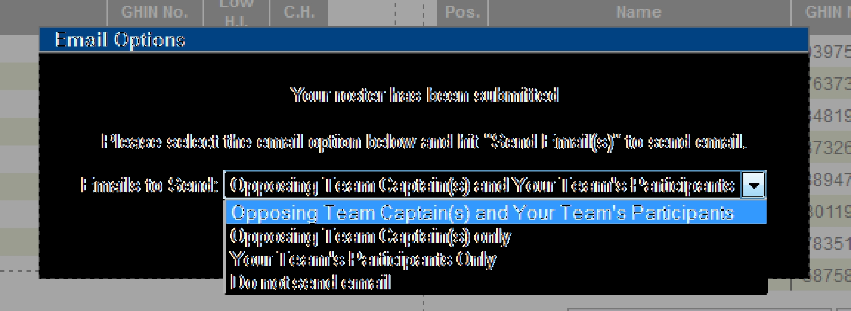
HOW TO SET YOUR MATCH ROSTER
11.You have the option of e-mailing your roster to:
  The opposing team captain(s)
  The opposing team captain(s) and your players
  Your players only
  Don’t send any e-mail

Slide 87
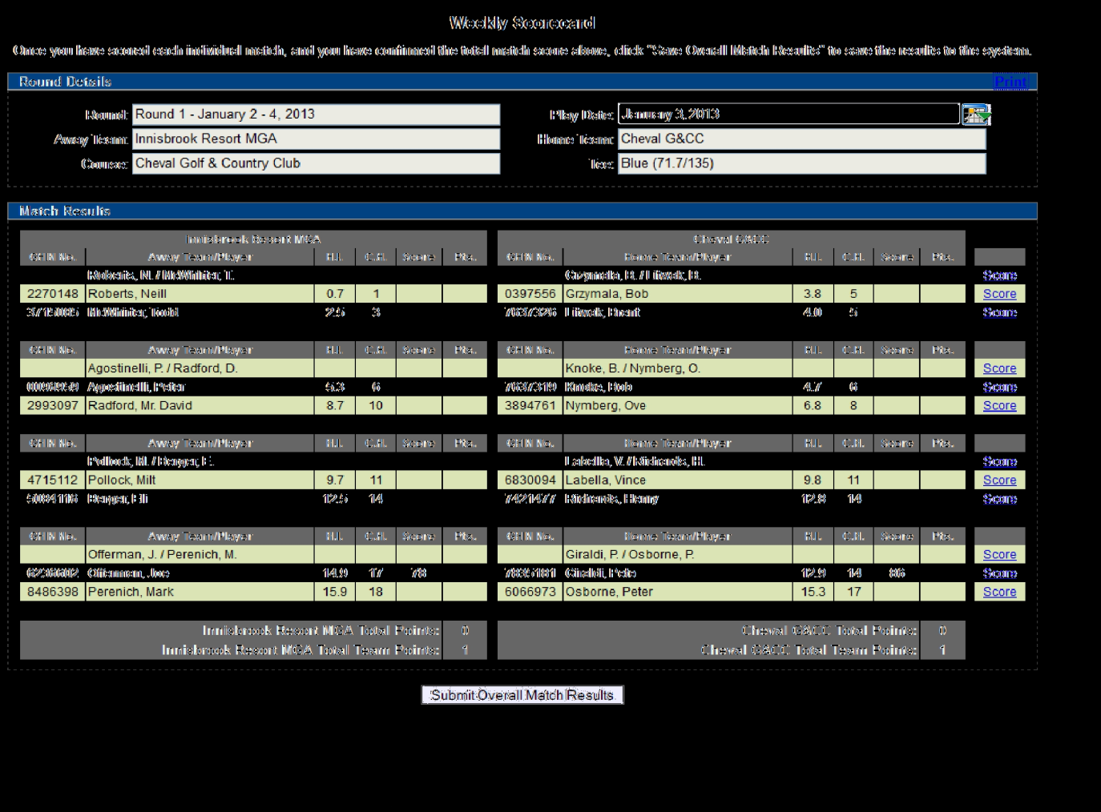
HOW TO SET YOUR MATCH ROSTER
When all players have been entered click Teams tab, select Weekly Management, then select Show Scores. This will bring up your Weekly Scorecard.
To print off your match worksheet click on Print on the top right side of the screen.

Slide 88
HOW TO SUBMIT MATCH RESULTS with PLAYER SCORES
Under the Teams tab, select Weekly Management.

Slide 89
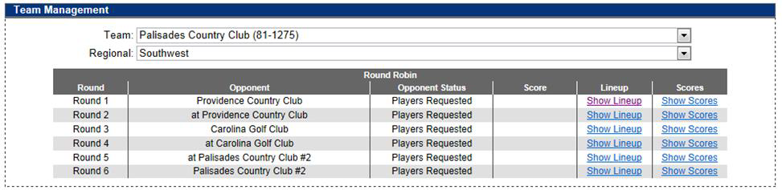
HOW TO SUBMIT MATCH RESULTS with PLAYER SCORES
Select Show Scores for the appropriate match when you are ready to input match scores.

Slide 90
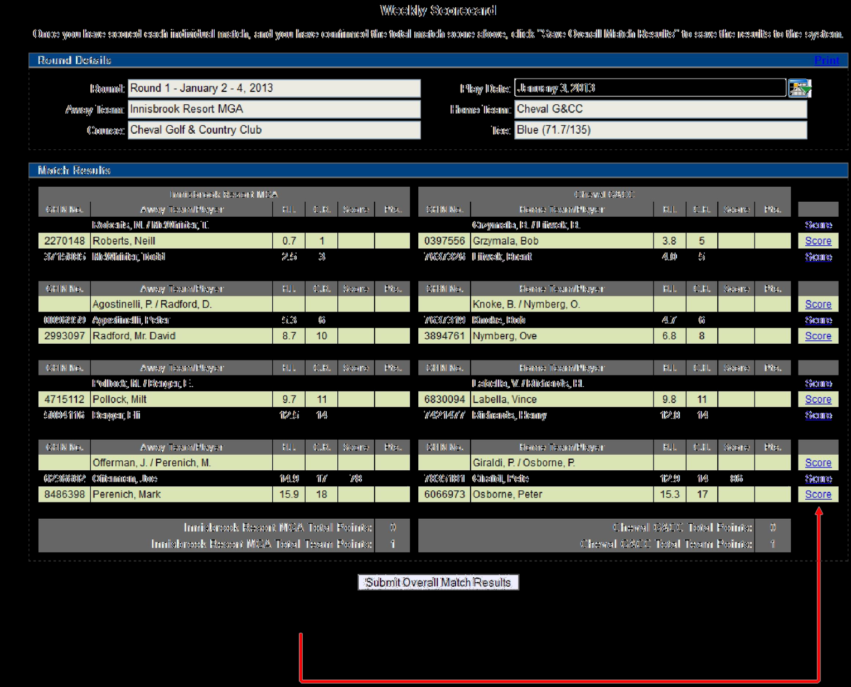
HOW TO SUBMIT MATCH RESULTS with PLAYER SCORES
To input results, click on Score for each match on the right side of the screen.

Slide 91
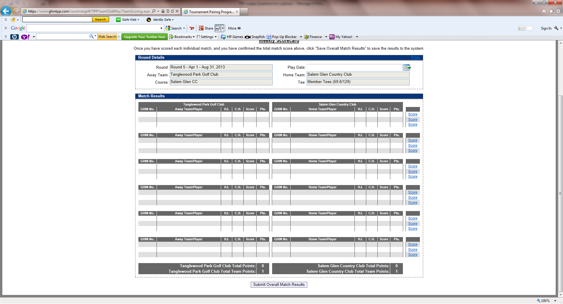
HOW TO SUBMIT MATCH RESULTS with PLAYER SCORES
To input results, click on Score for each match on the right side of the screen.

Slide 92
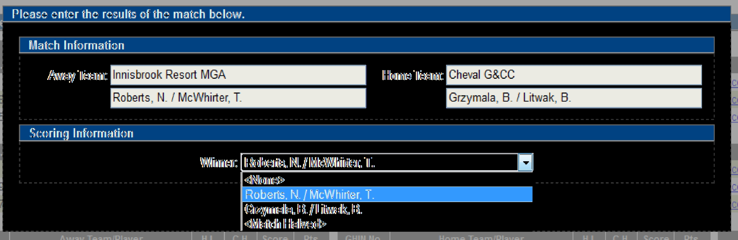
HOW TO SUBMIT MATCH RESULTS with PLAYER SCORES
For the four-ball match select the winning team or <Match Halved> if it ended in a tie, and hit Save.

Slide 93
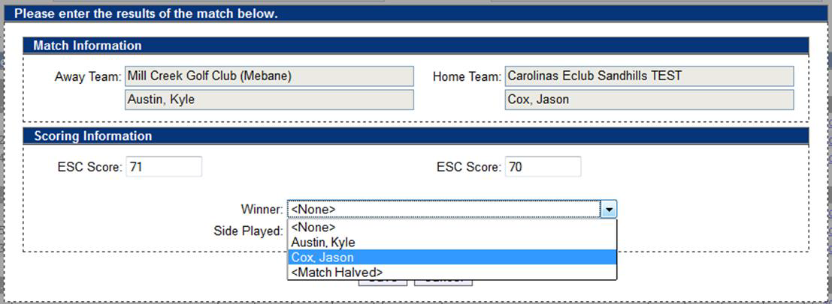
HOW TO SUBMIT MATCH RESULTS with PLAYER SCORES
For the individual matches, you have to enter each players’ ESC score and who won the match or if it was halved.
You can also specify if the match was played over 18 holes or just 9 holes. If it was only 9 holes, you would input the 9 hole score.

Slide 94
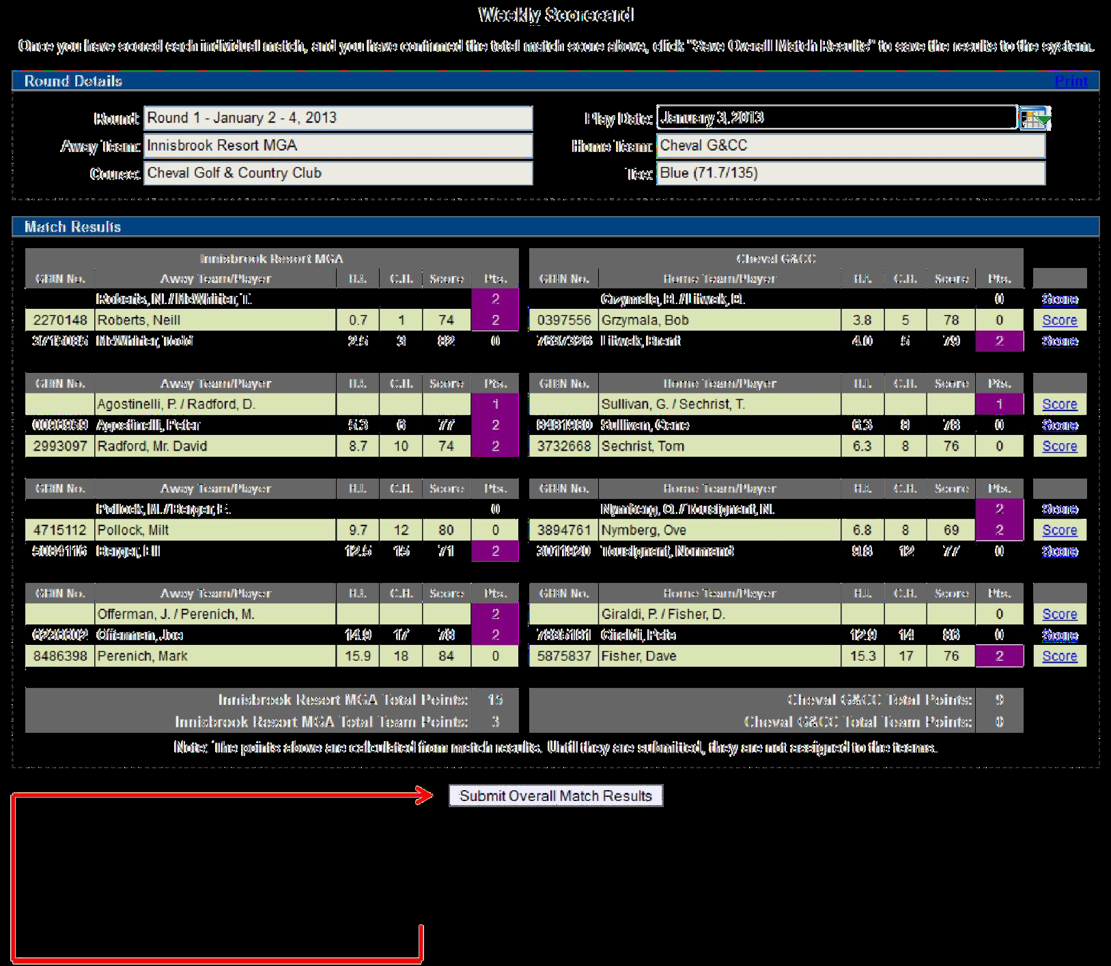
HOW TO SUBMIT MATCH RESULTS with PLAYER SCORES
When you are done, all match results should be filled out. Match and overall points will be calculated for you.
Make sure to hit Submit Overall Match Results at the bottom of the screen.

Slide 95
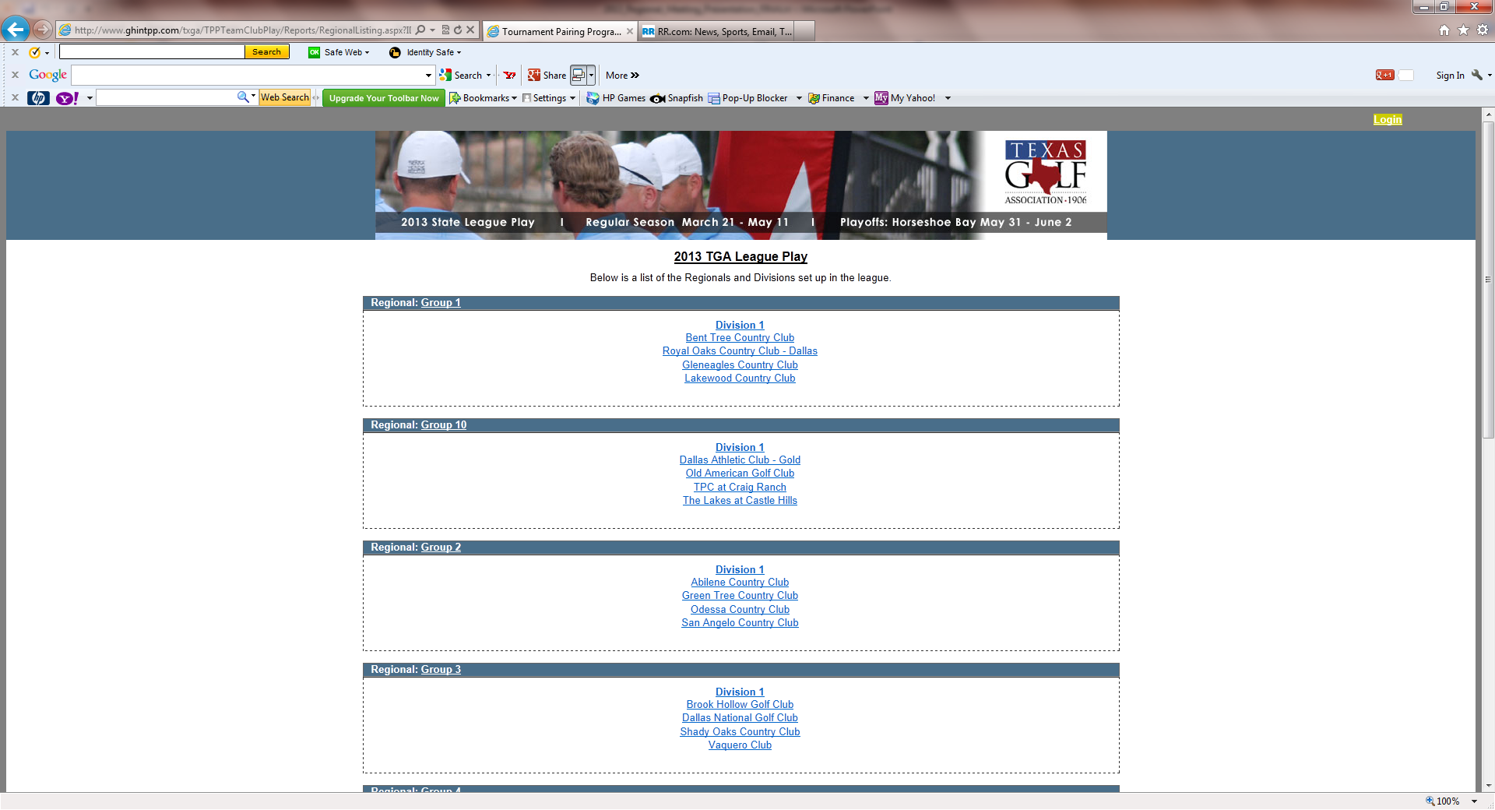
WEB LAYOUT will Look Something Like This – LEAGUE PLAY

Slide 96
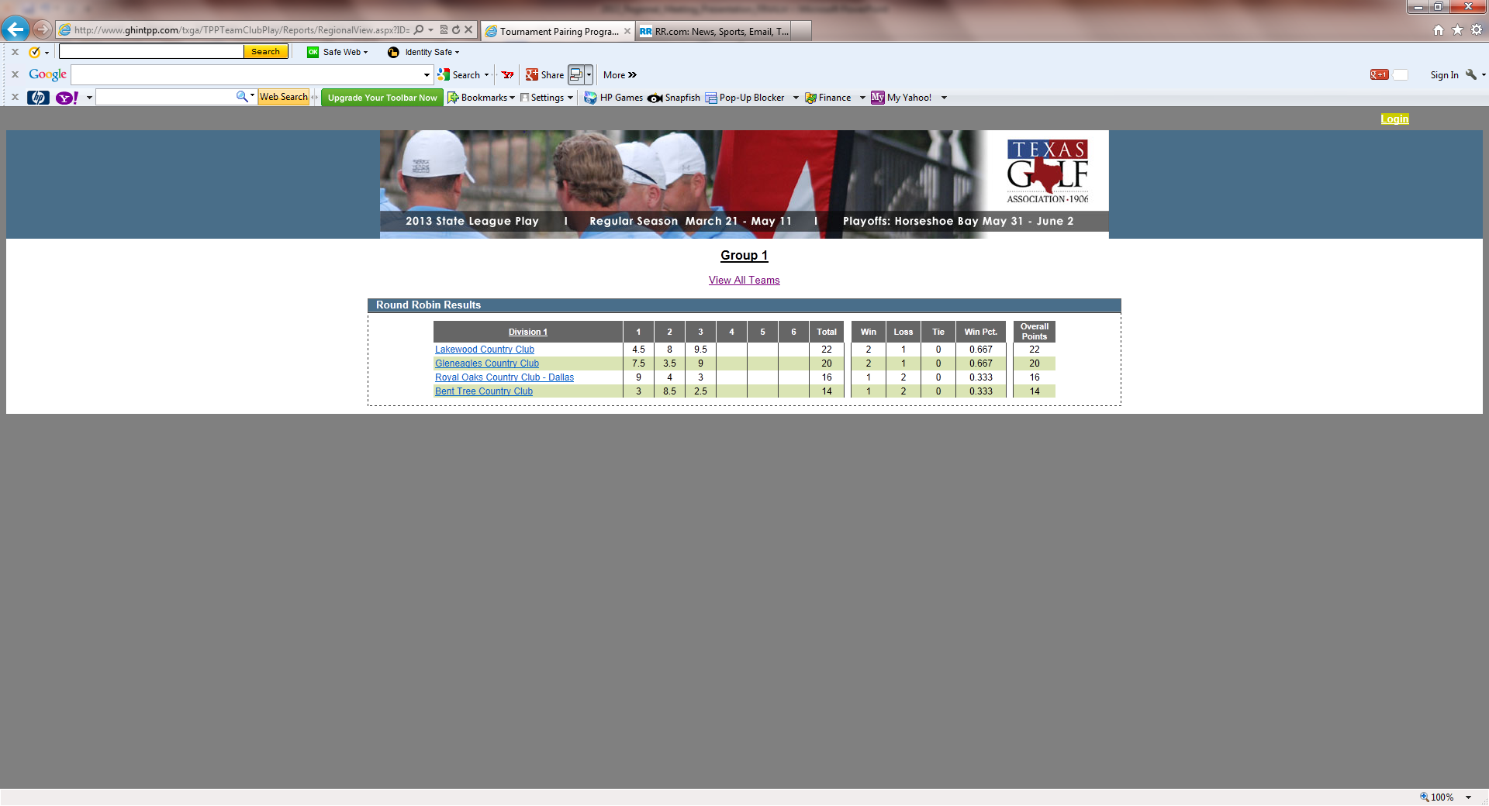
WEB LAYOUT will Look Something Like This – REGION VIEW

Slide 97
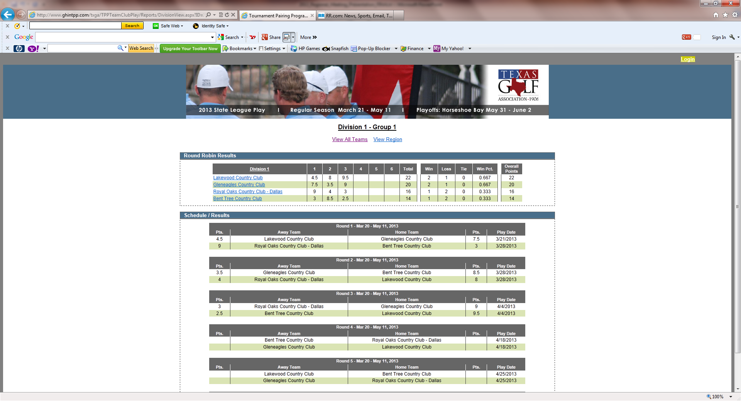
WEB LAYOUT will Look Something Like This – VIEW ALL TEAMS

Slide 98
CGA Interclub Competition 2013
Agenda
Objectives
  Review Rules of Play
  Discuss Captains Duties
  Learn TPP Steps (4)
  Preview 2013 Groups
  Begin Scheduling Matches
    Discuss
      fees
      social plans

Slide 99
CGA Interclub Competition 2013
Questions ?

Slide 100
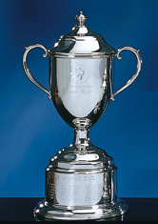
CGA Interclub Competition 2013
SUMMARY
  Hold Group Captains Meeting
    schedule matches
    submit schedule to CGA
    discuss fees, social, tees, etc.
  Create Team Roster in TPP
  Set match tees in TPP
  Hold Team Meeting
    discuss rules, format
      match play & interclub
    match sign-up procedures
  Compete
    refer to Captains checklist
    prepare rosters in TPP
    exchange rosters in TPP
    prepare scorecards (host)
  Submit Results in TPP

