Slide 1

CGA Interclub
Regional Captains
Meeting
2015

Slide 2
CGA Interclub Competition 2015
Staff
Rusty Harder – Tournament Director
(o) 910-687-6865 or (c) 919-475-7775
Tom Thorpe – Interclub Administrator
(c) 336-575-0447
Kim Jett – Office Manager
(o) 910-673-1000

Slide 3
CGA Interclub Competition 2015
Agenda
Objectives today
Review Format & Rules of Play
Discuss Captains Duties
Review 4 TPP Tasks
Preview 2015 Groups

Slide 4

CGA Interclub Competition 2015
Ask questions anytime

Slide 5
Verify Contact Information
Group | Eastern Region | City, State | Captain Name | Captain email | Captain phone | Pro Name | Pro email | Pro phone
U | Birchwood CC | Nash, NC |  |  |  | Randy Davis | rdbwcc00@aol.com
U | Coharie CC | Clinton, NC | Jackie Parrish | pgaprofessional@embarqmail.com | 910-592-6772 | Dickie Walters | pgaprofessional@embarqmail.com | 910-592-2951
U | Southern Wayne CC | Mt. Olive, NC | Kevin Kornegay |  |  | Howard A. Hunt | csouthernwayne@nc.rr.com
U | Willow Springs CC | Wilson, NC |  |  |  | Jimmy Gurkin | willowspringscc@cocentral.com
V | Greenville CC | Greenville, NC |  |  |  | Brady Pinner | golfpro@greenvillecountryclub.com
V | Kinston CC | Kinston, NC |  |  |  | Burt Williams | bwilliams@kinstoncc.com
V | Morehead City CC | Morehead City, NC |  |  |  | Nick Eatman | neatman@moreheadcitycc.com
V | New Bern CC | New Bern, NC |  |  |  | Alan Ferebee | aferebee@suddenlink.net

Slide 6
CGA Interclub Competition 2015
Captains / Club Contact Info:
Accessible on the web (www.carolinasgolf.org)
Click on: Tournaments
Click on: Interclub
Click on: Captains Contact Information
Password protected (Interclub)
Email edits to: interclub@carolinasgolf.org

Slide 7
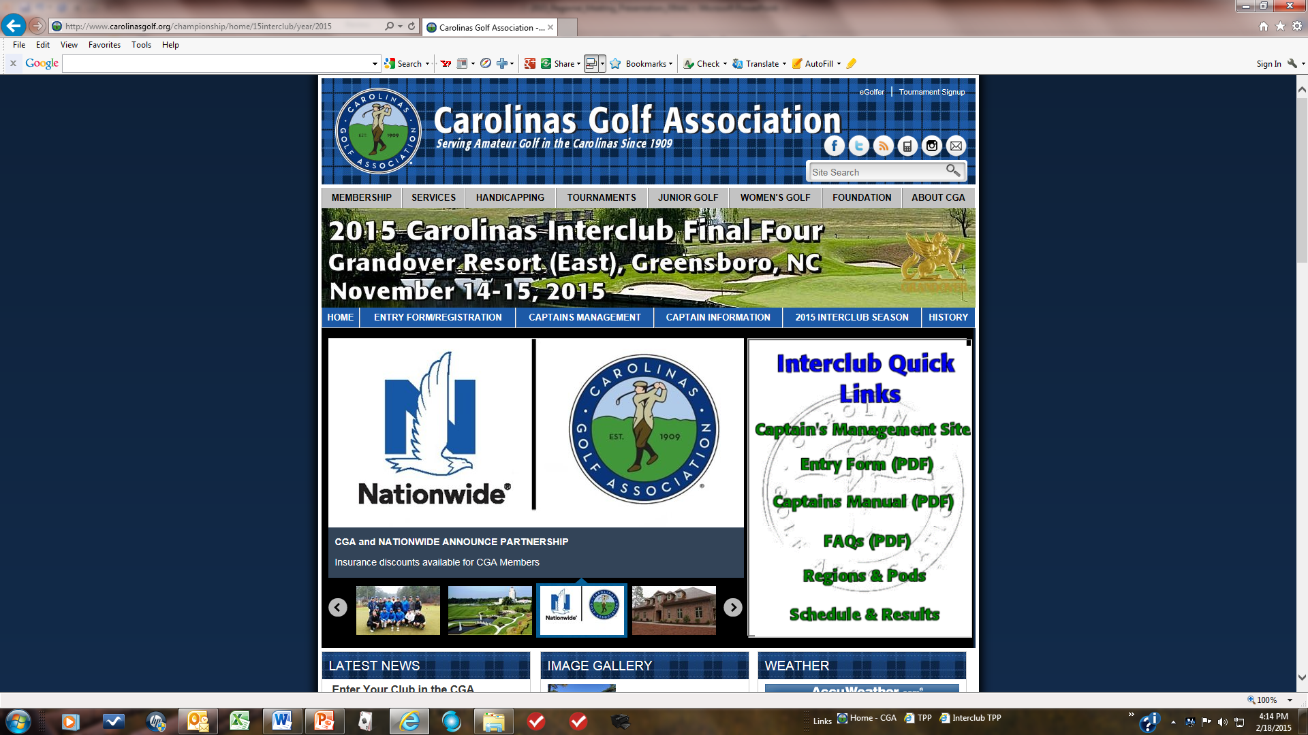
CGA Interclub Competition 2015
www.carolinasgolf.org

Slide 8
CGA Interclub Competition 2015
Rules of Play
Interclub (1 – 26)
USGA Match play

Slide 9
CGA Interclub Competition 2015
26 Interclub Rules of Play (TABLE OF CONTENTS)
PLAYER ELIGIBILITY |  | MATCH PLAY CLAIMS
SEASON |  | ADVICE
STARTING TIMES |  | GOLF CARTS AND CADDIES
DEFINITION OF TEAM |  | RAIN / WEATHER PROCEDURES, POSTPONED & SUSPENDED MATCHES
LESS THAN TWELVE (12) PLAYERS |  | WITHDRAWAL FROM TEAM PLAY
TEAM CAPTAINS' DUTIES |  | FORFEITURES
PRACTICE ROUNDS |  | PROTESTS
HOME TEAM ARRANGEMENTS |  | DETERMINING GROUP WINNERS
INDEXES / HANDICAPS & PAIRINGS |  | PLAY-OFF MATCHES
ORDER OF PLAY |  | POLICY FOR COURSE USAGE
TYPE OF COMPETITION AND SCORING |  | PACE OF PLAY
USGA RULES OF PLAY |  | CELLULAR PHONES and ELECTRONIC DEVICES
BALLS AND IMPLEMENTS |  | ETIQUETTE

Slide 10
CGA Interclub Competition 2015
Rules of Play
CLUB / PLAYER ELIGIBILITY:
All Clubs:
must be members and in good standing with the Carolinas Golf Association (CGA)
must be licensed to offer USGA Handicaps
must be in compliance with the USGA Handicap Certification Program
must maintain or have access to a regulation length golf course (minimum 6,000 yards) (REVISED)
All Players:
must be male members and in good standing with the CGA member club
must be an amateur golfer (with the exception of 1N)
must be listed on the club’s GHIN handicap roster
must have a minimum of 10 posted scores within the past 12 months and two handicap revisions processed
must have a low index of 18.4 or less
must be at least 18 years of age (REVISED)
must not have played in CGA Interclub competition for another club in the current year
In addition:
Club staff/employees (with membership rights and who meet all other eligibility requirements) are eligible
Special circumstances may be considered by Interclub Director upon review of presented circumstances.
Each team may include up to 2 (two) non-amateur players for any match with the requirements that they are either a full-time employee or a member of the club. They must also meet eligibility requirements G – K, and comply with all other Interclub rules. The use of professional players is optional. (NEW)

Slide 11
CGA Interclub Competition 2015
Rules of Play
SEASON
groups consist of 3, 4 or 6 teams
teams play home and away matches
matches scheduled primarily on the weekends
regular season starts in April but must end by August ______
Playoffs - minimum 32 Teams
play-offs start immediately following end of regular season
2015 “Final 4” - November 14/15 at Grandover Golf Resort

Slide 12
CGA Interclub Competition 2015
Rules of Play
STARTING TIMES
mutually agreed by BOTH team captains
allow time to complete before daylight ends
can start from 1st or 10th tees, or shotgun
Note: adjust handicap holes if 10th tee start

Slide 13
CGA Interclub Competition 2015
Rules of Play
4. DEFINITION OF TEAM/MATCH ROSTERS:
No permanent Team roster
No limit to number of players used during the regular season
Eligible players may be added to the Team Roster at any time
NOTE: Team rosters may include eligible members from clubs under the same ownership. The CGA will validate the set-up in TPP upon request. (NEW)
B. Each team may represent 1 club and each player 1 team
A match roster consists of 12 eligible players (regular season and play-off match)
Once a player competes for a team, he cannot compete for any other team in 2015
C. Clubs may sponsor more than one team
must have balanced rosters
players must remain on same team after playing in first match

Slide 14
CGA Interclub Competition 2015
Rules of Play
LESS THAN TWELVE (12) PLAYERS
Less than 12 players allowed
“Singles Match”
can be either opponent
must declare before match begins
“Four-Ball Match”
one-man team vs two-man team in the
Minimum of 6 players to be an official match

Slide 15
CGA Interclub Competition 2015
Rules of Play
LESS THAN TWELVE (12) PLAYERS (cont’d)
NOTE: A player listed on the match roster prior to the start of a match may join the match at any time, but only at the beginning of the next hole. Without “exceptional circumstances” preventing him to start on time (USGA 6-3.a), the player forfeits the individual match point but can participate in the four-ball competition from that point forward (USGA 30-3.a).

Slide 16
CGA Interclub Competition 2015
Rules of Play
TEAM CAPTAINS' DUTIES:
Create team roster (TPP)
Determine your team’s sign-up procedure for a match
Educate your team on format and match play rules
Set tees to be used for each match (TPP)
Prepare match roster (TPP)
review opponents lineup
resolve questions / issues prior to the match
Create scorecards (home team captain) manually
Submit match results (TPP)
NOTE: LI’s, HDCP STROKES and OPPOSING PLAYER ELIGIBILITY MAY NOT BE QUESTIONED ONCE A MATCH HAS STARTED UNLESS INFORMATION GIVEN WAS DIFFERENT THAN THAT WAS APPROVED PRIOR TO THE START OF EACH MATCH. CAPTAINS SHOULD DOUBLECHECK THE SCORECARDS AND LINEUPS PRIOR TO THE START OF EACH MATCH.

Slide 17

CGA Interclub Competition 2015
Rules of Play
TEAM CAPTAINS' DUTIES (cont’d):
Course set-up
determine local rules
tee placement
Recommended course yardage:
between 6,000 – 6,500 yards
consider course conditions
consider playability for all players

Slide 18
CGA Interclub Competition 2015
Rules of Play
TEAM CAPTAINS' DUTIES (cont’d):
both captains collect scorecards and agree on match results
host captain to submit match results and players scores (on TPP)
TPP will automatically post the players scores when submitted w/ results
NOTE - POSTING OF INDIVIDUAL SCORES –
NOTE 1: REGULAR SEASON & PLAYOFF SCORES will be POSTED as tournament scores (NEW)
NOTE 2: FAILURE TO POST SCORES FROM A MATCH (i.e. Adjusted Gross Scores missing on TPP Results screen):
USGA Handicap System Manual, 8-4 b. Penalty Scores for Failure to Post
If a player fails to report an adjusted gross score following a match, or if the captain fails to include the score on the TPP results screen, the Interclub Handicap Committee (in this case the CGA) will post a penalty score equal to the lowest/highest Handicap Differential in the scoring record. The Handicap Committee is not required to notify the player prior to posting a penalty score

Slide 19
e. Posting a Tournament Score
A tournament score is a score made in a competition organized and conducted by a Committee in charge of the competition. The competition must identify a winner(s) based on a stipulated round(s), and must be played under the principles of the Rules of Golf.
The Committee (preferably the Handicap Committee, in consultation with the Committee in charge of the competition) must determine in advance if these conditions are met, and announce in advance whether the score must be identified by the letter "T" when posted. Routine events such as regular play days normally are not to be designated as T-scores because they are not significant in the traditions, schedules, formats, and membership of the club.

Slide 20
CGA Interclub Competition 2015
Rules of Play
PRACTICE ROUNDS
regular season at the discretion of each club
playoff practice rounds should be;
pre-arranged by the captain
scheduled at a date/time agreeable by host club
not allowed on host course day of match

Slide 21
CGA Interclub Competition 2015
Rules of Play
HOME TEAM ARRANGEMENTS
home team to host green fees
carts/caddies equal availability (both teams)
F&B available for purchase
applies to regular season & play-off matches

Slide 22
CGA Interclub Competition 2015
Rules of Play
INDEXES / HANDICAPS & PAIRINGS
INDEXES
players play at 100% of their 12 month Low Index (LI)
maximum LI is 18.4
multi-member players must use lowest index from any club
HANDICAPS
based on competition course ratings (regular season & finals)
based on home course ratings (playoffs)
strokes allotted off lowest handicap (four-ball & individual)

Slide 23
CGA Interclub Competition 2012
Rules of Play
9. INDEXES / HANDICAPS & PAIRINGS (cont’d)
a. PAIRINGS – (“Full Team Complement” -same course-)
players paired in Competition Course Hdcp sequence - low to high
lowest handicap players listed first
the two lowest handicap players must be paired together
followed by the next two lowest LI’s, etc.
equal handicaps may be paired in any sequence - captain’s choice

Slide 24
CGA Interclub Competition 2015
Rules of Play
9. INDEXES / HANDICAPS & PAIRINGS (cont’d)
F. b. PAIRINGS – (“Split Format”) (REVISED)
involves 2 courses - 6 play home / 6 play away
use Home Course Slope to determine handicaps.
sequence lineup from low to high
like handicaps may be paired in the sequence of the captain’s choice
captain selects two (2) players, within each set of four, as to who will play away and who will play at home
Players must be paired in handicap sequence at their assigned course

Slide 25
CGA Interclub Competition 2015
Rules of Play
ORDER OF PLAY
visiting teams shall have honors on first tee
regular season (low to high) recommended
playoffs (high to low) highly recommended

Slide 26
CGA Interclub Competition 2015
Rules of Play
TYPE OF COMPETITION AND SCORING
three matches played simultaneously in a group
2 Individual Matches and 1 Four ball Match
individual winners awarded 1 point (ties 1/2 pt each)
four-ball winners awarded 1 point (ties 1/2 pt each)
3 points available in each foursome
18 points for the team match
NOTE: Point accumulation important for playoff spots

Slide 27
CGA Interclub Competition 2015
Rules of Play
USGA RULES OF PLAY
USGA Rules of Golf govern all matches
Host professional staff shall administer the rules
Local rules must conform to the USGA Rules of Golf
Preferred lies
Stones in bunkers
Obstructions near putting green
Unmarked GUR
DMDs (distance measuring devices) are allowed

Slide 28
CGA Interclub Competition 2015
USGA MATCH PLAY RULES OF GOLF
2-4 CONCESSION OF MATCH, or HOLE can be made at any time
2-4 CONCESSION of OPPONENTS NEXT STROKE IN MATCH PLAY
opponent’s ball must be at rest
A's ball is the farthest from the hole with B's ball on the same line. Side C-D concedes B's next stroke for the four-ball match only, but B goes ahead and putts before A. In the four-ball match, A is disqualified for the hole (see Decision 2-4/6)
2-5 CLAIMS AND DISPUTES if a player makes a claim in a doubt or dispute and no rules official is available, the players must continue the match without delay. The Committee may consider a claim only if the player making the claim notifies his opponent (i) that he is making a claim, (ii) of the facts of the situation and (iii) that he wants a ruling. The claim must be made before any player in the match plays from the next teeing ground or, in the case of the last hole of the match, before all players in the match leave the putting green
2-6 GENERAL PENALTY Loss of hole

Slide 29
CGA Interclub Competition 2015
USGA MATCH PLAY RULES OF GOLF (cont’d)
3-3 SECOND BALL
not allowed in Match Play
10-1 ORDER OF PLAY
playing out of turn may constitute a replay

Slide 30
CGA Interclub Competition 2015
USGA MATCH PLAY RULES OF GOLF (cont’d)
30-3. BEST-BALL AND FOUR-BALL MATCH PLAY
REPRESENTATION OF SIDE - An absent partner may join a match between holes, but not during play of a hole
ORDER OF PLAY Balls belonging to the same Side may be played in the order the Side considers best
WRONG BALL Individual involved is DQ’d for that hole, not his partner
PENALTY TO A SIDE for a breach of any of the following by any partner
Rule 4 Clubs
Rule 6-4 Caddie
DISQUALIFICATION OF SIDE
A side shall be disqualified for a breach of any of the following by any partner:
Rule 1-3 Agreement to Waive Rules.
Rule 4-1or 2 Clubs.
Rule 5-1or 2 The Ball.
Rule 6-2a Handicap (playing off higher handicap).
Rule 6-4 Caddie.
Rule 6-7 Undue Delay; Slow Play (repeated offense).
Rule 14-3 Artificial Devices and Unusual Equipment.

Slide 31
CGA Interclub Competition 2015
Rules of Play
BALLS AND IMPLEMENTS
must conform to USGA standards
maximum 14 clubs
“One Ball” rule not in effect
MATCH PLAY CLAIMS
must be made before teeing off on next hole
the privilege of playing a 2nd ball does not exist

Slide 32
CGA Interclub Competition 2015
Rules of Play
ADVICE
Allowed when four-ball match undecided
Not allowed when a four-ball match is closed out
exception: when one players individual match is closed, he can become a non-playing caddy for his partner
GOLF CARTS AND CADDIES
equal caddy availability

Slide 33
CGA Interclub Competition 2015
Rules of Play
POSTPONED AND SUSPENDED MATCHES
pertains to both Regular Season & Playoff matches
rescheduled by both captains if postponed
suspended: ALL matches NOT completing 9 holes;
entire match to be replayed at later date
suspended: ALL matches COMPLETING 9 holes;
all matches stand based on the last completed hole at the time play was suspended

Slide 34
CGA Interclub Competition 2015
Rules of Play
WITHDRAWAL FROM TEAM PLAY
may result in ineligibility next year
FORFEITURES
shall be scored as "no match“
previous matches played will be considered as "no match" in determining the final group standings

Slide 35
CGA Interclub Competition 2015
Rules of Play
PROTESTS
once reviewed and agreed by both Captains, results will be considered "official", unless a valid protest has been made
subsequent protest shall not be considered unless it is based on facts previously unknown to the team making the claim
must be made by the team Captain
must be registered with the opponent's Captain
must be submitted in writing (by email)

Slide 36
CGA Interclub Competition 2015
Rules of Play
GROUP WINNERS
determined on “Record points” based on the Club’s won and lost record
three (3) points for a win
one (1) point for a tie
zero (0) points for a loss
accumulated match points used to break ties

Slide 37
CGA Interclub Competition 2015
Rules of Play
PLAY-OFF MATCHES
Minimum of 32 teams qualify for play-offs (group winners +)
single elimination
1st round will avoid same group match-ups
split format used prior to the Finals (6 players at home and 6 away)

Slide 38
CGA Interclub Competition 2015
Rules of Play
PLAY-OFF MATCHES (cont’d)
PLAYERS HANDICAPS
use home course rating/slope when creating lineup
allotted strokes may change on away course
PAIRINGS
paired in sequence from low to high
player course assignment made by the captain (see rule 9.F)
captain selects two (2) players, within each set of four, as to who will play away and who will play at home
Players must be paired in handicap sequence at their assigned course
late changes will play at the lowest LI if no time to re-pair

Slide 39
CGA Interclub Competition 2015
Rules of Play
PLAY-OFF MATCHES (cont’d)
Ties broken by sudden-death
involves only the # 1 teams at each club
unavailable players due to injury or an emergency leave ONLY
In the event of a tie of an officially completed match with no possibility of a playoff the tie breaker will be based on Rule 21A-E. (REVISED)
“Finals”
The final four teams (in 2015) will compete for the Championship over the same weekend at a neutral site designated by the CGA
twelve (12) players & two (2) alternates

Slide 40
CGA Interclub Competition 2015
Rules of Play
POLICY for COURSE USAGE
available for all scheduled matches
regular season
postponed or suspended matches
play-off matches
If host course unavailable, play the match at an alternate site
captains must strive to reschedule cancelled matches to avoid forfeiture
PACE OF PLAY:
play without undue delay (USGA Rule 6-7 )
penalty for breach of Rule 6-7 is loss of hole
USE OF PORTABLE PHONES:
except in emergency situations, use of cell phones, pagers, beepers or similar audible devices is prohibited
penalty – 1st offense = warning. 2nd offense = disqualification
ETIQUETTE:
See USGA Rule 33-7

Slide 41
- Captains Checklist -
BEFORE SEASON BEGINS
Submit Team entry
Attend Regional Captain’s meeting
Meet with Group Captains to:
Set regular season schedules
Coordinate social plans & cart fees
Secure TPP logon ID and password to;
Set-up team roster on TPP
Set regular season match dates on TPP
Set tees used for home matches on TPP
Hold team meeting to review: format, match play rules, schedule, etc.

Slide 42
- Captains Checklist -
BEFORE EVERY MATCH
1 Week Prior to a Match, both Captains to;
Confirm match schedule (If re-scheduled, edit in TPP)
Prepare a 12 man team match roster in TPP
List players in correct handicap order (refer to Rule 9.F)
Exchange Rosters (via TPP generated email)
Verify opposing team’s lineup (eligibility, correct order, etc.)
Contact opposing captain with questions/inquiries
If necessary, notify CGA Interclub Administrator with questions for resolution
1 or 2 Days Prior to the Match, the Host Captain to;
Coordinate all activities with the host pro:
Discuss local rules (document & prepare hard copies per group for both teams)
Ensure tees for the competition have been or will be set correctly
Discuss social activities (if any) following play
Provide staff with pairings for scoreboard and (optional) cart signs
Generate scorecards for each foursome
Use separate scorecards for singles vs four-ball match
Make two sets (one for each cart)

Slide 43
- Captains Checklist -
DAY OF MATCH
Captains confirm rosters
Adjust lineups / scorecards accordingly
Communicate local rules
(i.e., playing the ball down, tees, GUR, etc.)
to all players
Remind players to post hole by hole scores and return scorecards for posting
NOTE: CLAIMS regarding HANDICAPS and PLAYER ELIGIBILITY MUST BE MADE PRIOR to the PLAYER TEEING OFF. ONCE a MATCH has STARTED, HANDICAP and/or ELIGIBILITY CLAIMS are INVALID UNLESS a PLAYER knowingly begins the MATCH with INCORRECT INFORMATION (USGA Rule 6-2a/5).

Slide 44
- Captains Checklist -
AFTER EACH MATCH
Collect scorecards
Verify that each player has an adjusted gross score
Host captain submits match results in TPP (Scores will post automatically)
Retain scorecards for 1 week

Slide 45
CGA Interclub Competition 2015
Any questions?

Slide 46
CGA Interclub Competition 2015
TPP
ADMINISTRATIVE
PROCEDURES

Slide 47
CGA Interclub Competition 2015
TPP ADMINISTRATIVE PROCEDURES
Captains will use TPP (Tournament Pairing Program) to:
Set Team Rosters
Set Home Tees
Prepare Match Rosters
Submit Match Results with (Players ESC) scores

Slide 48
CGA Interclub Competition 2015
TO GET STARTED
Login to Captains Management Sight (TPP) using the following link:
https://www.ghintpp.com/carolinasgolf/TPPTeamClubPlay/logon.aspx?ReturnUrl=%2fcarolinasgolf%2fTPPTeamClubPlay%2fLeagueSelect.aspx
NOTE: This link is also listed on the Interclub web site
User ID and Password pre-assigned:
call Rusty (919-475-7775), or Tom (336-575-0447) or
email: rusty.harder@carolinasgolf.org, or tthorpe@carolinasgolf.org.
Follow instructions listed in the ADMINISTRATIVE PROCEDURES document.

Slide 49
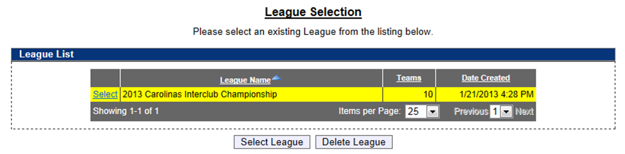
HOW TO SET TEAM ROSTERS
Once you login, click on the Select League icon, the Carolinas Interclub Championship will be the only one available.

Slide 50
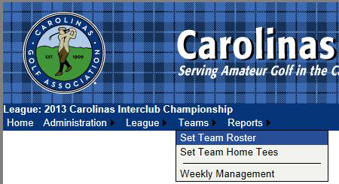
HOW TO SET TEAM ROSTERS
Under the Teams tab in the top left, select Set Team Roster.

Slide 51
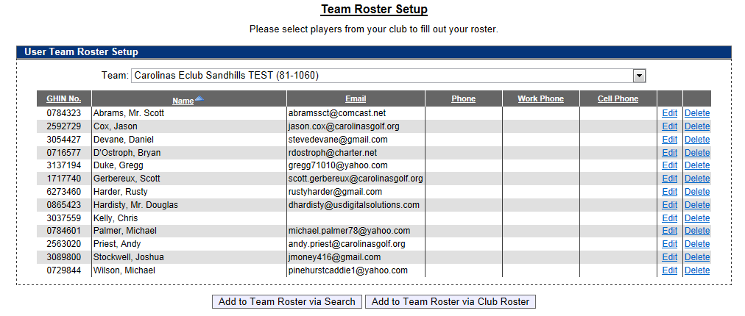
HOW TO SET TEAM ROSTERS
Select Add to Team Roster via Club Roster to bring up your club’s entire handicap roster.

Slide 52
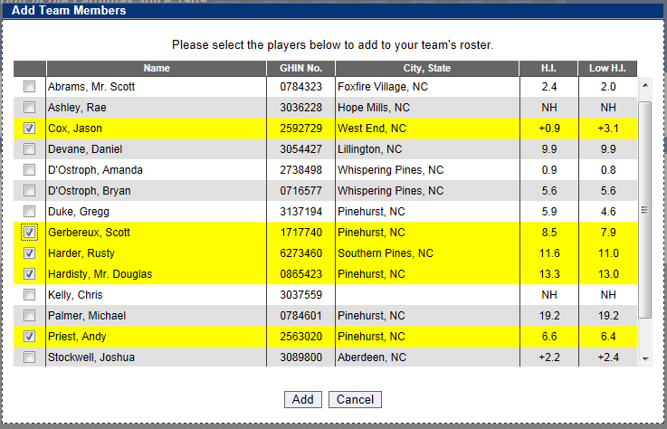
HOW TO SET TEAM ROSTERS
Select all players that you wish to participate during the season. Players are listed in alphabetical order.
You can choose all eligible players on your club’s roster (recommend minimum of 20).
You can add players from this list throughout the season; you do not need to put all players on your team immediately.
Remember, their low index must be no more than 18.4.
Click Add to add players to team roster.

Slide 53
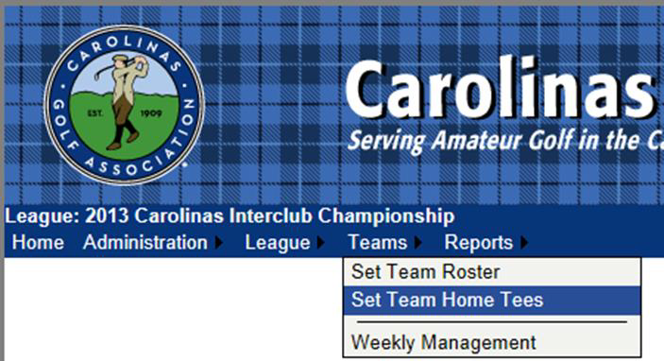
HOW TO SET HOME TEES
Under the Teams tab, select Set Team Home Tees

Slide 54
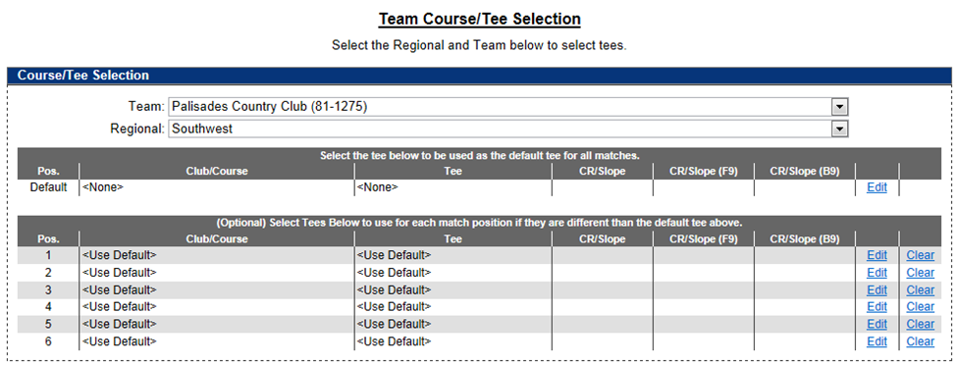
HOW TO SET HOME TEES
To set default tee for all matches, click Edit under the header “Select the tee below to be used as the default tee for all matches”.

Slide 55
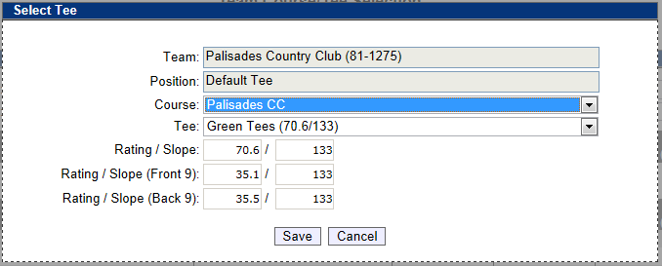
HOW TO SET HOME TEES
Select the Course name and then select the Tee to be played for all matches. Click SAVE once correct tee is selected. As per interclub rules, each player will play from this tee in all matches.

Slide 56
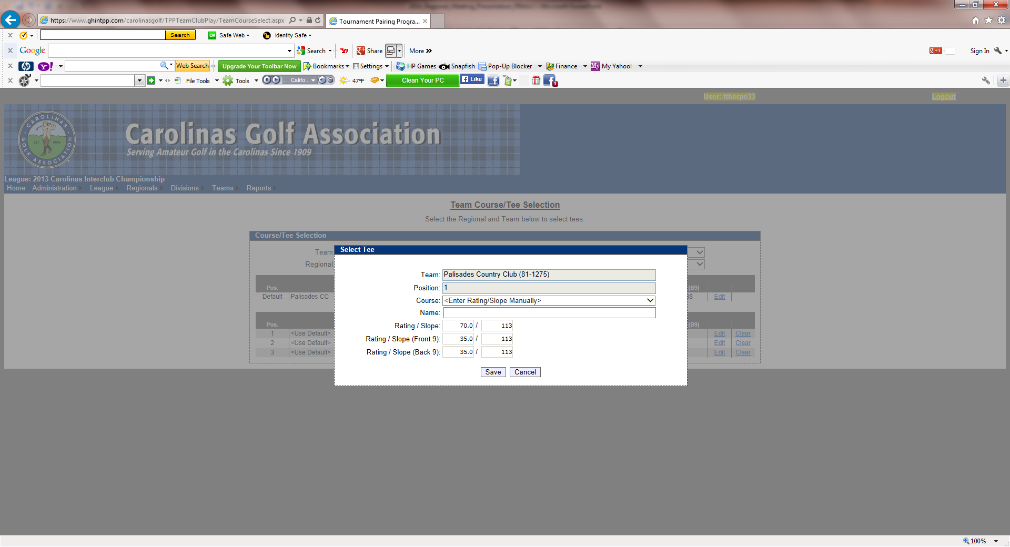
HOW TO SET HOME TEES
If you are using a combination tee that is not listed, you can manually enter the course rating and slope to better reflect the appropriate tee.
When you are finished, “Use default tee” should be selected for each position. Any tees that are not set will be set to the default tee.

Slide 57
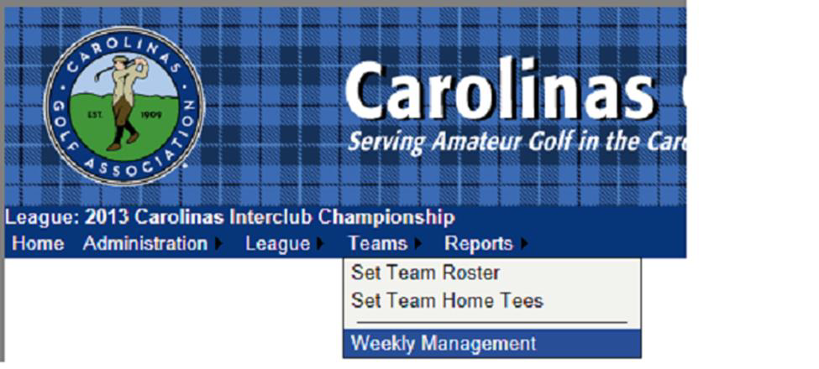
HOW TO SET YOUR MATCH ROSTER
Under the Teams tab, select Weekly Management.

Slide 58
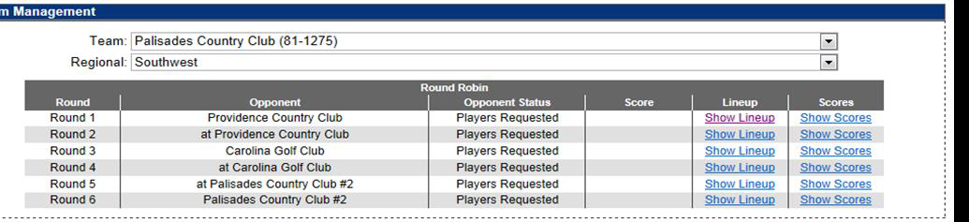
HOW TO SET YOUR MATCH ROSTER
The Team Management menu shows your regular season schedule, from here you can select your match lineup, and input scores for matches.
To select players for a match, click on Show Lineup.

Slide 59
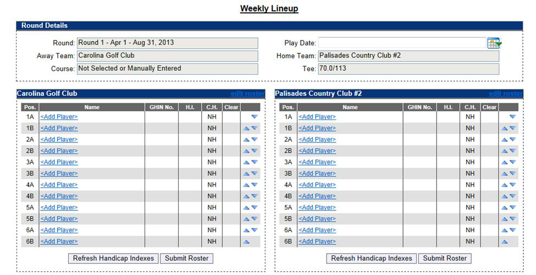
HOW TO SET YOUR MATCH ROSTER
Click on Add Player to select a player from your team roster.
Please enter the date of each match

Slide 60
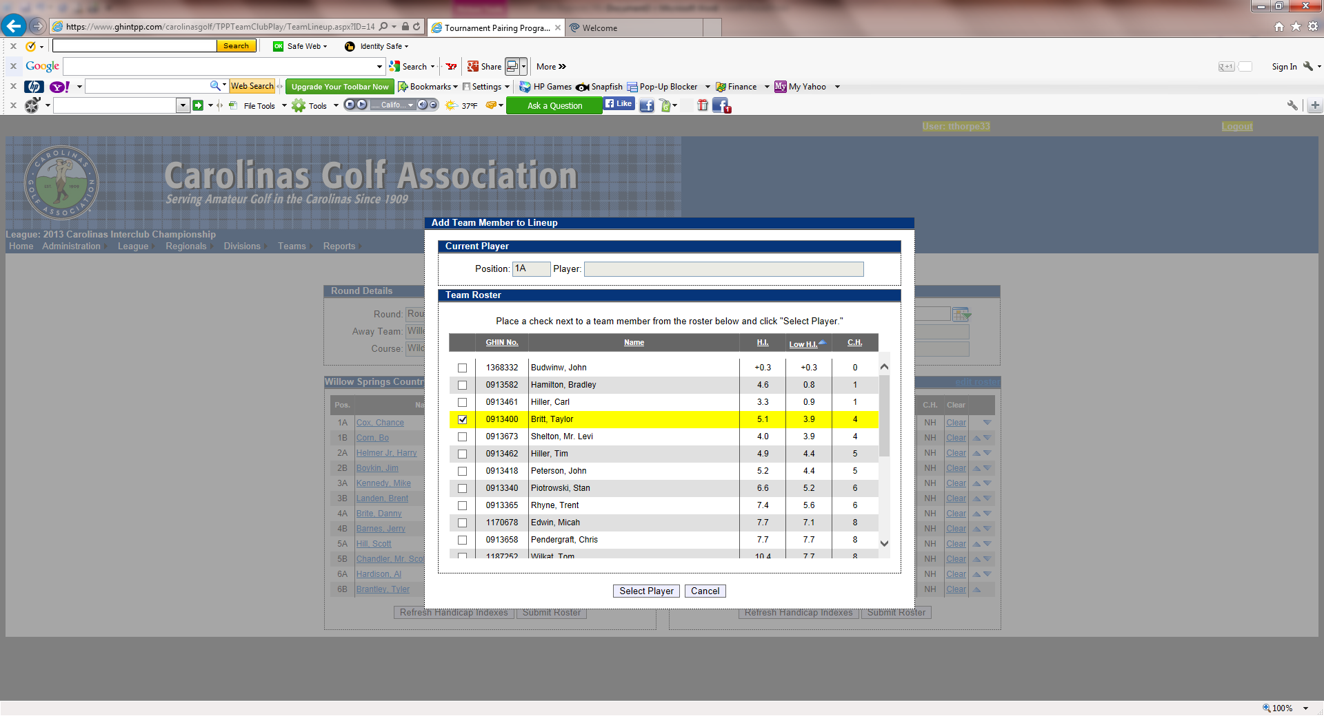
HOW TO SET YOUR MATCH ROSTER
Select whichever player you want
Players can be sorted alphabetically, by handicap index, course handicap, or GHIN number by clicking on the category header.
Players must be selected one at a time.

Slide 61
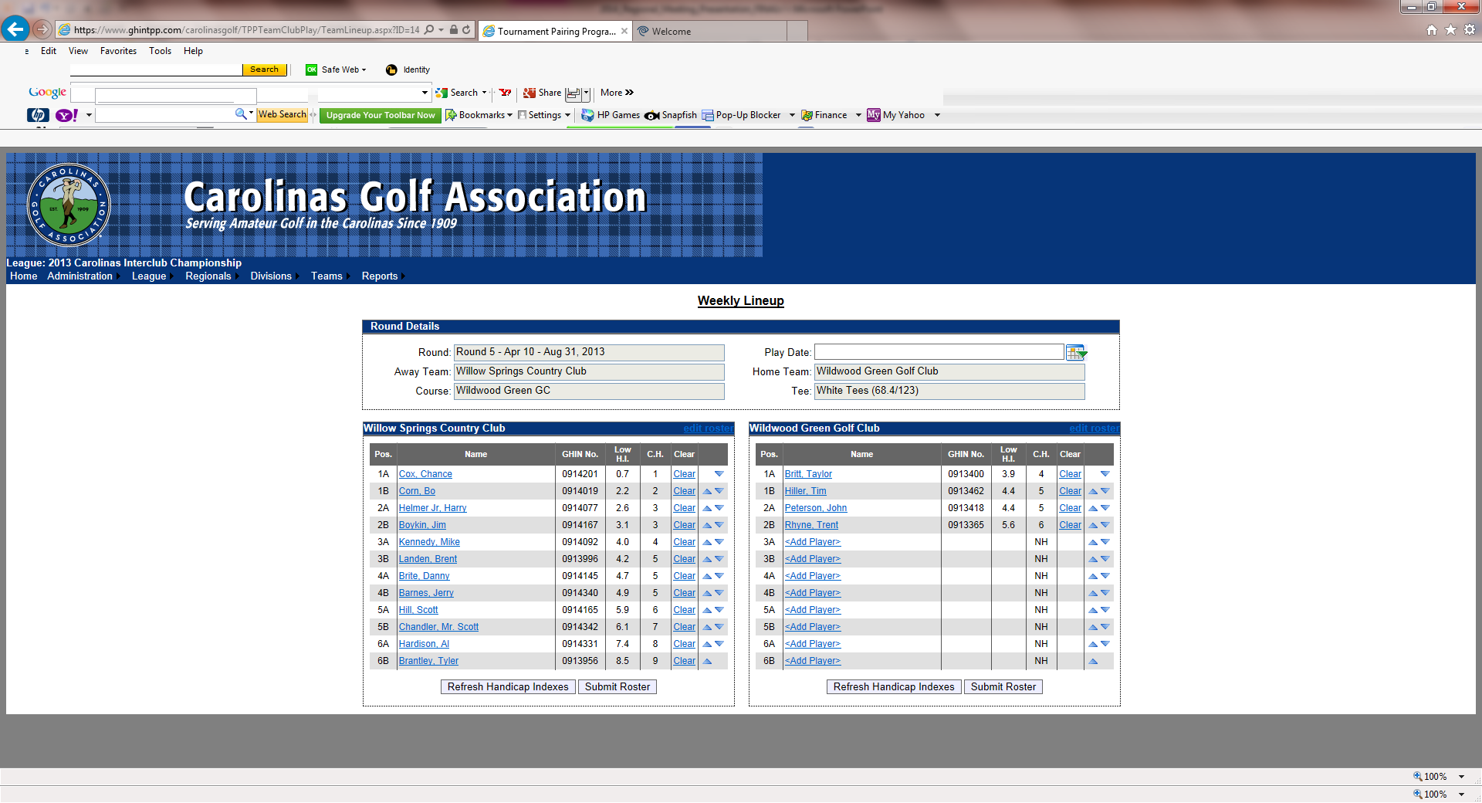
HOW TO SET YOUR MATCH ROSTER
Players need to be listed in handicap order, use the arrows on the right of the screen to put them in the correct order.
The Player in position 1A will play four-ball with the player in position 1B and so forth.
Make sure to click Submit Roster when you finish.

Slide 62
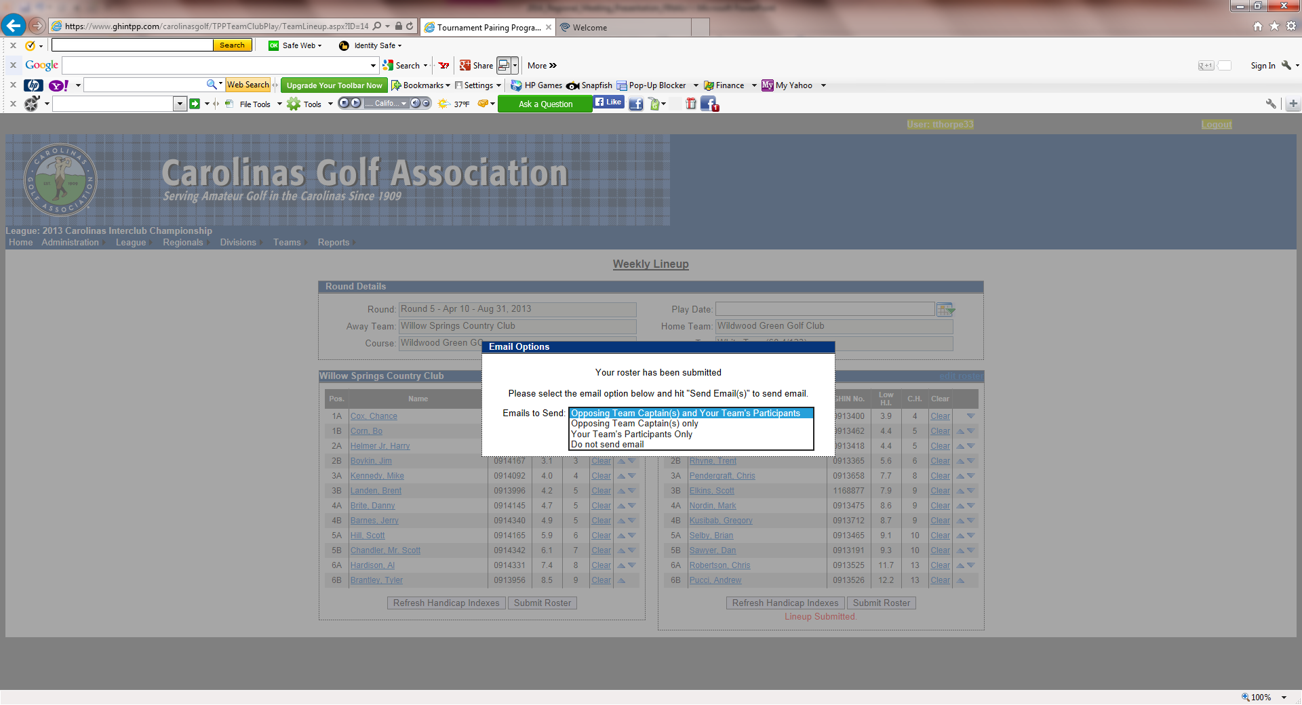
HOW TO SET YOUR MATCH ROSTER
11.You have the option of e-mailing your roster to:
The opposing team captain(s)
The opposing team captain(s) and your players
Your players only
Don’t send any e-mail

Slide 63
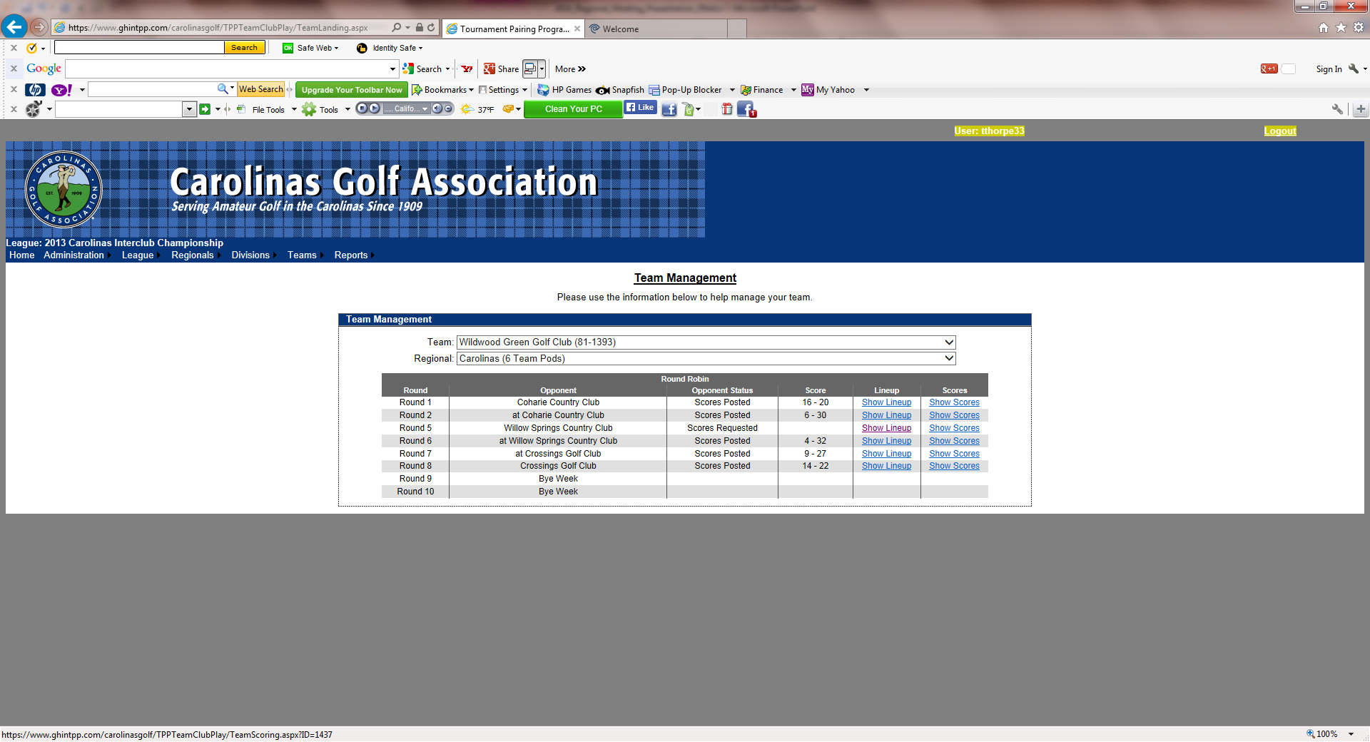
HOW TO SET YOUR MATCH ROSTER
When all players have been entered click Teams tab. Select Weekly Management, then select Show Scores. This will bring up your Weekly Scorecard.

Slide 64
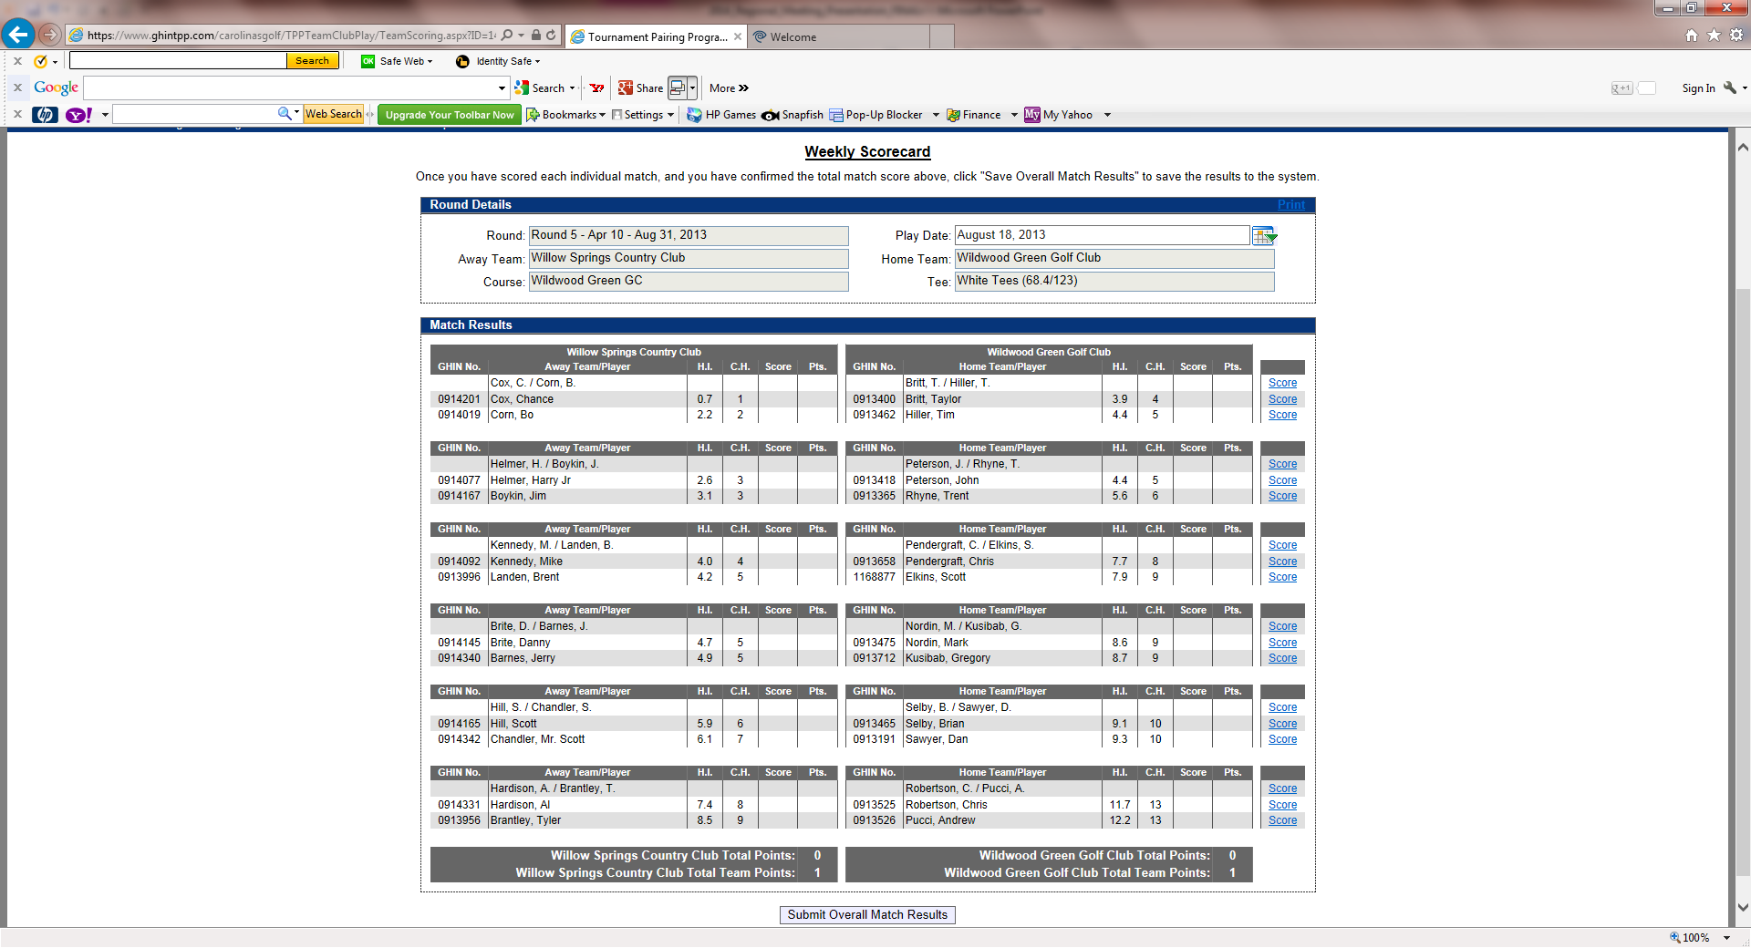
HOW TO SET YOUR MATCH ROSTER
To print off your match worksheet click on Print on the top right side of the screen.

Slide 65
HOW TO SUBMIT MATCH RESULTS with PLAYER SCORES
Under the Teams tab, select Weekly Management.

Slide 66
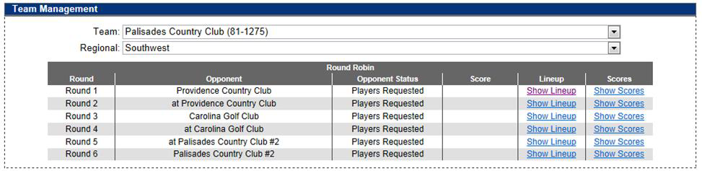
HOW TO SUBMIT MATCH RESULTS with PLAYER SCORES
Select Show Scores for the appropriate match when you are ready to input match scores.

Slide 67
HOW TO SUBMIT MATCH RESULTS with PLAYER SCORES
To input results, click on Score for each match on the right side of the screen.

Slide 68
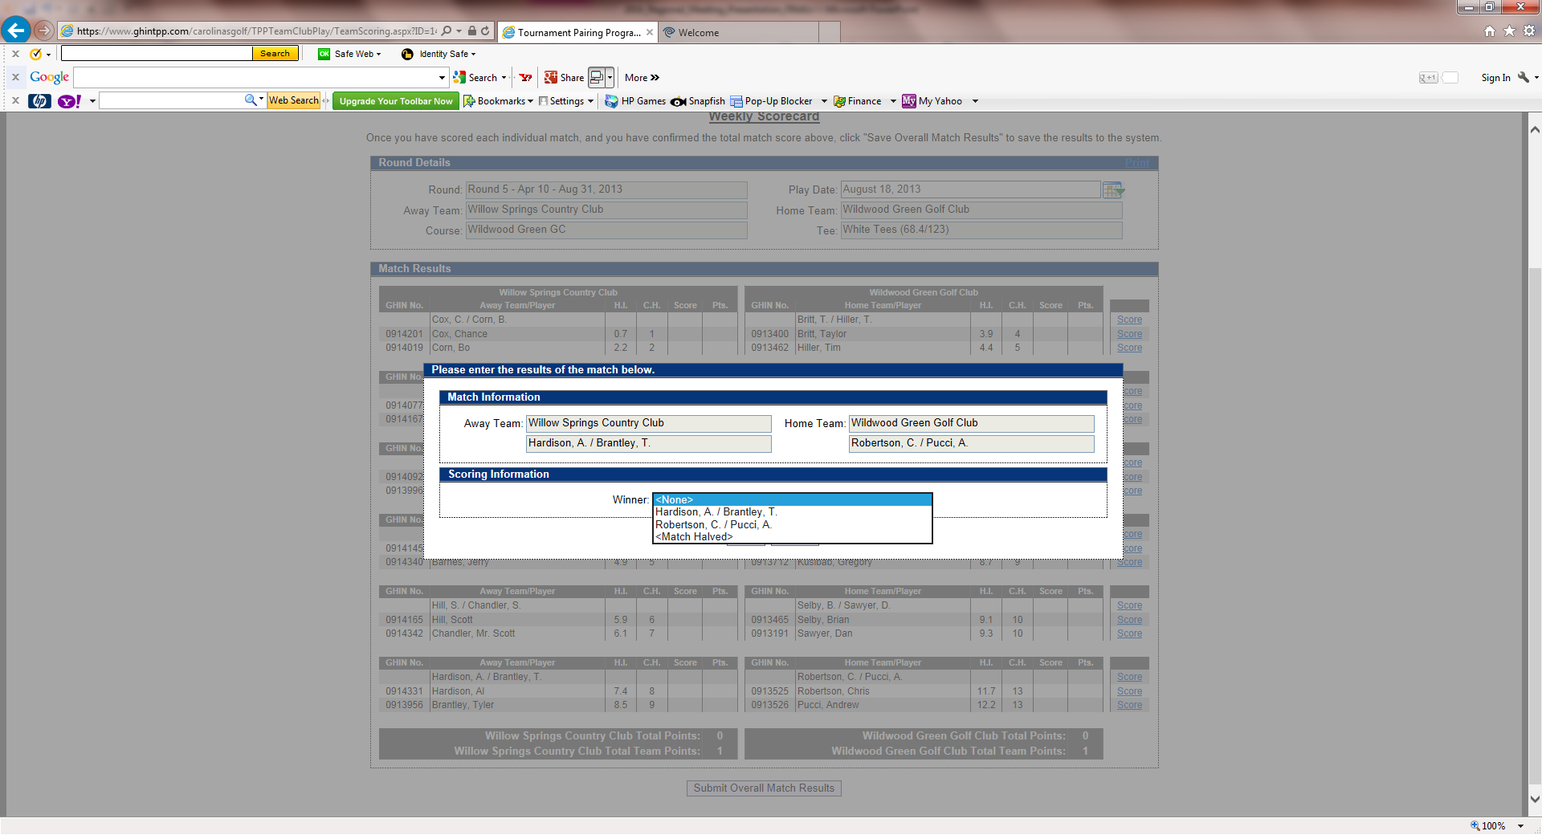
HOW TO SUBMIT MATCH RESULTS with PLAYER SCORES
For the four-ball match select the winning team or <Match Halved> if it ended in a tie, and hit Save.

Slide 69
HOW TO SUBMIT MATCH RESULTS with PLAYER SCORES
To input Individual results, click on Score for each player on the right side of the screen.

Slide 70
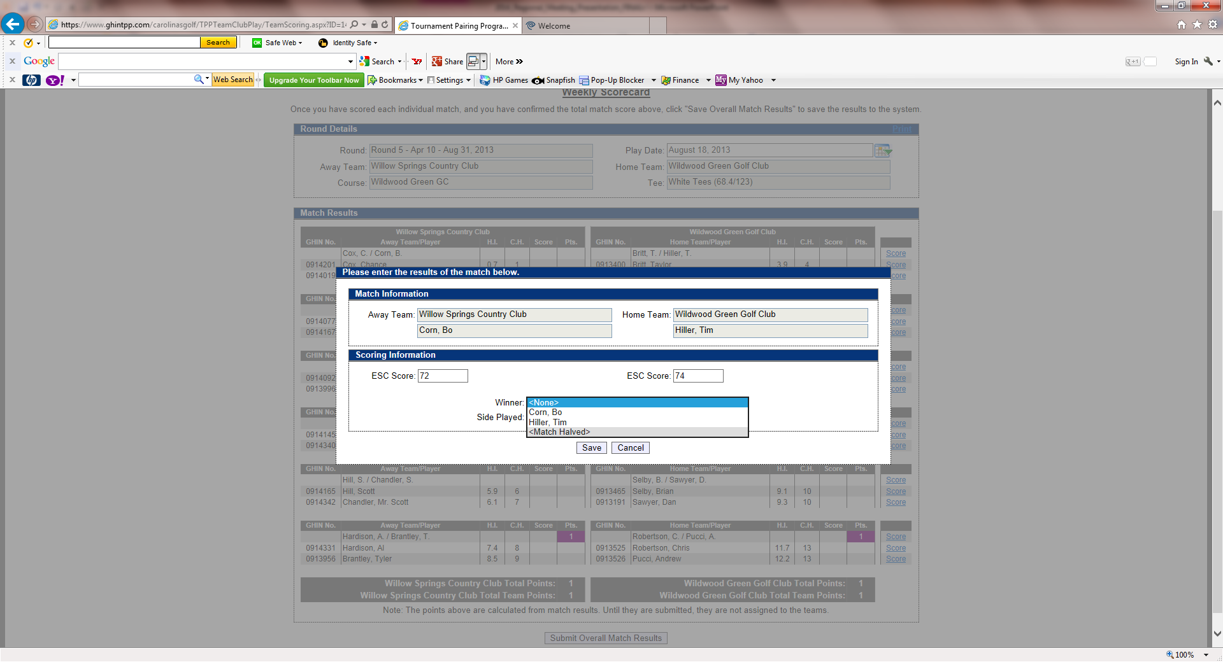
HOW TO SUBMIT MATCH RESULTS with PLAYER SCORES
For the individual matches, you have to enter each players’ ESC score and who won the match or if it was halved.
You can also specify if the match was played over 18 holes or just 9 holes. If it was only 9 holes, you would input the 9 hole score.

Slide 71
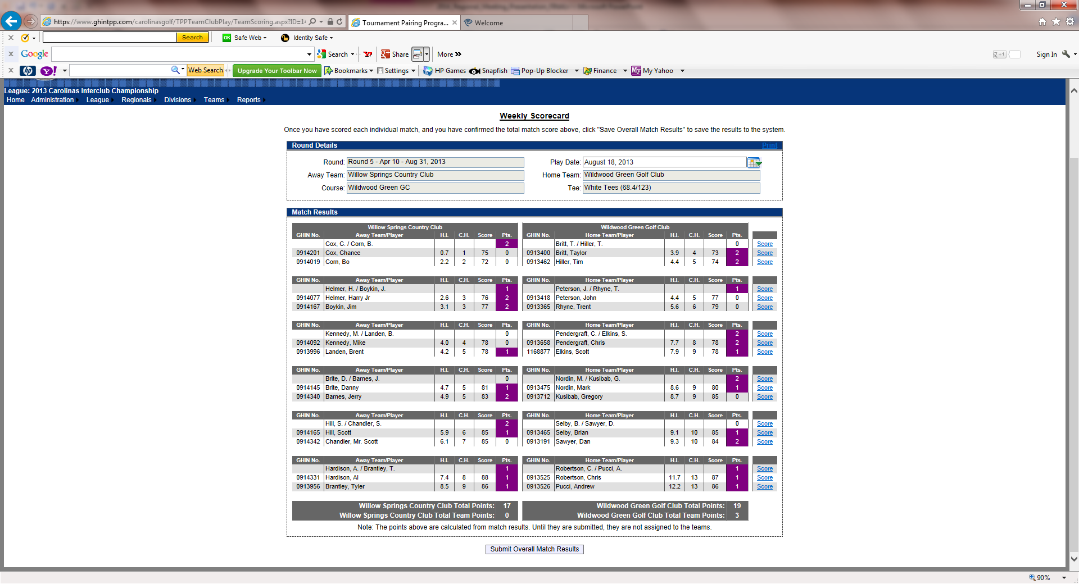
HOW TO SUBMIT MATCH RESULTS with PLAYER SCORES
Don’t forget to
PRINT results form
When all match results are filled out, match and overall points will be calculated for you.
Make sure to hit Submit Overall Match Results at the bottom of the screen.

Slide 72
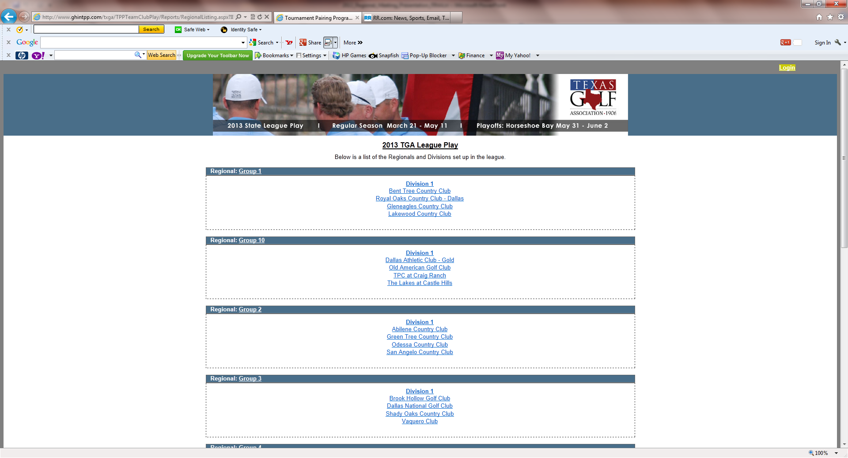
WEB LAYOUT will Look Something Like This – LEAGUE PLAY

Slide 73
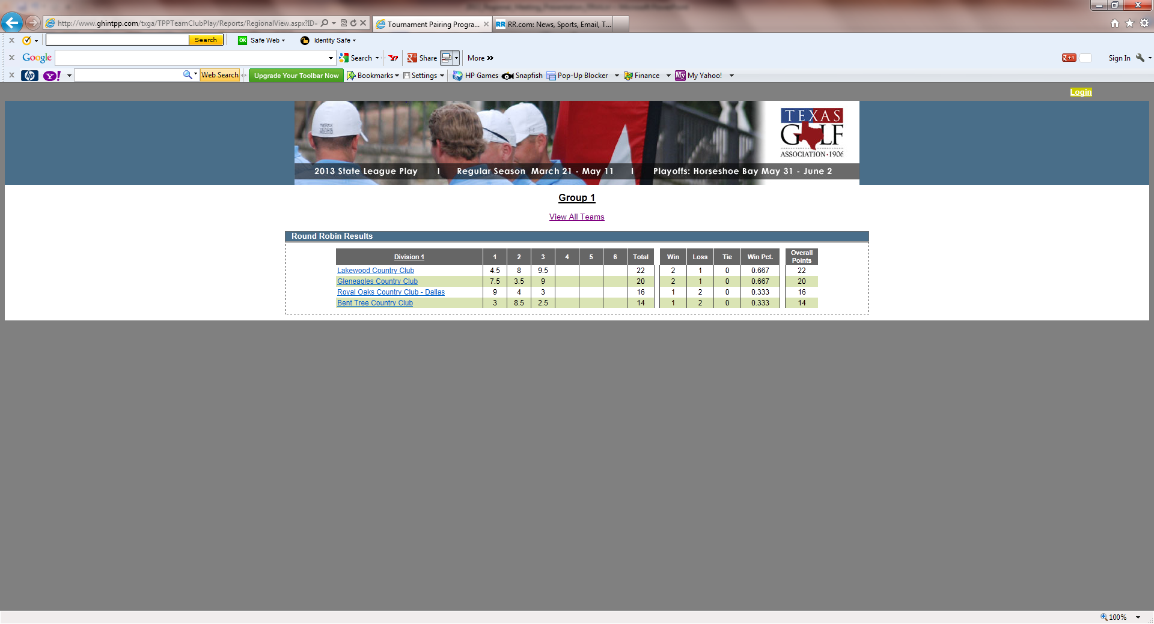
WEB LAYOUT will Look Something Like This – REGION VIEW

Slide 74
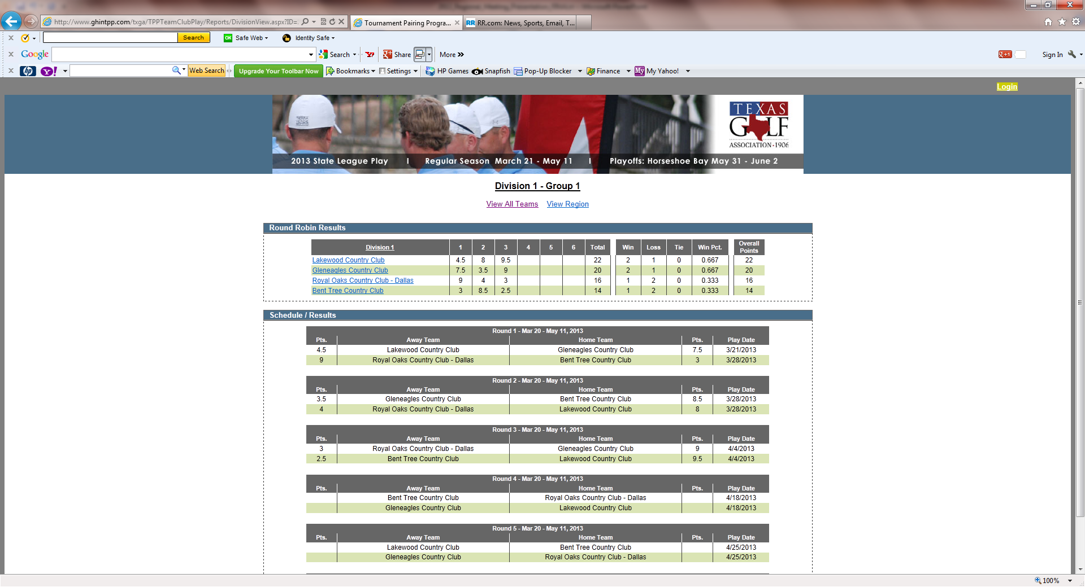
WEB LAYOUT will Look Something Like This – VIEW ALL TEAMS

Slide 75
Any Questions ?

Slide 76
CGA Interclub Competition 2015
Captains Duties
Checklist
Before the season begins
Before every match
Day of Match
After each match

Slide 77
CGA Interclub Competition 2015
Before Season Begins
Submit Team entry form on-line or by mail with entry fee
Attend Regional Captain’s meeting (mandatory) to review:
CGA Interclub rules of play
USGA match play rules
TPP procedures
Meet with Group Captains to:
Set regular season schedules
Coordinate social plans & cart fees
Secure TPP logon ID and password to;
Set-up team roster on TPP
Set regular season match dates on TPP
Set tees used for home matches on TPP
Hold team meeting to review: format, match play rules, schedule, etc.

Slide 78
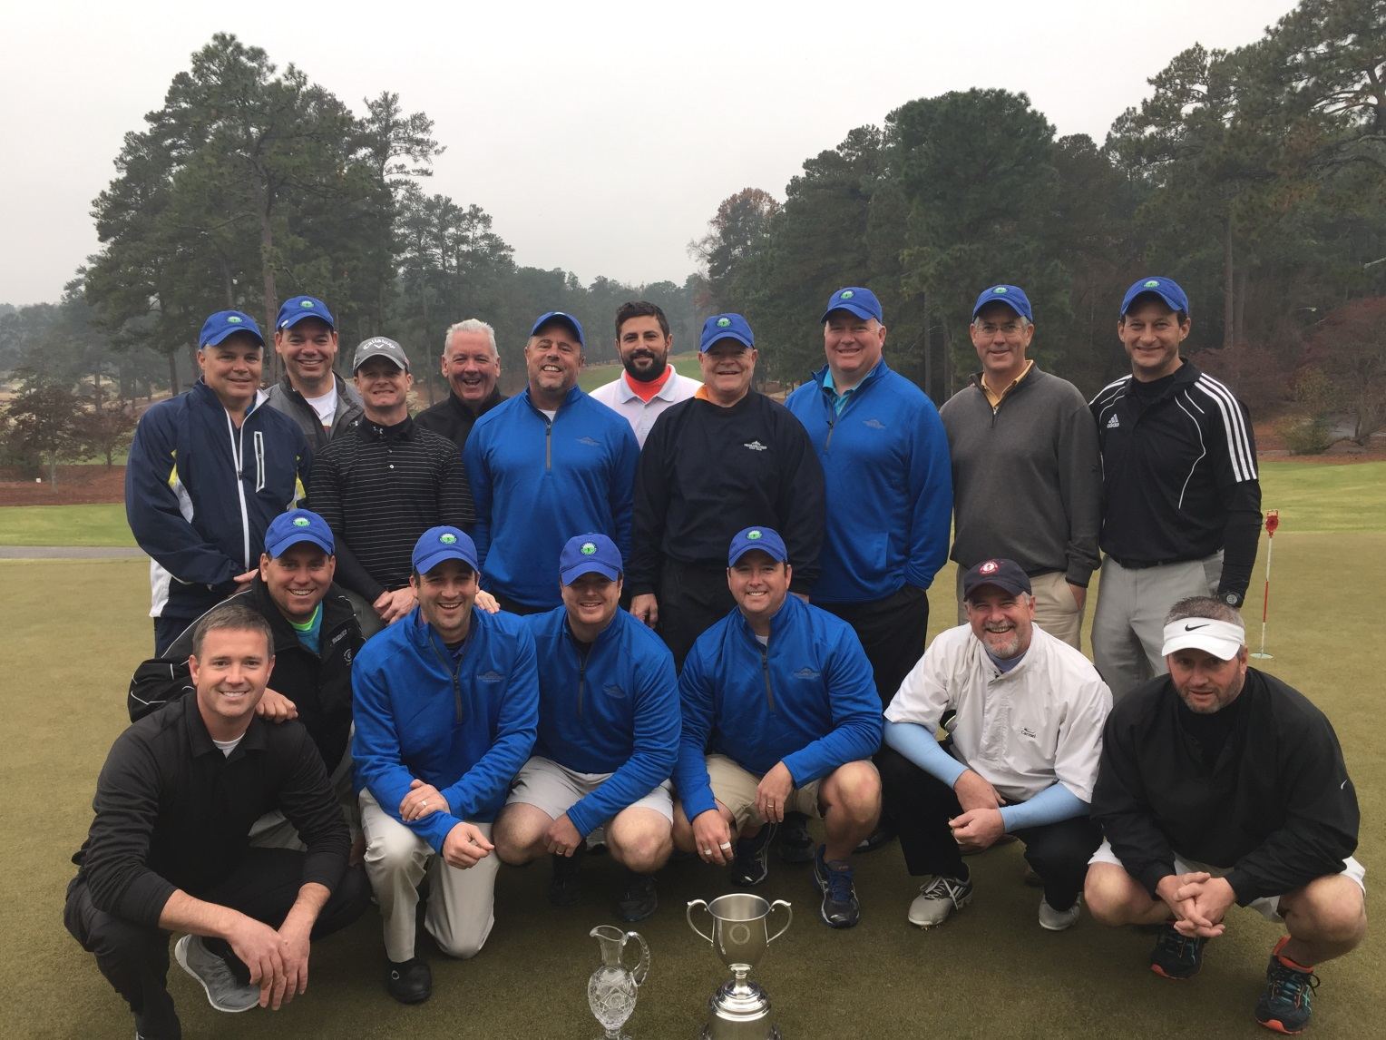
CGA Interclub Competition 2015
Captains 1st Duty - Assemble your Team
2014
Interclub
Champions
The Creek GA
Charlotte, NC

Slide 79
CGA Interclub Competition 2015
Before Every Match
1 Week Prior to a Match, both Captains to;
Confirm the schedule
Date and Tee Times
If re-scheduling necessary, edit in TPP
Prepare a 12 man team match roster in TPP
List players in correct handicap order (refer to Rule 9.F)
Exchange Rosters (via TPP generated email)
Verify opposing team’s eligibility
Contact opposing captain with questions/inquiries
Contact CGA for resolution of issues

Slide 80
CGA Interclub Competition 2015
Before Every Match
1 or 2 Days Prior to the Match, the Host Captain to;
Coordinate all activities with the host pro:
Discuss local rules (provide hard copies for both teams)
Ensure the tees for the competition have been set correctly
Discuss social activities (if any) following play
Provide staff with pairings for scoreboard / cart signs
Generate scorecards for each foursome
Use separate scorecards for singles vs four-ball match
Make two sets (one for each cart)

Slide 81
CGA Interclub Competition 2015
Day of Match
Captains - re-confirm both rosters & scorecards for changes
NOTE: CLAIMS regarding HANDICAPS and PLAYER ELIGIBILITY MUST BE MADE PRIOR to the PLAYER TEEING OFF. ONCE a MATCH has STARTED, HANDICAP and/or ELIGIBILITY CLAIMS are INVALID UNLESS a PLAYER knowingly begins the MATCH with INCORRECT INFORMATION (USGA Rule 6-2a/5).
Communicate local rules to all players
Remind players to:
post hole by hole scores
return scorecards for posting

Slide 82
CGA Interclub Competition 2015
After each Match
Both captains to:
collect scorecards
verify that each player has an adjusted gross score
Host captain:
submits overall match results in TPP
scores will post automatically
Retain scorecards for 1 week

Slide 83
CGA Interclub Competition 2015
Host Captain to:
Generate 2 scorecards for each foursome:
dot strokes for each individual match
dot strokes for the four-ball match

Slide 84
Individuals Scorecard
 | Par | 4 | 4 | 3 | 5 | 4 | 4 | 5 | 3 | 4 | 36 | 5 | 3 | 4 | 4 | 4 | 3 | 4 | 4 | 5 | 36 | 72
 | Hole | 1 | 2 | 3 | 4 | 5 | 6 | 7 | 8 | 9 | Out | 10 | 11 | 12 | 13 | 14 | 15 | 16 | 17 | 18 | In | Total
 | Hdcp | 7 | 11 | 1 | 5 | 9 | 17 | 15 | 13 | 3 |  | 10 | 16 | 8 | 18 | 6 | 12 | 4 | 14 | 2
 | Coharie CC Player1 3hdcp - net 2 |  |  | . |  |  |  |  |  |  |  |  |  |  |  |  |  |  |  | .
 | Fort Mill CC Player2 1hdcp - net 0
 | Coharie CC Player 2 2hdcp – net 0
 | Fort Mill CC Player2 5hdcp – net 3 |  |  | . |  |  |  |  |  | . |  |  |  |  |  |  |  |  |  | .

Slide 85
Four Ball Scorecard
 | Par | 4 | 4 | 3 | 5 | 4 | 4 | 5 | 3 | 4 | 36 | 5 | 3 | 4 | 4 | 4 | 3 | 4 | 4 | 5 | 36 | 72
 | Hole | 1 | 2 | 3 | 4 | 5 | 6 | 7 | 8 | 9 | Out | 10 | 11 | 12 | 13 | 14 | 15 | 16 | 17 | 18 | In | Total
 | Hdcp | 7 | 11 | 1 | 5 | 9 | 17 | 15 | 13 | 3 |  | 10 | 16 | 8 | 18 | 6 | 12 | 4 | 14 | 2
 | Coharie CC Player1 3hdcp - 2 |  |  | . |  |  |  |  |  |  |  |  |  |  |  |  |  |  |  | .
 | Coharie CC Player2 5hdcp - 4 |  |  | . |  |  |  |  |  | . |  |  |  |  |  |  |  | . |  | .
 | Fort Mill CC Player1 1hdcp - 0
 | Fort Mill CC Player2 3hdcp - 2 |  |  | . |  |  |  |  |  |  |  |  |  |  |  |  |  |  |  | .

Slide 86
Scoreboard
Carolinas Golf Association
InterClub Match: |  |  |  | June 3, 2010
Host Club |  |  |  | Visiting Club
Tanglewood |  |  |  | Forest Oaks
Captain: M. Hartson |  |  |  | Captain: G. Gupton
Individual & Team Results |  |  | Cumulative Points |  | Individual & Team Results
J. Nieters | 1up | 2 | 5 | 1 | 0 |  | G. Sexton
T. Payne | e | 1 |  |  | 1 | e | M. Daniel
Four Ball | 2up | 2 |  |  | 0 |  | Four Ball
G. Howard |  | 0 | 6 | 6 | 2 | 3up | R. Long
R. Morgan | e | 1 |  |  | 1 | e | B. McNally
Four Ball |  | 0 |  |  | 2 | 2up | Four Ball
M. Pask |  | 0 | 10 | 8 | 2 | 2up | D. Turner
J. Blevins | 1up | 2 |  |  | 0 |  | C. Marion
Four Ball | 2up | 2 |  |  | 0 |  | Four Ball

Slide 87

CGA Interclub Competition 2015
2015
Finals
Grandover
Golf resort
Greensboro, NC
Semi-Finals
Sat Nov 14
Championship
Sun Nov 15

Slide 88

CGA Interclub Competition 2015
SUMMARY
Hold Group Captains Meeting
schedule matches
submit schedule to CGA
discuss fees, social, tees, etc.
Create Team Roster in TPP
Set match tees in TPP
Hold Team Meeting
discuss rules, format
match play & interclub
match sign-up procedures
Compete
refer to Captains checklist
prepare rosters in TPP
exchange rosters in TPP
prepare scorecards (host)
Submit Results in TPP

Slide 89
CGA Interclub Competition 2015
Any questions?

Slide 90

CGA Interclub Competition 2015
Questions ?

