Slide 1

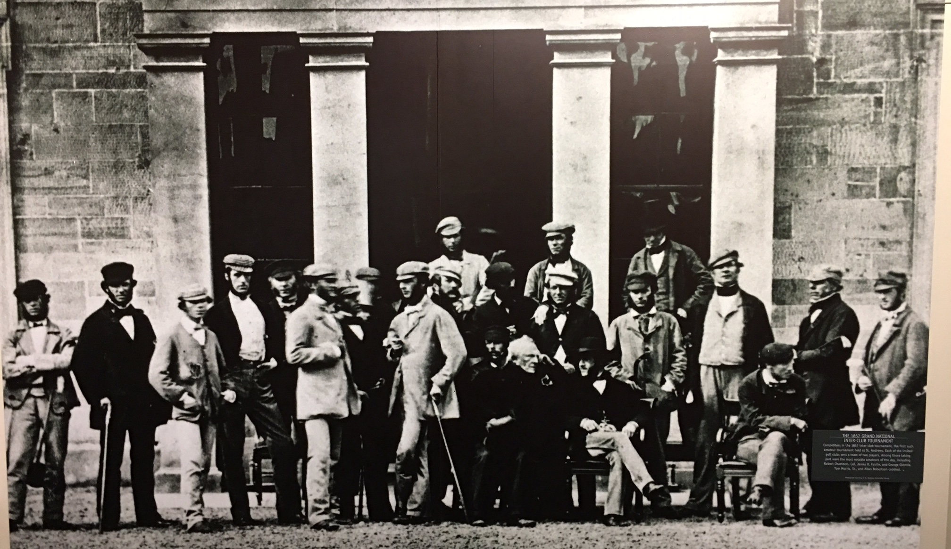
CGA Interclub Captains Meeting 2018
(Regular & Senior Competitions)
The 1857 Grand National – Inter-club Tournament
Competitors in the 1857 inter-club tournament, the first such amateur tournament held at St. Andrews.

Slide 2
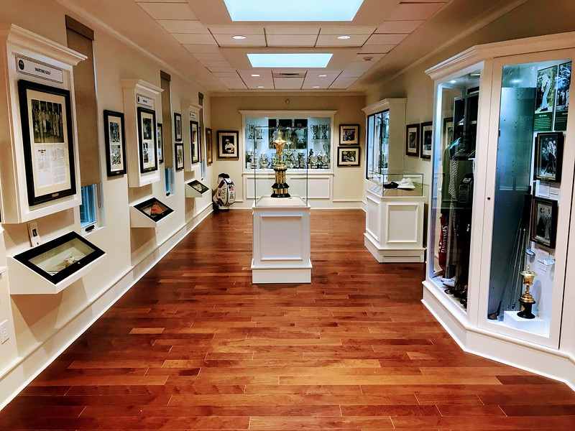
Hall of History

Slide 3
Interclub Assistance
Chris Zeh– Tournament Director
(o) 910-687-6868
Tom Thorpe – Interclub Administrator
(c) 336-575-0447
Rusty Harder – Director of Rules and Competitions
(o) 910-687-6865

Slide 4


Kim Jett
Torey Johnson

Slide 5
21st Season (Regular) Competition
3rd Annual (Senior)
Competition

Slide 6
Agenda
Review Format / Rules
Review TPP Tasks (4)
Form 2018 Groups/Pods

Slide 7


Slide 9

Ask questions anytime

Slide 10
Verify Contact Information
Group | Eastern Region | City, State | Captain Name | Captain email | Captain phone | Pro Name | Pro email | Pro phone
U | Birchwood CC | Nash, NC |  |  |  | Randy Davis | rdbwcc00@aol.com
U | Coharie CC | Clinton, NC | Jackie Parrish | pgaprofessional@embarqmail.com | 910-592-6772 | Dickie Walters | pgaprofessional@embarqmail.com | 910-592-2951
U | Southern Wayne CC | Mt. Olive, NC | Kevin Kornegay |  |  | Howard A. Hunt | csouthernwayne@nc.rr.com
U | Willow Springs CC | Wilson, NC |  |  |  | Jimmy Gurkin | willowspringscc@cocentral.com
V | Greenville CC | Greenville, NC |  |  |  | Brady Pinner | golfpro@greenvillecountryclub.com
V | Kinston CC | Kinston, NC |  |  |  | Burt Williams | bwilliams@kinstoncc.com
V | Morehead City CC | Morehead City, NC |  |  |  | Nick Eatman | neatman@moreheadcitycc.com
V | New Bern CC | New Bern, NC |  |  |  | Alan Ferebee | aferebee@suddenlink.net

Slide 11
Captains Contact Info:
  www.carolinasgolf.org
    Click on: Tournaments
      Click on: Interclub
        Click on: Captains Contact Information
  Password protected (Interclub)
  If you are not receiving e-mails . . .

Slide 12
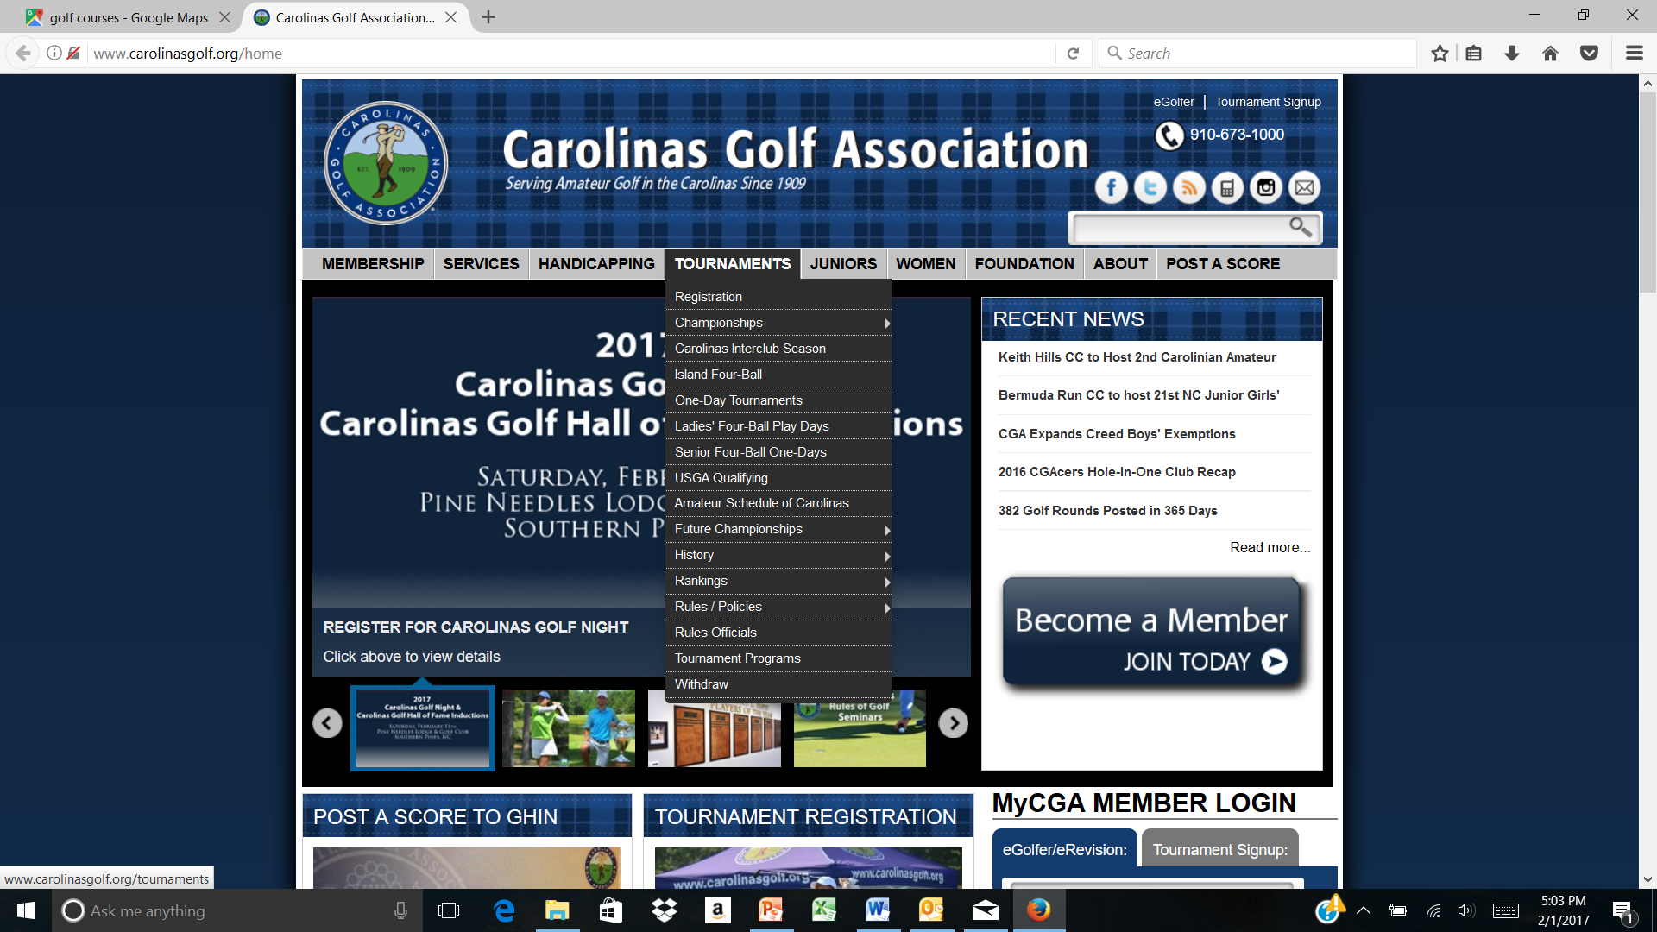

Slide 13
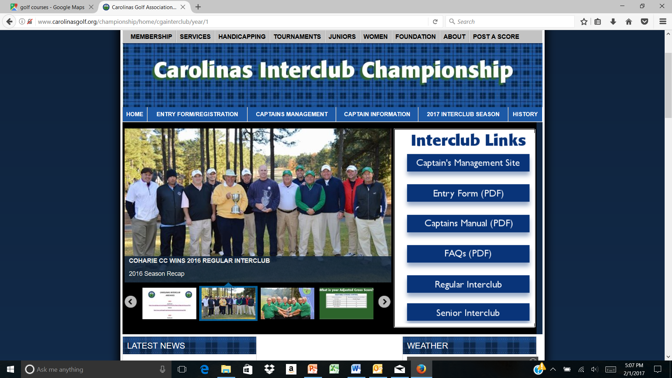

Slide 14
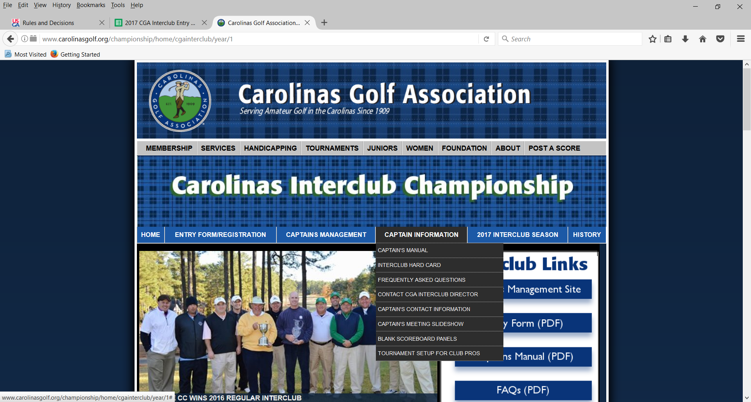

Slide 15
26 Interclub Rules of Play (TABLE OF CONTENTS)
TABLE OF CONTENTS
RULE # | PAGE # |  | RULE # | PAGE #
1. CLUB/PLAYER ELIGIBILITY | 5 |  | 14. MATCH PLAY CLAIMS | 12
2. GROUPS / SEASON / PLAYOFFS | 5 |  | 15. ADVICE | 12
3. STARTING TIMES | 6 |  | 16. GOLF CARTS AND CADDIES | 12
4. DEFINITION OF TEAM/MATCH ROSTERS | 6 |  | 17. RAIN / WEATHER PROCEDURES, POSTPONED & SUSPENDED MATCHES | 12
5. MINIMUM NUMBER OF COMPETING PLAYERS | 6 |  | 18. WITHDRAWAL DURING THE REGULAR SEASON | 13
6. TEAM CAPTAINS' DUTIES | 6 |  | 19. FORFEITURES | 13
7. PRACTICE ROUNDS | 9 |  | 20. PROTESTS | 14
8. HOME TEAM ARRANGEMENTS | 9 |  | 21. DETERMINING POD STANDINGS | 14
9. INDEXES / HANDICAPS & PAIRINGS | 9 |  | 22. PLAY-OFF MATCHES | 14
10. ORDER OF PLAY | 11 |  | 23. POLICY FOR COURSE USAGE | 15
11. TYPE OF COMPETITION AND SCORING | 11 |  | 24. PACE OF PLAY | 15
12. USGA RULES OF PLAY | 11 |  | 25. CELLULAR PHONES and ELECTRONIC DEVICES | 16
13. BALLS AND IMPLEMENTS | 12 |  | 26. ETIQUETTE | 16
This discussion will concentrate on the Highlighted Rules above

Slide 16
(Rule #1) CLUB / PLAYER ELIGIBILITY
(Clubs)
must be CGA member in good standing
must be licensed to offer USGA Handicaps
must be in compliance with the USGA Handicap Certification Program
must have access to a regulation length golf course
(Players)
must be male members of a CGA member club
must be an amateur golfer (exception 1.L. below Regular League only)
must be listed on the club’s GHIN handicap roster
must have 10 posted scores within the past 12 months
must have a low index (LI) of:
  Regular League 18.4 or less
  Senior League no maximum LI
minimum age: Regular League 18+ Senior League 55+
restricted to 1 team in the current year
may include up to 2 (two) non-amateur players (Regular League only)
Special circumstances may be considered by a CGA Committee

Slide 17
Rule #2 REGULAR SEASON
  Pods normally consist of 4 or 6 teams (3, 5 & 7 team Pods possible)
  Teams play home and home (total of 6 matches)
  REGULAR - matches played primarily Sat/Sun
  SENIOR – matches played primarily Mon-Fri
  Season begins: April Ends: early August
  Playoffs begin Mid August with Final 4 in Oct/Nov

Slide 18
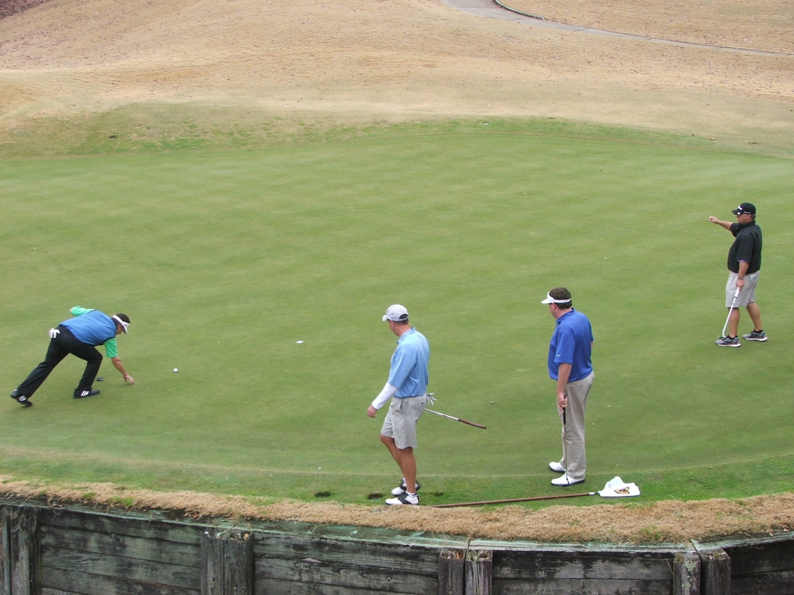
Interclub Format
Four-Ball Match Play

Slide 19
Rules #4 DEFINITION OF TEAM/MATCH ROSTERS:
  TEAM Roster
    Unlimited
    Eligible players may be added any time
  B. MATCH Roster
    REGULAR - 12 eligible players
    SENIOR – 8 eligible players
    Players can only compete for 1 team in the current season
  C. Clubs may sponsor more than one team
    must have balanced rosters
    players must remain on same team after playing in first match

Slide 20
Rule #5 LESS THAN TWELVE (12) / (8) PLAYERS
    “Four-Ball Match”
      one-man team vs two-man team
      Captains choice where to play singles
      must maintain high to low handicap order
    Official match minimum # of players 6 (REGULAR) / 4 (SENIOR)
    ABSENT PLAYERS
    must be listed on Match Roster prior to start of match
    may join the match at any time, at beginning of next hole.
    ALTERNATES
    must be listed on Team Roster prior to start of match
    may be inserted before the match begins.

Slide 21

Rule #6 TEAM CAPTAINS' DUTIES:
  Attend a Meeting to review the rules
  Create Team and Match Rosters (TPP)
      Determine your team’s sign-up procedure for a match
      Educate your team on format and match play rules
  Set tees to be used for each match (TPP)

Slide 22
Rule #6 TEAM CAPTAINS' DUTIES: (cont’d)
  SELECT TEE PLACEMENT (on TPP) -
      Tees must not change during season (ex; special circumstances)
      must be a CGA rated set of tees (on the clubs scorecard)
must adhere to the following yardage guidelines related to par:
(REGULAR Competition Tees)
        ➢ Par 68 – minimum 5600 maximum 6100
        ➢ Par 69 – minimum 5700 maximum 6150
        ➢ Par 70 - minimum 6000 maximum 6200
        ➢ Par 71 - minimum 6000 maximum 6350
        ➢ Par 72 - minimum 6000 maximum 6500
(SENIOR Competition Tees)
        ➢ Par 68 – minimum 4950 maximum 5900
        ➢ Par 69 – minimum 5150 maximum 6000
        ➢ Par 70 - minimum 5300 maximum 6000
        ➢ Par 71 - minimum 5500 maximum 6100
        ➢ Par 72 - minimum 5600 maximum 6200

Slide 23
Rule #6 TEAM CAPTAINS' DUTIES: (cont’d)
  Course condition/set-up
  Communicate local rules to both teams
    Unmarked areas (i.e. GUR, hazards, etc.)
    Out of Bounds (White Stakes, Lines, Roads, Fences, etc.)
    Play the ball down or Preferred lies (for wet conditions)
    TIO’s

Slide 24
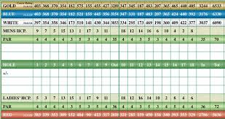
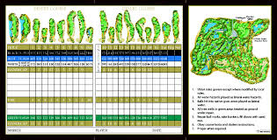
Rule #6 TEAM CAPTAINS' DUTIES: (cont’d)
  Create scorecards (home team captain)
    Use club scorecards or TPP generated cards
    Play off the low ball (i.e.; low handicap)
    Dot strokes for each four-ball match
    Make 2 sets for each foursome

Slide 25
Four Ball Match Scorecard
 | Par | 4 | 4 | 3 | 5 | 4 | 4 | 5 | 3 | 4 | 36 | 5 | 3 | 4 | 4 | 4 | 3 | 4 | 4 | 5 | 36 | 72
 | Hole | 1 | 2 | 3 | 4 | 5 | 6 | 7 | 8 | 9 | Out | 10 | 11 | 12 | 13 | 14 | 15 | 16 | 17 | 18 | In | Total
 | Hdcp | 7 | 11 | 1 | 5 | 9 | 17 | 15 | 13 | 3 |  | 10 | 16 | 8 | 18 | 6 | 12 | 4 | 14 | 2
 | Coharie CC Player1 3hdcp - 2 |  |  | . |  |  |  |  |  |  |  |  |  |  |  |  |  |  |  | .
 | Coharie CC Player2 5hdcp - 4 |  |  | . |  |  |  |  |  | . |  |  |  |  |  |  |  | . |  | .
 | Fort Mill CC Player1 1hdcp - 0
 | Fort Mill CC Player2 3hdcp - 2 |  |  | . |  |  |  |  |  |  |  |  |  |  |  |  |  |  |  | .

Slide 26
Rule #6 TEAM CAPTAINS' DUTIES: (cont’d)
  Submit match results (TPP)
    both captains collect scorecards
    agree on match results
    HOST CAPTAIN to submit match results in TPP
      Include Players ESC Scores
      TPP will automatically post the players scores
      Make sure there is a match date in TPP

Slide 27
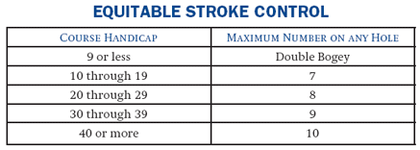
Rule #6 TEAM CAPTAINS' DUTIES: (cont’d)
  Players ESC Scores (USGA Handicap System Manual 4-3)
  NOTE: LI’s, HDCP STROKES and OPPOSING PLAYER ELIGIBILITY MAY NOT BE QUESTIONED ONCE A MATCH HAS STARTED UNLESS INFORMATION GIVEN WAS DIFFERENT THAN THAT WAS APPROVED PRIOR TO THE START OF EACH MATCH. CAPTAINS SHOULD DOUBLECHECK THE SCORECARDS AND LINEUPS PRIOR TO THE START OF EACH MATCH.

Slide 28
Rule #6 TEAM CAPTAINS' DUTIES: (cont’d)
  NOTE 1 - POSTING OF INDIVIDUAL SCORES
Automatic by TPP
REGULAR SEASON posted as NON-TOURNAMENT scores
PLAYOFF SCORES posted as tournament scores
FAILURE TO POST PLAYERS ESC SCORES:
  USGA Handicap System Manual, 8-4 b. Penalty Scores for Failure to Post
  Failure to report an adjusted gross score each match may result in a penalty score equal to the lowest/highest Handicap Differential in the scoring record

Slide 29
Rule #7 PRACTICE ROUNDS
  regular season - at the discretion of each club
  playoff practice rounds should be;
    pre-arranged by both captains
    scheduled date/time agreeable by host club
  not allowed on host course on the day of a match

Slide 30
Rule #8 HOME TEAM ARRANGEMENTS
  home team to host green fees (cart fee only charge)
  carts/caddies equal availability (both teams)
  F&B available for purchase
  post match social (optional)
  applies to regular season & play-off matches

Slide 31
Rule #9 INDEXES / HANDICAPS & PAIRINGS
  INDEXES
    players play at 100% of their 12 month Low Index (LI)
    REGULAR: maximum LI is 18.4
    SENIOR: no maximum
    multi-member players must use lowest index
  HANDICAPS
    players are listed low to high on lineup card
    strokes allotted off lowest handicap in the group
    18 stroke maximum

Slide 32
Rule #9 INDEXES / HANDICAPS & PAIRINGS (cont’d)
  a. PAIRINGS – (“Full Team Complement” -same course-)
    players paired in Competition Course Hdcp sequence - low to high
    captain can pair up the lowest 4 players into two “four-ball” teams. Continue with the next 4 lowest players, etc.
    equal handicaps may be paired in any sequence - captain’s choice

Slide 33
CGA Interclub Competition 2015
Rule #9 INDEXES / HANDICAPS & PAIRINGS (cont’d)
F. b. PAIRINGS – (“Split Format” Playoffs)
    involves both courses
    half of each team play their home course / other half play away
    use Home Course Slope to determine handicaps.
    list players in handicap order (low to high)
    within each set of four, captain selects two (2) players to play away and remaining two play at home. Repeat for next set of four, etc.
    players must be paired in handicap sequence at their assigned course

Slide 34
Rule #11 TYPE OF COMPETITION and SCORING
  Four ball Match Play
  2 points each side and 2 points overall
  6 points available in each foursome
  36 point total for a REGULAR team match
  24 point total for a SENIOR team match
  NOTE: Accumulated Match Points used to break ties
  (important for determining playoff spots)

Slide 35
Rule #12 USGA RULES OF PLAY
  USGA Rules of Golf govern all matches
  Host professional staff shall administer the rules
  Local rules must conform to the USGA Rules of Golf
      Preferred lies
      Stones in bunkers
      Obstructions near putting green
      Unmarked GUR
  DMDs (distance measuring devices) are allowed

Slide 36
USGA MATCH PLAY RULES OF GOLF
2-4 CONCESSION OF MATCH, or HOLE can be made at any time
2-4 CONCESSION of OPPONENTS NEXT STROKE IN MATCH PLAY
    opponent’s ball must be at rest
2-5 CLAIMS AND DISPUTES (If no rules official available):
    the players must continue the match without delay.
    the Committee may consider a claim if the player making the claim notifies his opponent;
      (i) that he is making a claim,
      (ii) of the facts of the situation
      (iii) that he wants a ruling
    claims must be made before play from the next teeing ground or, in the case of the last hole of the match, before all players in the match leave the putting green
2-6 GENERAL PENALTY Loss of hole

Slide 37
USGA MATCH PLAY RULES OF GOLF (cont’d)
  3-3 SECOND BALL
    not allowed in Match Play
  10-1 ORDER OF PLAY
    playing out of turn may constitute a replay

Slide 38
USGA MATCH PLAY RULES OF GOLF (cont’d)
  30-3. BEST-BALL AND FOUR-BALL MATCH PLAY
    REPRESENTATION OF SIDE - An absent partner may join a match between holes, not during play of a hole
    ORDER OF PLAY Balls belonging to the same Side may be played in the order the Side considers best
    WRONG BALL Individual involved is DQ’d for that hole, not his partner
    PENALTY TO A SIDE for a breach of any of the following by any partner
      Rule 4 Clubs
      Rule 6-4 Caddie
    DISQUALIFICATION OF SIDE
      A side is disqualified if any partner incurs a penalty of disqualification under the following:
        Rule 1-3 Agreement to Waive Rules.
        Rule 4-1 or 2 Clubs.
        Rule 5-1 or 2 The Ball.
        Rule 6-2a Handicap (playing off higher handicap).
        Rule 6-4 Caddie.
        Rule 6-7 Undue Delay; Slow Play (repeated offense).
        Rule 14-3 Artificial Devices and Unusual Equipment
    Effect of Other Penalties
      If a player's breach of a Rule assists his partner's play or adversely affects an opponent's play, the partner incurs the applicable penalty in addition to any penalty incurred by the player.
      In all other cases where a player incurs a penalty for breach of a Rule, the penalty does not apply to his partner. Where the penalty is stated to be loss of hole, the effect is to disqualify the player for that hole.

Slide 39
Rule #14 MATCH PLAY CLAIMS
  must be made before teeing off on next hole
  the privilege of playing a 2nd ball does not exist

Slide 40
Rule #17 POSTPONED / SUSPENDED MATCHES
  pertains to both regular season & playoff matches
  Postponed - rescheduled by both captains
  Suspended play: ALL matches NOT completing 9 holes;
    entire match to be replayed at a later date
  Suspended play: ALL matches COMPLETING 9 holes;
    all matches stand based on the last completed hole at the time play was suspended if continuance is not an option

Slide 41
Rule #20 PROTESTS
  reviewed / agreed by both Captains
  results considered "official", unless a valid protest made
  protests must be made by the team Captain
  must be registered with the opponent's Captain
  must be submitted in writing (by email)

Slide 42
Rule #21 POD STANDINGS
  determined by “Record Points” (won/loss/tie record)
    three (3) points for a team match win
    one (1) point for a team match tie
    zero (0) points for a loss
  accumulated match points used to break ties

Slide 43
Rule #22 PLAY-OFF MATCHES
  Minimum 32 teams qualify (Regular & Senior)
    Pod winners + 2nd place teams automatically qualify
    Remaining spots awarded based on records
    Single elimination
    1st round avoid same pod match-ups
    Split format in effect (excluding Final Four)

Slide 44
Rule #22 PLAY-OFF MATCHES (cont’d)
  PLAYERS HANDICAPS
    use home course rating/slope when creating lineup
    allotted strokes may change on away course
  PAIRINGS
    paired in sequence from low to high
    player course assignment made by the captain (see rule 9.F)
    late changes will play at the lowest LI if no time to re-pair

Slide 45
Rule #22 PLAY-OFF MATCHES (cont’d)
  Ties broken by sudden-death
    involves only the #1 teams at each course
    If a tie of an officially completed match with no possibility of a playoff the tie breaker will be based on Rule 21A-E.
  “Final Four”
    SENIOR – The Final Four
      eight (8) players & two (2) alternates
      TBD 2018 - TBD
    REGULAR - The Final Four
      twelve (12) players & two (2) alternates
      Nov 10/11, 2018 - Pinehurst Country Club (#5)

Slide 46
- Captains Checklist -
BEFORE SEASON BEGINS
Submit Team entry (include other confirmed Pod teams)
Attend Captains Meeting
Meet with Pod Captains to:
  Set regular season schedules
  Coordinate social plans & cart fees
Secure TPP logon ID and password to;
  Set-up team & match rosters on TPP
  Set regular season match dates on TPP
  Set tees used for home matches on TPP
Hold team meeting to review: format, match play rules, schedule, etc.

Slide 47
- Captains Checklist -
BEFORE EVERY MATCH
1 Week Prior to a Match;
Confirm match schedule (NOTE: If re-scheduled, edit in TPP)
Prepare a 12 man team match roster in TPP (48 hours prior to a match)
  List players in correct handicap order (refer to Rule 9.F)
  Exchange Rosters (via TPP generated email)
Verify opposing team’s lineup (eligibility, correct order, etc.)
Contact opposing captain with questions/inquiries
  If necessary, notify CGA Interclub Administrator with questions for resolution
1 or 2 Days Prior to the Match, the Host Captain should;
Coordinate all activities with the host pro:
  Discuss local rules (document & prepare hard copies per group for both teams)
  Ensure tees for the competition have been or will be set correctly
  Discuss social activities (if any) following play
  Provide staff with pairings for scoreboard and (optional) cart signs
Generate scorecards for each foursome
  Four-Ball format (play off the low handicap)
  Make two sets (one for each cart)

Slide 48
- Captains Checklist -
DAY OF MATCH
Captains re-confirm rosters
Adjust lineups / scorecards accordingly
Communicate local rules
  (i.e., playing the ball down, tees, GUR, etc.)
  to ALL players
  remind players to post hole by hole (ESC) scores
  remind players to return scorecards for posting
NOTE: CLAIMS regarding HANDICAPS and PLAYER ELIGIBILITY MUST BE MADE PRIOR to the PLAYER TEEING OFF. ONCE a MATCH has STARTED, HANDICAP and/or ELIGIBILITY CLAIMS are INVALID UNLESS a PLAYER knowingly begins the MATCH with INCORRECT INFORMATION (USGA Rule 6-2a/5).

Slide 49
- Captains Checklist -
FOLLOWING EACH MATCH (Host Captain):
  collect scorecards
  verify each players adjusted gross score
  submit match results and players ESC gross score in TPP (Scores will post automatically)
  Retain scorecards for 1 week

Slide 50
CGA Interclub Competition 2018
Available Forms+ on the web:
Regular Schedule worksheet
Blank Scoreboard
Sample Local Rules
This presentation

Slide 51
CGA Interclub Competition 2018
Any questions?

Slide 52
TPP
ADMINISTRATIVE
PROCEDURES

Slide 53
TPP ADMINISTRATIVE PROCEDURES
Captains will use TPP (Tournament Pairing Program) to:
Set Team Rosters
  Set Home Tees
    Prepare Match Rosters
      Submit Match Results with (Players ESC) scores

Slide 54
TO GET STARTED
Login to Captains Management Sight (TPP) using the link on the web site
https://www.ghintpp.com/carolinasgolf/TPPTeamClubPlay/logon.aspx?ReturnUrl=%2fcarolinasgolf%2fTPPTeamClubPlay%2fLeagueSelect.aspx
User ID and Password pre-assigned:
  call Chris (910-687-6868), or Tom (336-575-0447) or
  email: chris.zeh@carolinasgolf.org, or tthorpe@carolinasgolf.org.
Follow instructions listed in the ADMINISTRATIVE PROCEDURES document.

Slide 55
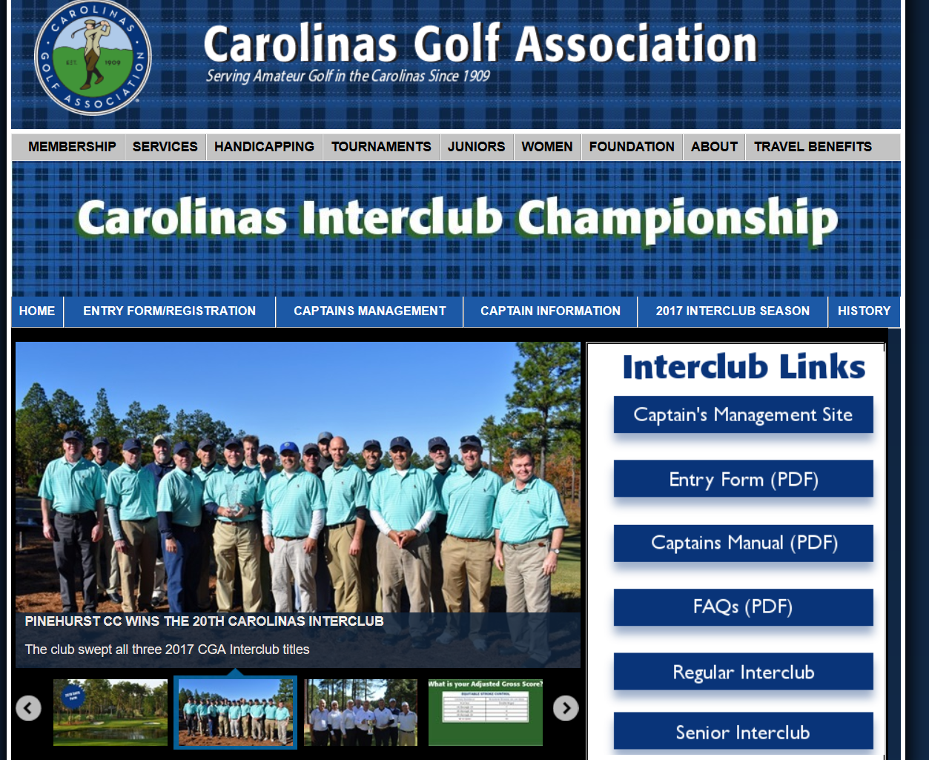

Slide 56
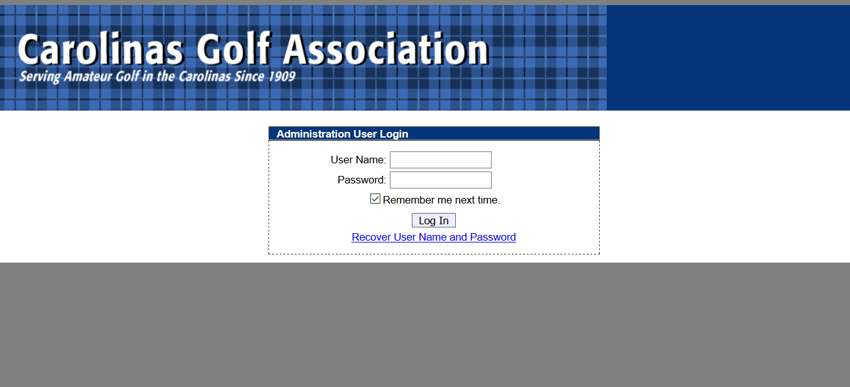
Use your assigned Interclub login ID and Password. If you don’t have one, call or text: Tom Thorpe @ 336-575-0447 or Chris Zeh @ 910-687-6868

Slide 57
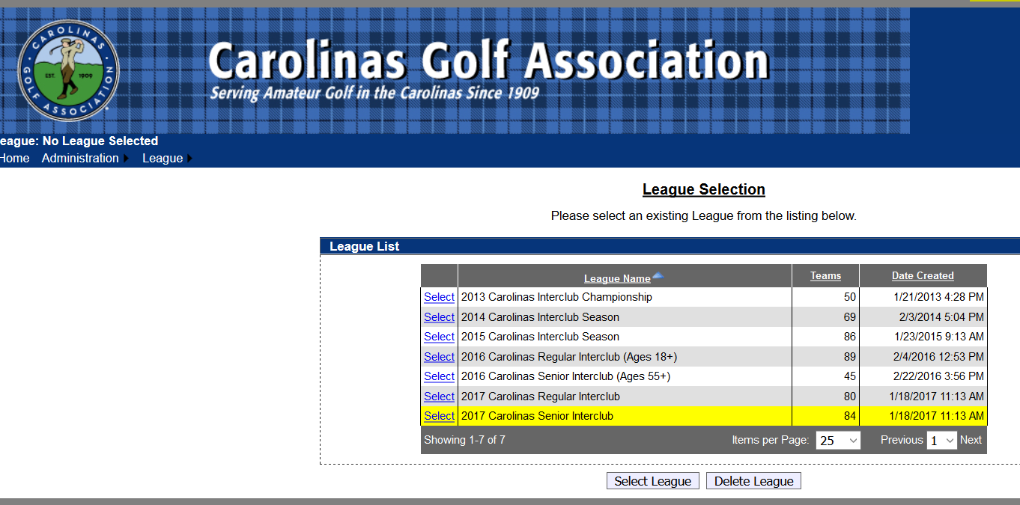
HOW TO SET TEAM ROSTERS
Select the correct league to administer your teams info

Slide 58
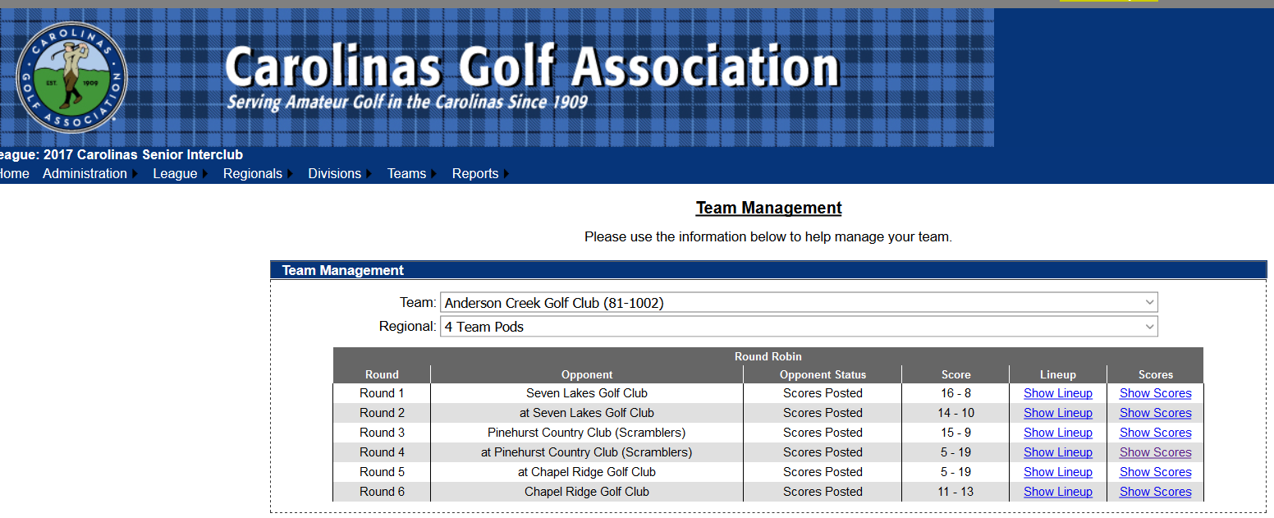
HOW TO SET TEAM ROSTERS
Under the Teams tab in the top left, . . . . . .

Slide 59
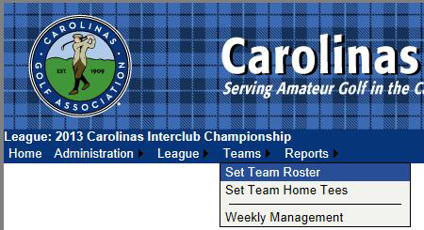
HOW TO SET TEAM ROSTERS
Select Set Team Roster.

Slide 60
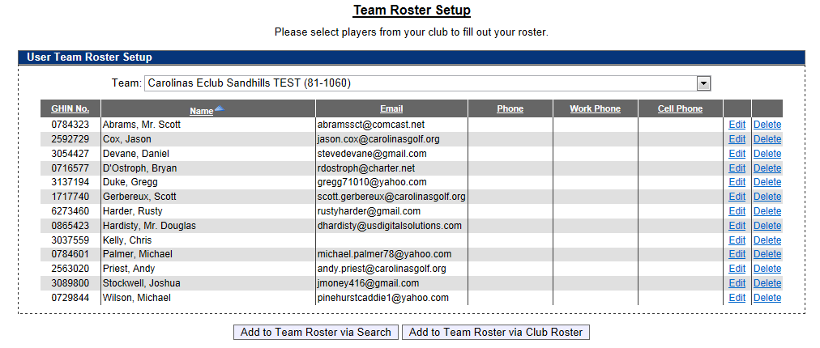
HOW TO SET TEAM ROSTERS
Select Add to Team Roster via Club Roster to bring up your club’s entire handicap roster.

Slide 61
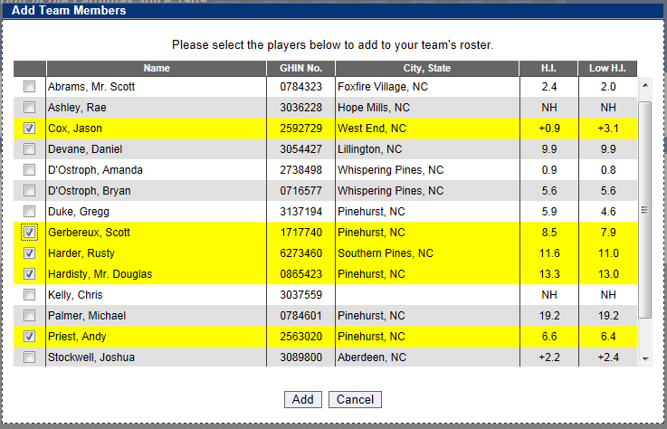
HOW TO SET TEAM ROSTERS
Select all players that you wish to participate during the season. Players are listed in alphabetical order.
You can choose all eligible players on your club’s roster (recommend minimum of 20).
You can add players from this list throughout the season; you do not need to put all players on your team immediately.
Remember, their low index must 18.4 or less for Regular Interclub play.
Click Add to add players to team roster.

Slide 62
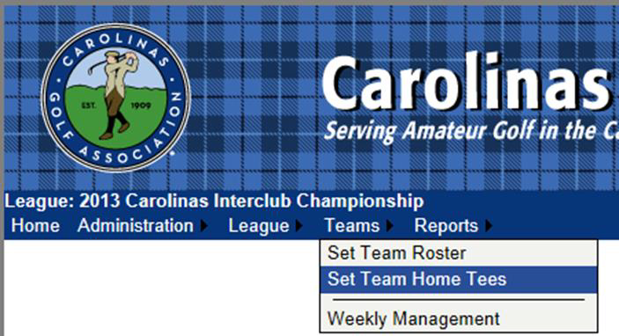
HOW TO SET HOME TEES
Under the Teams tab, select Set Team Home Tees

Slide 63
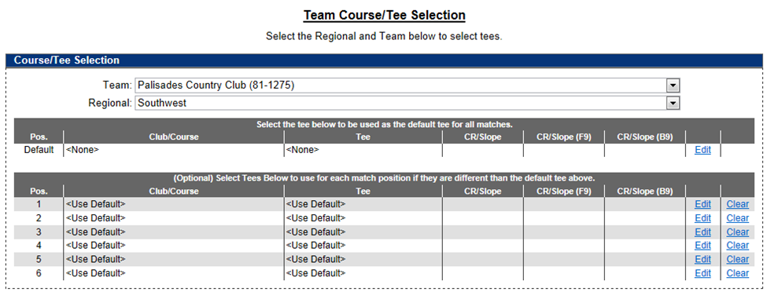
HOW TO SET HOME TEES
To set default tee for all matches, click Edit under the header “Select the tee below to be used as the default tee for all matches”.

Slide 64
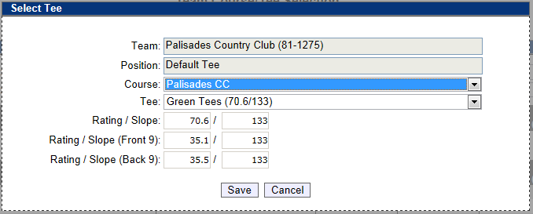
HOW TO SET HOME TEES
Select the Course name and then select the Tee to be played for all matches. Click SAVE once correct tee is selected. As per interclub rules, each player will play from this tee in all matches.

Slide 65
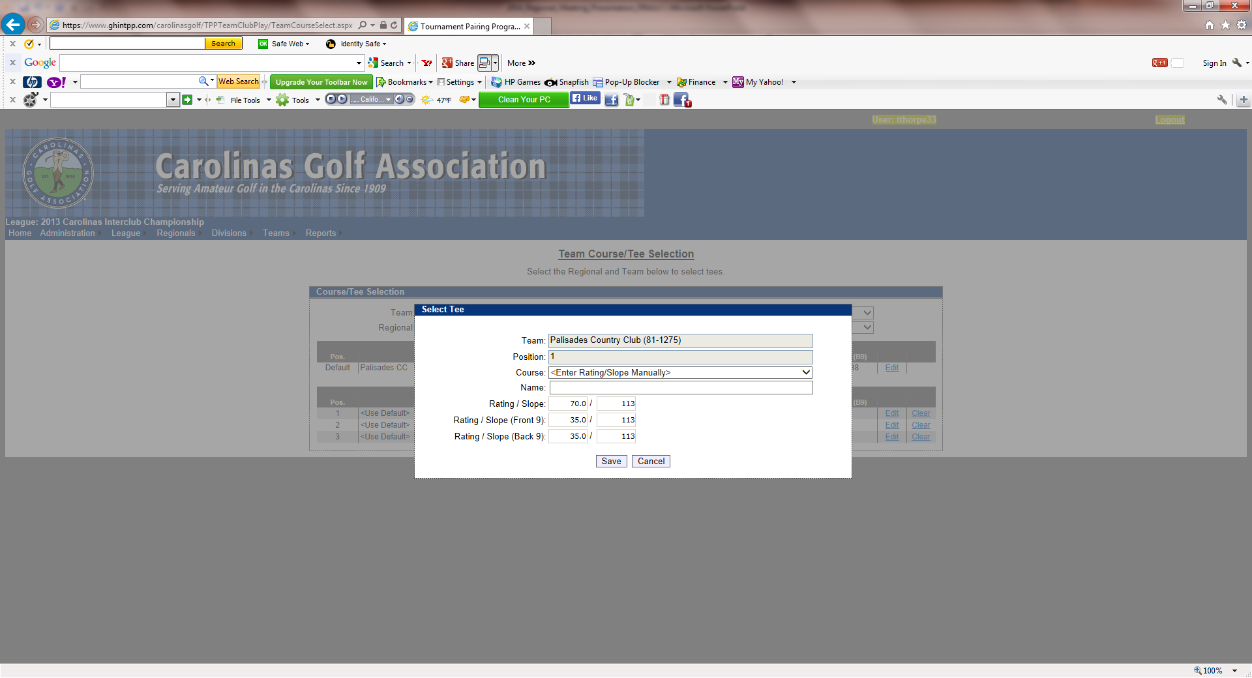
HOW TO SET HOME TEES
If you are using a combination tee that is not listed, you can manually enter the course rating and slope to better reflect the appropriate tee.
When you are finished, “Use default tee” should be selected for each position. Any tees that are not set will be set to the default tee.

Slide 66
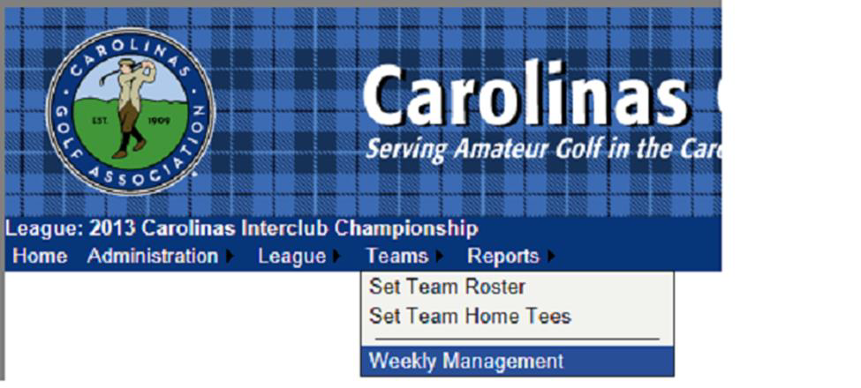
HOW TO SET YOUR MATCH ROSTER
Under the Teams tab, select Weekly Management.

Slide 67
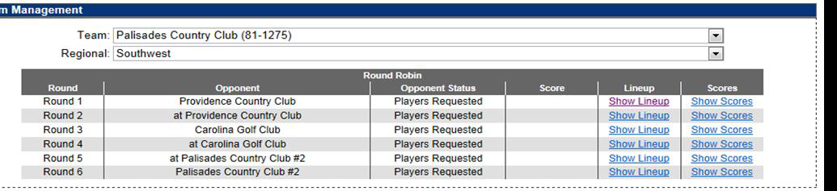
HOW TO SET YOUR MATCH ROSTER
The Team Management menu shows your regular season schedule, from here you can select your match lineup, and input scores for matches.
To select players for a match, click on Show Lineup.
Ignore the Round (1 - 6) order. Matches can be scheduled in any order.

Slide 68
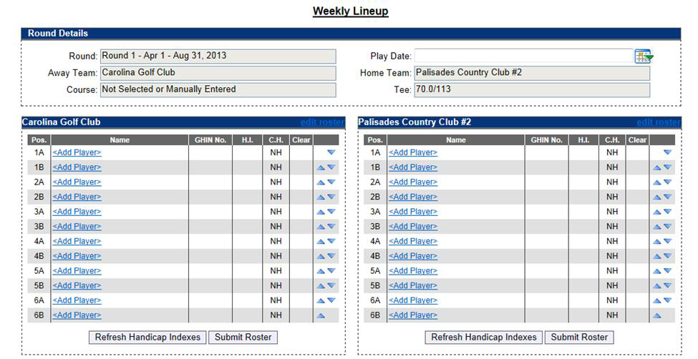
HOW TO SET YOUR MATCH ROSTER
Click on Add Player to select a player from your team roster.
YOU MUST enter the date for each match

Slide 69
REFRESHING PLAYERS HANDICAPS
When match roster complete,
Refresh Handicap Indexes
Players handicaps (on GHIN) are revised on the 15th and 30th / 31st. Captains need to coordinate refreshing hdcps when these dates are close to a match date.

Slide 70
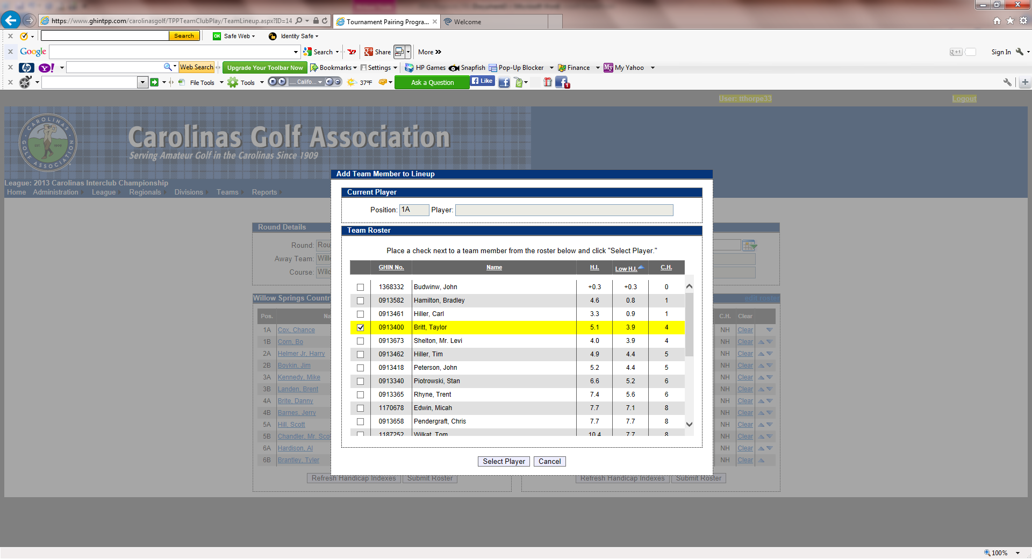
HOW TO SET YOUR MATCH ROSTER
Select whichever player you want
Players can be sorted alphabetically, by handicap index, course handicap, or GHIN number by clicking on the category header.
Players must be selected one at a time.

Slide 71
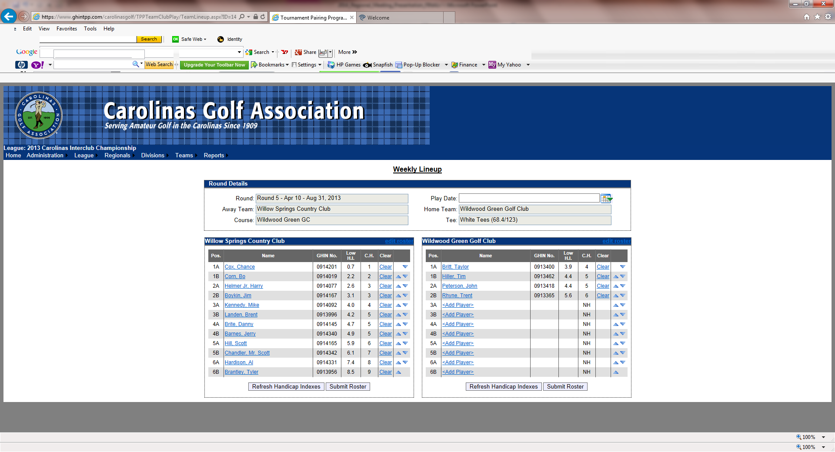
HOW TO SET YOUR MATCH ROSTER
Players need to be listed in handicap order, use the arrows on the right of the screen to put them in the correct order.
The Player in position 1A will play four-ball with the player in position 1B and so forth.
Make sure to click Submit Roster when you finish.

Slide 72
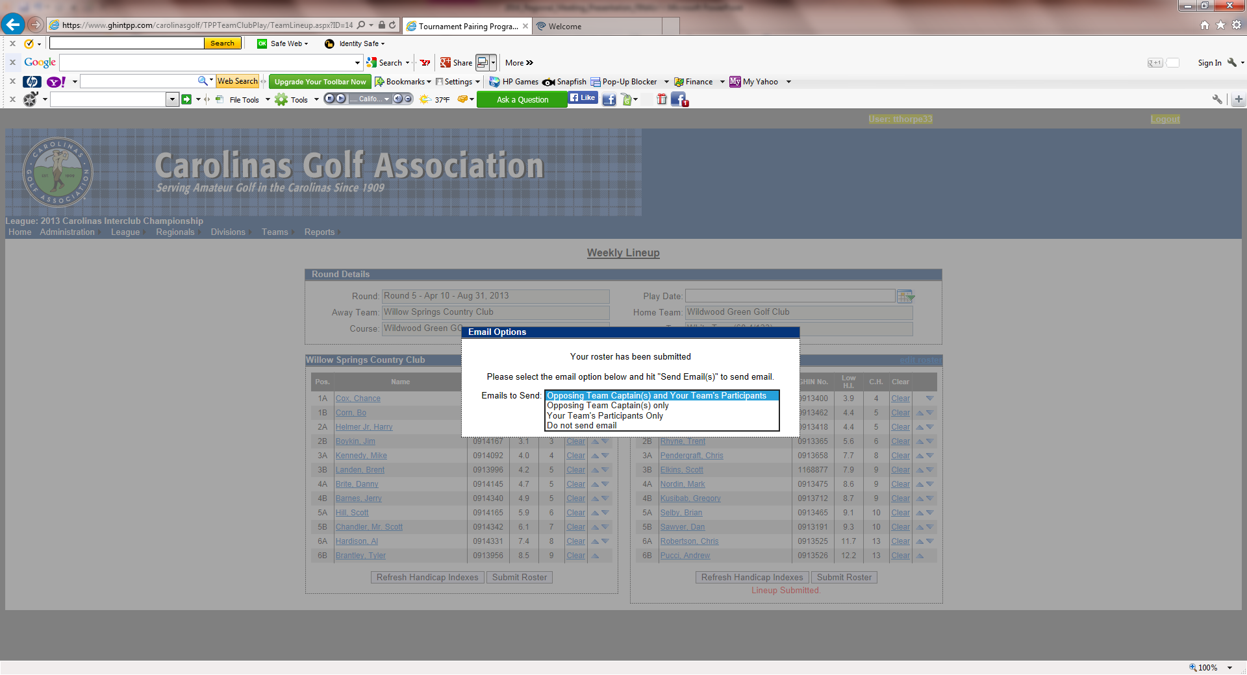
HOW TO SET YOUR MATCH ROSTER
11.You have the option of e-mailing your roster to:
  The opposing team captain(s)
  The opposing team captain(s) and your players (if they have a TPP profile)
  Your players only
  Don’t send any e-mail

Slide 73
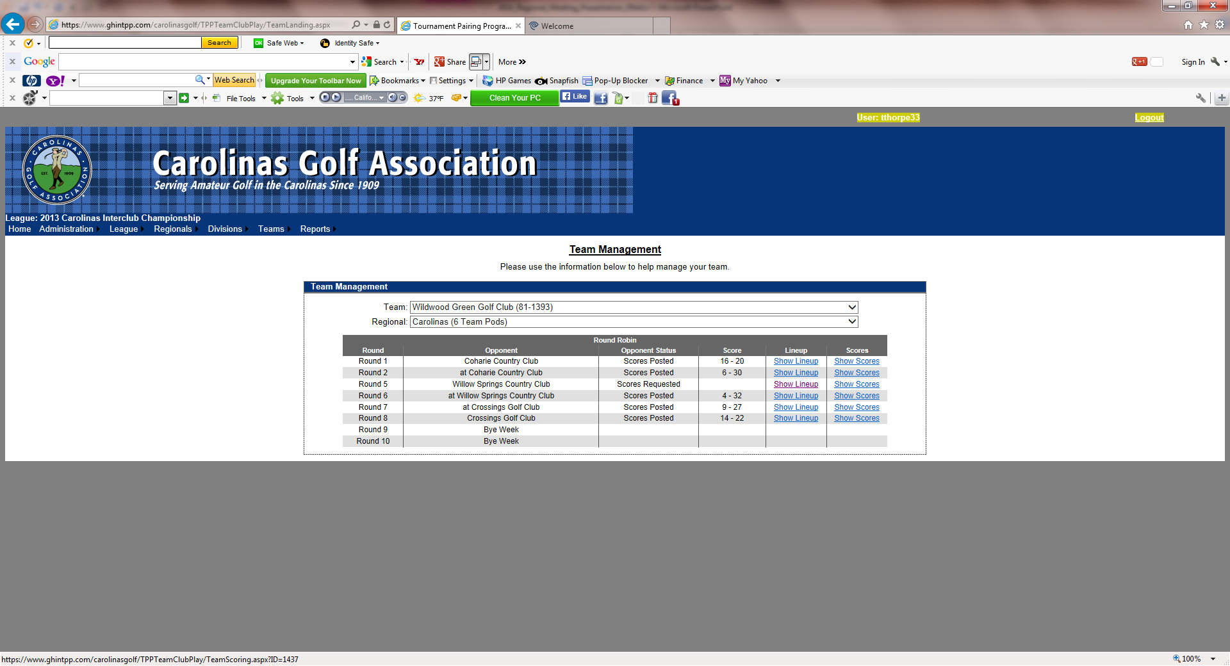
HOW TO SET YOUR MATCH ROSTER
When all players have been entered click Teams tab. Select Weekly Management, then select Show Scores. This will bring up your Weekly Scorecard.

Slide 74
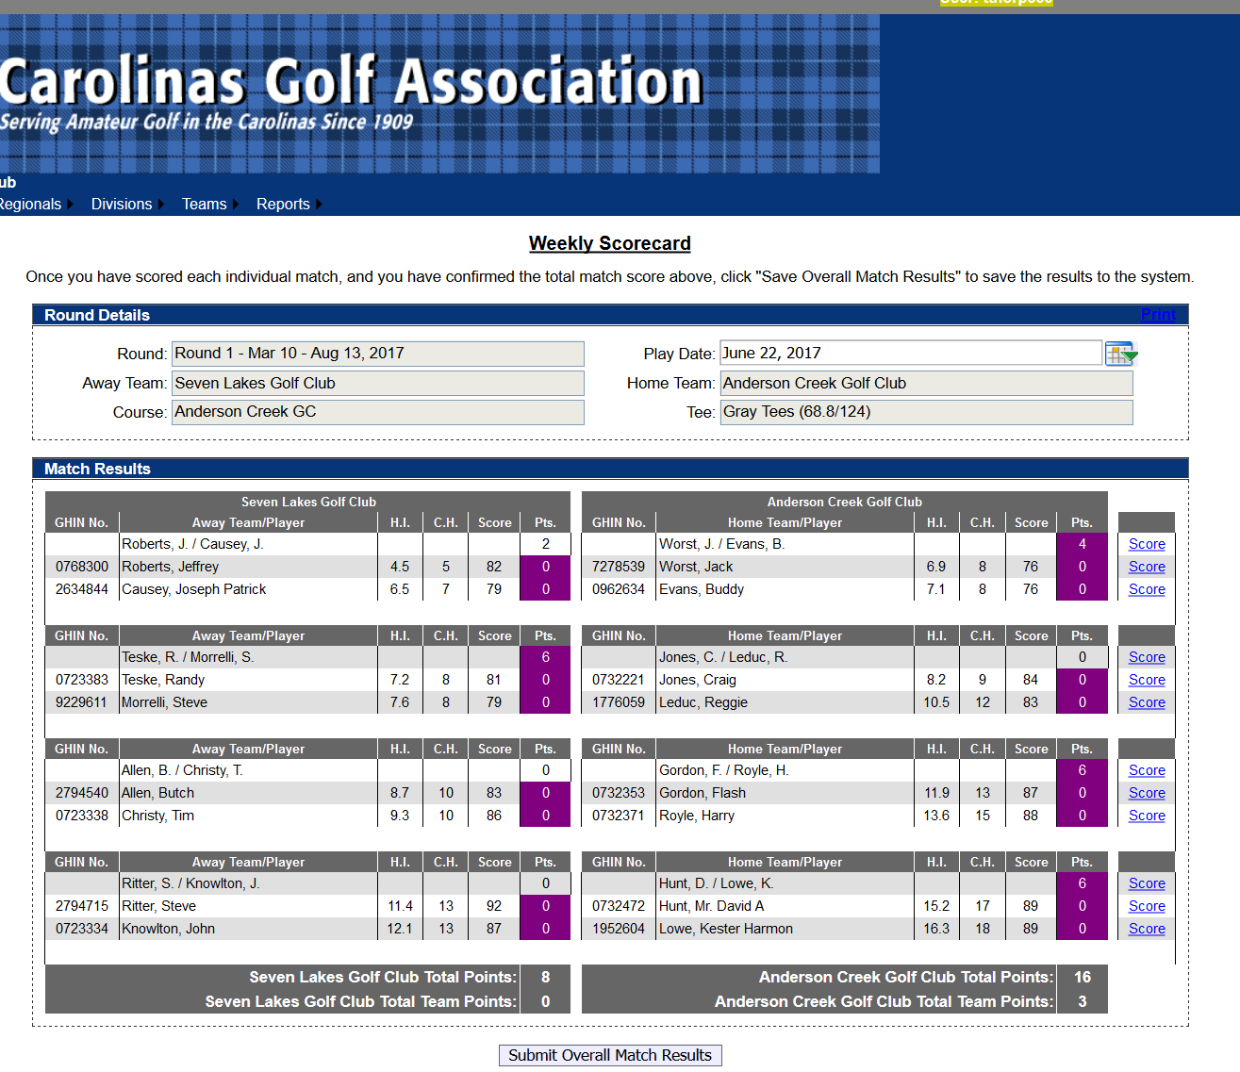
HOW TO SET YOUR MATCH ROSTER
Print
Don’t forget to set Date
To print off your match worksheet click on Print on the top right side of the screen.

Slide 75
HOW TO SUBMIT MATCH RESULTS with PLAYER SCORES
Under the Teams tab, select Weekly Management.

Slide 76
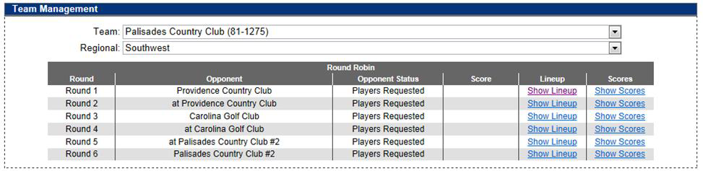
HOW TO SUBMIT MATCH RESULTS with PLAYER SCORES
Select Show Scores for the appropriate match when you are ready to input match scores.

Slide 77
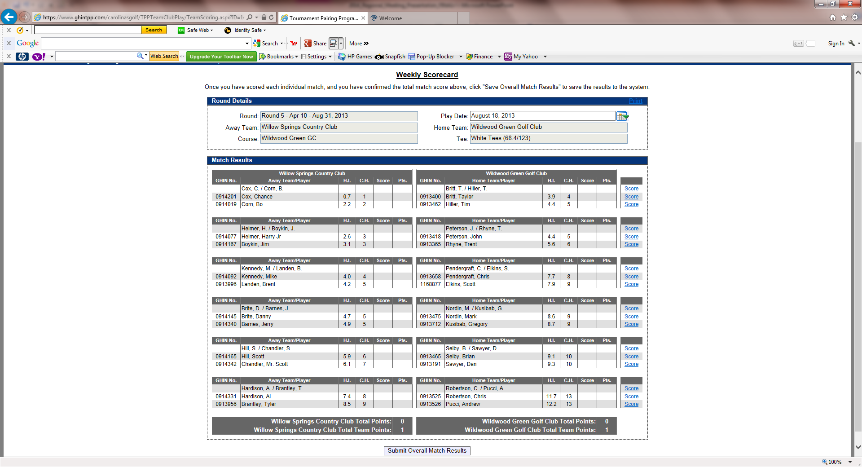
HOW TO SUBMIT MATCH RESULTS with PLAYER SCORES
To input results, click on Score for each team match.

Slide 78
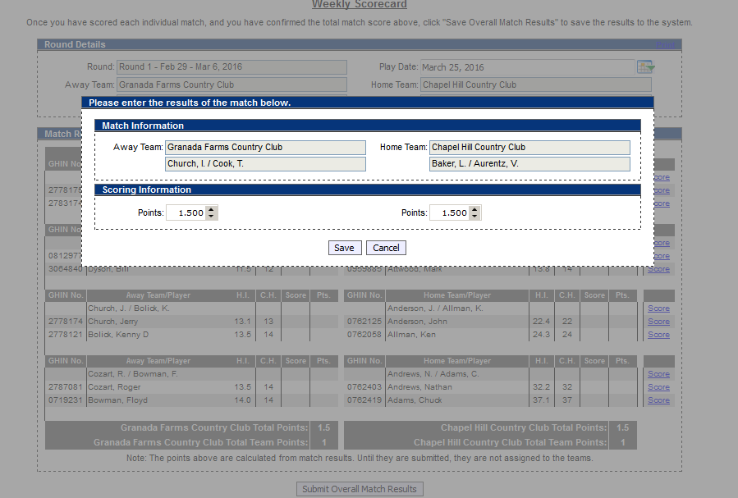
HOW TO SUBMIT MATCH RESULTS with PLAYER SCORES
For each match assign points won per team (0 - 6), and hit Save.
Pod results, standings and players gross scores are updated automatically.

Slide 79
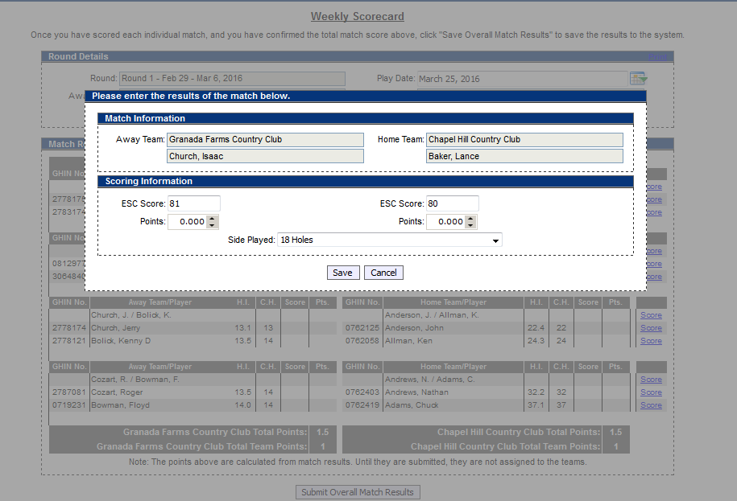
HOW TO SUBMIT MATCH RESULTS with PLAYER SCORES
For each player, you have to enter their ESC gross score. Do not enter any points on this screen. Click Save.
You can also specify if the match was played over 18 holes or just 9 holes. If it was only 9 holes, you would input the 9 hole score.

Slide 80
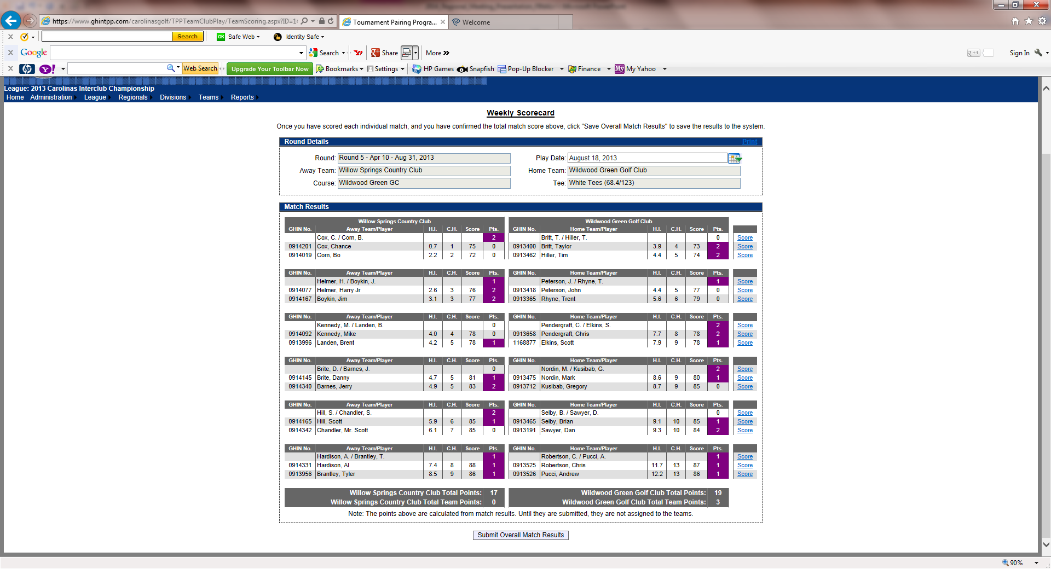
HOW TO SUBMIT MATCH RESULTS with PLAYER SCORES
  Don’t forget to
  PRINT results form
  Don’t forget to
  Set match date
When all match results are filled out, match and overall points will be calculated for you.
Make sure to hit Submit Overall Match Results at the bottom of the screen.

Slide 81
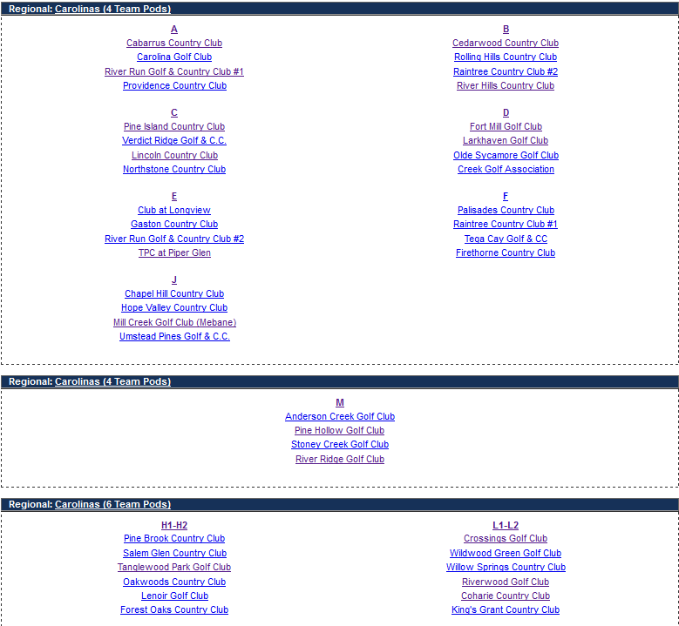
WEB LAYOUT will Look Something Like This for each League

Slide 82
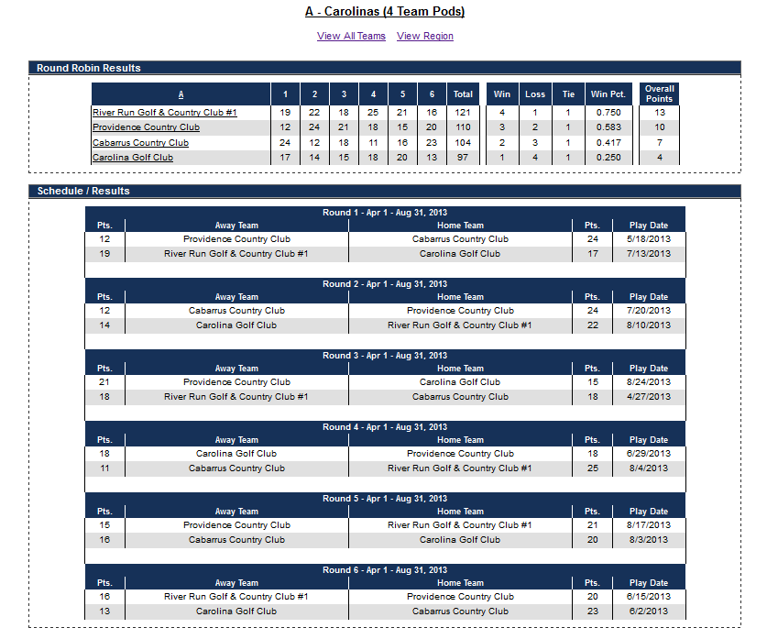
WEB LAYOUT will Look Something Like This – REGION VIEW

Slide 83
Any Questions ?

Slide 84
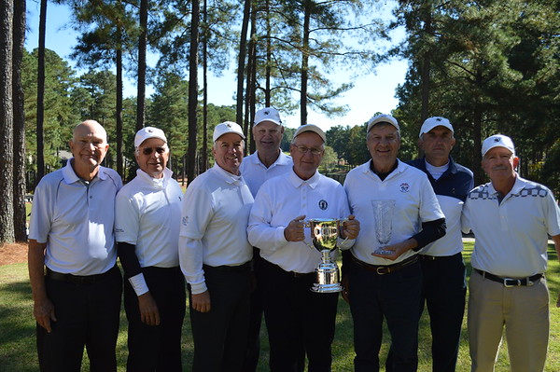
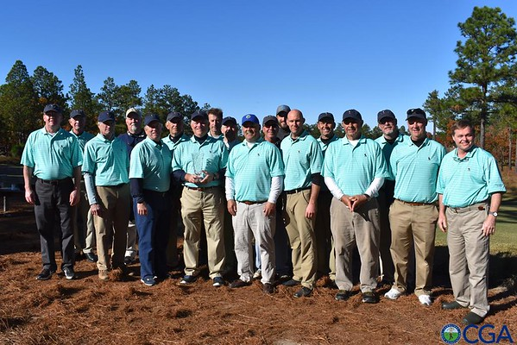
Captains 1st Duty - Assemble your Team
2017
SENIOR Champions
Pinehurst CC
at Pinewild CC
2017
REGULAR Champions
Pinehurst CC #1
at the Dormie Club

Slide 85
Scoreboard

Slide 86
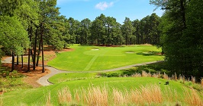
CGA Interclub Finals
(SENIOR)
2018
Final Four
Pine Needles Resort
Southern Pines, NC
Semi-Finals
Thur Oct 25
Championship
Fri Oct 26

Slide 87
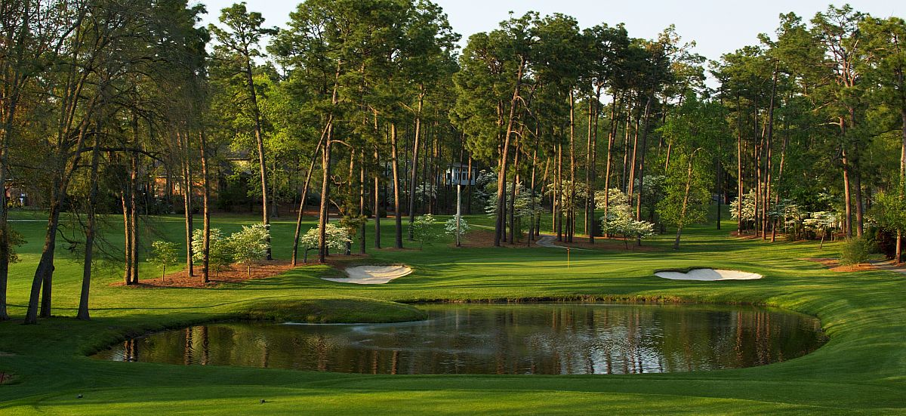
CGA Interclub Final Four (REGULAR)
2018
Final Four
  Pinehurst CC #5
Pinehurst, NC
Semi-Finals
Sat Nov 10
Championship
Sun Nov 11

Slide 88
2018 Pods
  NOTE: Pods will be listed in TPP once they are confirmed.
and now the fun begins. . . . or in my case continues

Slide 89
Northern & Eastern Regions (REGULAR)
RA
Hasentree
Lonnie Poole GC
North Ridge CC
UNC Finley
RE
Mill Creek GC *
Siler City CC
Stoney Creek GC
Umstead Pines
RB
Duke University GC
Hope Valley CC
MacGregor Downs CC
Pinehurst (#1-6) CC *
RF
Chapel Hill CC *
Croasdaile CC *
Highland CC *
Pinehurst #7 & #9
Pine Needles Resort
RC
Lochmere GC
Pine Hollow GC
Riverwood GC
Wildwood Green GC
RJ
Forest Oaks CC *
Salem Glen CC
Maple Chase G&CC
Oak Valley GC
RD
Bentwinds
Club @ 12 Oaks
Falls Village GC
Preserve at Jordan Lake

Slide 90
Southern / Western Regions (REGULAR)
RH
Cabarrus CC #1
Palisades CC *
Providence CC
TPC Piper Glen #1
RL
Northstone CC #1
Olde Sycamore
Pine Island CC
Verdict Ridge CC *
RI
Cabarrus CC #2
Cowans Ford
Northstone CC #2
River Run CC
RM
Ballantyne CC
Club at Longview
Gaston CC
TPC Piper Glen #2
RJ
Cramer Mountain
River Hills CC *
Tega Cay #2
Waterford GC
RN
Cedarwood CC
Pine Lake CC *
Raintree CC *
Rolling Hills CC
RK
CC of Lexington
Fort Mill *
Rock Hill CC
Springfield GC
Tega Cay #1
RO
Highland Creek GC #1
Highland Creek GC #2
Lincoln CC
Marion Lake GC

Slide 91
Eastern Regions (SENIOR)
SA
Bentwinds CC *
Chapel Hill CC *
Club at 12 Oaks
Devils Ridge CC #2 *
SE
Lochmere GC *
Riverwood G&A Club*
Umstead Pines
Wildwood Green
SI
Croasdaile CC *
Devils Ridge GC #1 *
Preserve at Jordan Lake
Wakefield Plantation
SB
Brier Creek GC
Hasentree
Heritage GC
Lonnie Poole GC
SF
Duke University GC
Governors Club
Hope Valley
Pinehurst CC #7
SJ
Anderson Creek GC
Beacon Ridge
Chapel Ridge
Pinehurst CC (Scramblers)*
SC
Highland CC *
Pine Needles Resort *
Pinehurst #9
Pinewild CC
SG
Crossings GC, The *
Forest Oaks CC *
Mill Creek GC *
Stoney Creek GC
SD
Carolina Trace CC
Gates Four G&CC
Legacy GC
Mid South/Talamore
Pinehurst CC (MGA)
SH
Lane Tree Golf Club
Timberlake GC *
Willow Springs CC *

Slide 92
Northern Regions (SENIOR)
SK
Bermuda Run CC
High Point CC (Willow Creek)
Meadowlands GC
Tanglewood Men's GA
SL
Maple Chase G&CC
Oak Valley GC *
Salem Glen CC
SM
Forsyth CC
Greensboro CC
Old Town Club *
Starmount Forest CC *

Slide 93
Western & Coastal Regions (SENIOR)
SN
Olde Sycamore GP
Skybrook GC *
Tega Cay
Waterford GC
SR(a & b)
a1 Berkeley Hall Club
a2 Kiawah Island (Cassique/River)
a3 Daniel Island Club #1
b1 Belfair
b2 CC of Charleston
b3 Seabrook Island #1
SU
Cobb's Glen CC *
Links at Stoney Point *
Patriot GC at Grand Harbour
Preserve at Verdae *
Walker Course (Clemson)
SO
Cramer Mountain Club
Pine Lakes CC
Raintree CC *
TPC Piper Glen
SS
Daniel Island Club #2 *
Kiawah Island (Gov’s Club)
Pawleys Plantation
Tradition
SP
Carolina Lakes GC
Red Bridge GC
River Hills CC *
Rock Hill CC
ST
Bulls Bay
Grande Dunes Members Club
Rivertowne CC
Seabrook Island #2
SQ
Cowans Ford
Northstone CC
River Run CC
Verdict Ridge CC *

Slide 94

CGA Interclub Competition
SUMMARY
  Meet with Group/Pod Captains
    schedule matches in TPP
    discuss fees, social, tees, etc.
  Create Team Roster in TPP
  Set Tees in TPP
  Hold Team Meeting
    discuss rules, format
      match play & interclub
    determine sign-up procedures
  Prior to a Match
    refer to Captains checklist
    prepare match roster in TPP
    verify opponents rosters
    prepare scorecards (host)
  Submit Results in TPP (host)

