Slide 1

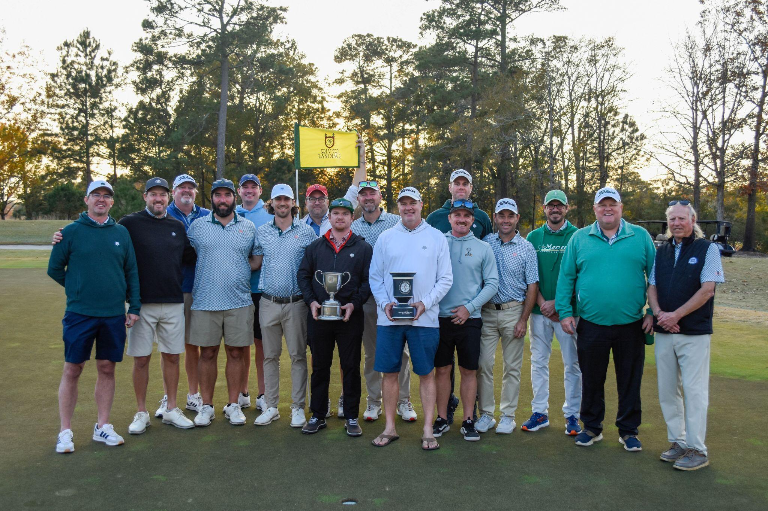
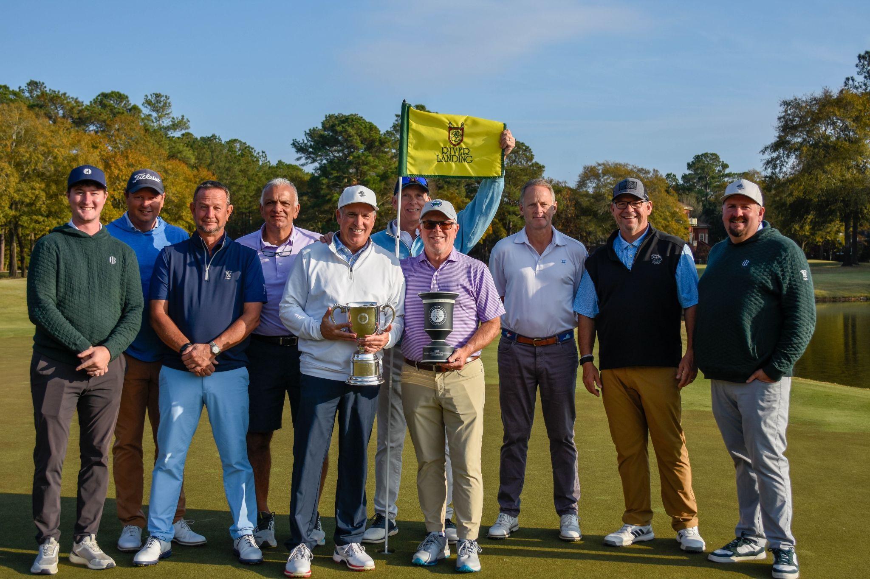
Welcome to the 2026 CGA Carolinas Interclub Captains Meeting!
29th (Carolinas) Championship
11th (Senior) Championship
4th (Super Senior) Championship
Wildwood Green GC ‘Dogwood’
2025 Carolinas Div. Champions
Highland Country Club
2025 Senior Div. Champions

Slide 2
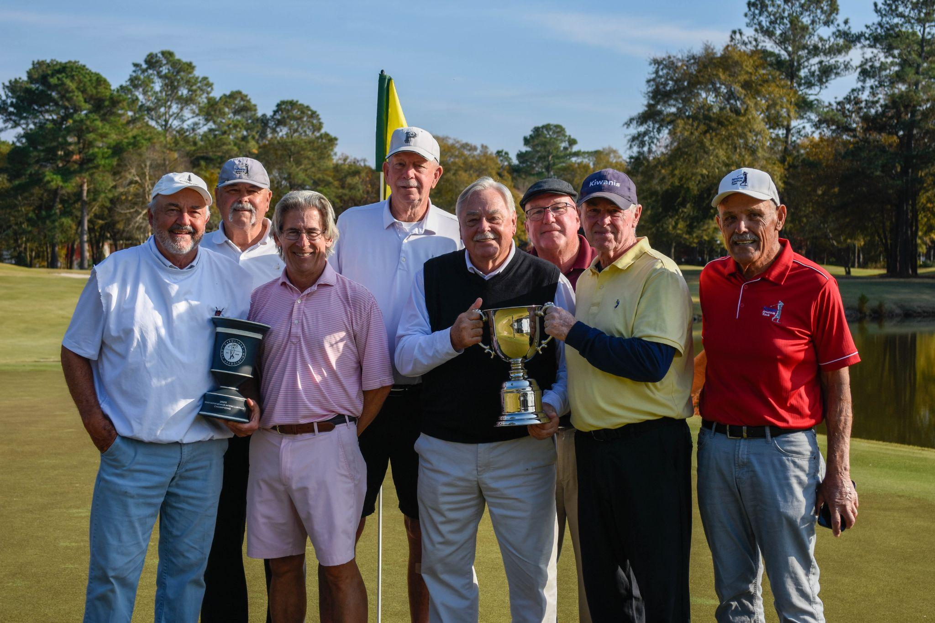
Southern Pines GC
3rd Super Senior Div. Champions

Slide 3
NEW Divisions for 2026 & beyond!
Women’s Division (net)
18 years old & older
Gross Division (no handicaps/no net)
18 years old & older

Slide 4

2026 Interclub Captains Meetings
o February 17th: 5:30 -7:00pm
o February 18th: 5:30-7:00pm
o February 19th: 5:30-7:00pm
  Golf Genius Manual Review
  Recordings of each meeting will be available under the ‘Captain’s Meetings’ tab on the Interclub website
Housekeeping Items:
Please keep your device always muted
If you have a question, write it down. Do not interrupt the presentation with a question.
We will periodically pause to answer questions about what was just covered.
Please do not converse in the chat

Slide 5



Interclub Administration
Hogan May – Assistant Director of Championships & Tournaments
Tom Thorpe – Interclub Administrator
Kevin Haracz - Senior Director of Member Services
CGA Interclub Email - interclub@carolinasgolf.org
CGA Interclub Phone # 910-673-1000 Ext. 3

Slide 6



Interclub Administration
Jim Douglass – Director of Handicapping
Anna Kathryn Herring – Manager of Member Services
Annie Grace Herman – Manager of Member Services
CGA Interclub Email - interclub@carolinasgolf.org
CGA Interclub Phone # 910-673-1000 Ext. 3

Slide 7
When EMAILING, TEXTING or CALLING w/ QUESTIONS,
PLEASE INDICATE:
Full Team Name (i.e. Augusta National 1)
  Which DIVISION your team is in
    Pod # (optional i.e. sA)
      Most importantly, your LAST NAME
Please cc all Interclub Admin staff

Slide 8
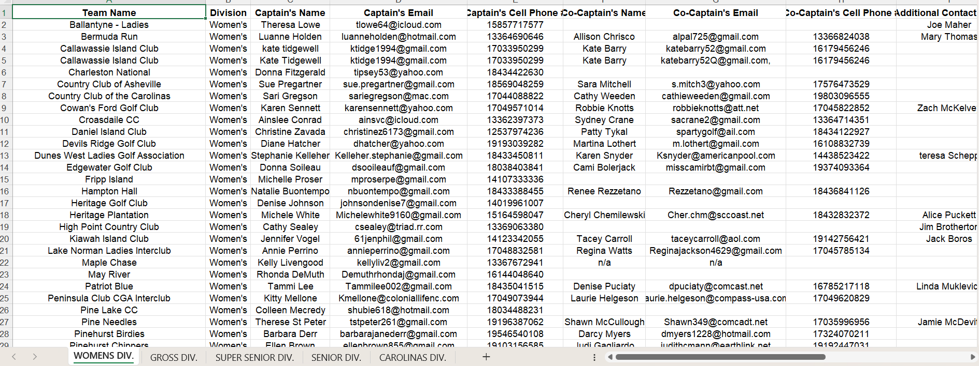
2026 Contact Information Sheet Based on Entry Forms
Available on the Interclub Website under ‘Captains Tools’ Tab

Slide 9
Agenda
Brief Interclub Overview (Who we are)
Discuss Important Sections of the Interclub Manual
  Eligibility / Format / Procedures

Slide 10
CGA Carolinas Interclub Background
For New Captains/Teams
Started in 1997 (18+ Division only)
Similar to So. Cal & Florida Golf Associations
Approximately 48 Teams in 2007 (Before Sr. Division)
Senior Division started in 2016 w/ 40 some teams
232 Teams in 2022 (Before Super Sr. Division)
355 Teams in 2025 (112 Caros; 124 Sr; 119 Super Sr)
140 CGA member clubs in 2025 (103 NC; 37 SC)
5,509 different CGA Members competed in 2025

Slide 11
2026 CGA Interclub Characteristics (Men’s Carolinas, Senior & Super Senior Divisions)
For New Captains/Teams
Format = Net Four-Ball MATCH PLAY
6 Regular season matches: 3 Home and 3 Away
16 players involved in each Team vs Team match
  8 players represent each team
  4, Four-Ball matches in play
Each Four-Ball match involves 1 point per hole
  If the match is over before #18, points can still be won!!
+ Individual match win is worth an additional 2 pts
80 points (4x18, + 4x2) overall in each Team match
A majority of points (40 ½) wins the Team Match

Slide 12
2026 CGA Interclub Characteristics (Women’s & Gross Divisions)
NEW WOMEN’S DIVISION
  Format = Net Four-Ball MATCH PLAY
  6 Regular season matches: 3 Home and 3 Away
  8 players involved in each Team vs Team match
    4 players represent each team
    2 Net Four-Ball matches in play
  Each Four-Ball match involves 1 point per hole
  If the match is over before #18, points can still be won!!
+ Individual match win is worth an additional 2 pts
40 points (2x18, + 2x2) overall in each Team vs Team match
A majority of points (20 ½) wins the Team vs Team Match

Slide 13
2026 CGA Interclub Characteristics (Women’s & Gross Divisions)
NEW GROSS DIVISION (NO HANDICAPS)
  Format = Four-Ball MATCH PLAY
  6 Regular season matches: 3 Home and 3 Away
  8 players involved in each Team vs Team match
    4 players represent each team
    2 Four-Ball matches in play
  Each Four-Ball match involves 1 point per hole
  If the match is over before #18, points can still be won!!
+ Individual match win is worth an additional 2 pts
40 points (2x18, + 2x2) overall in each Team vs Team match
A majority of points (20 ½) wins the Team vs Team Match

Slide 14
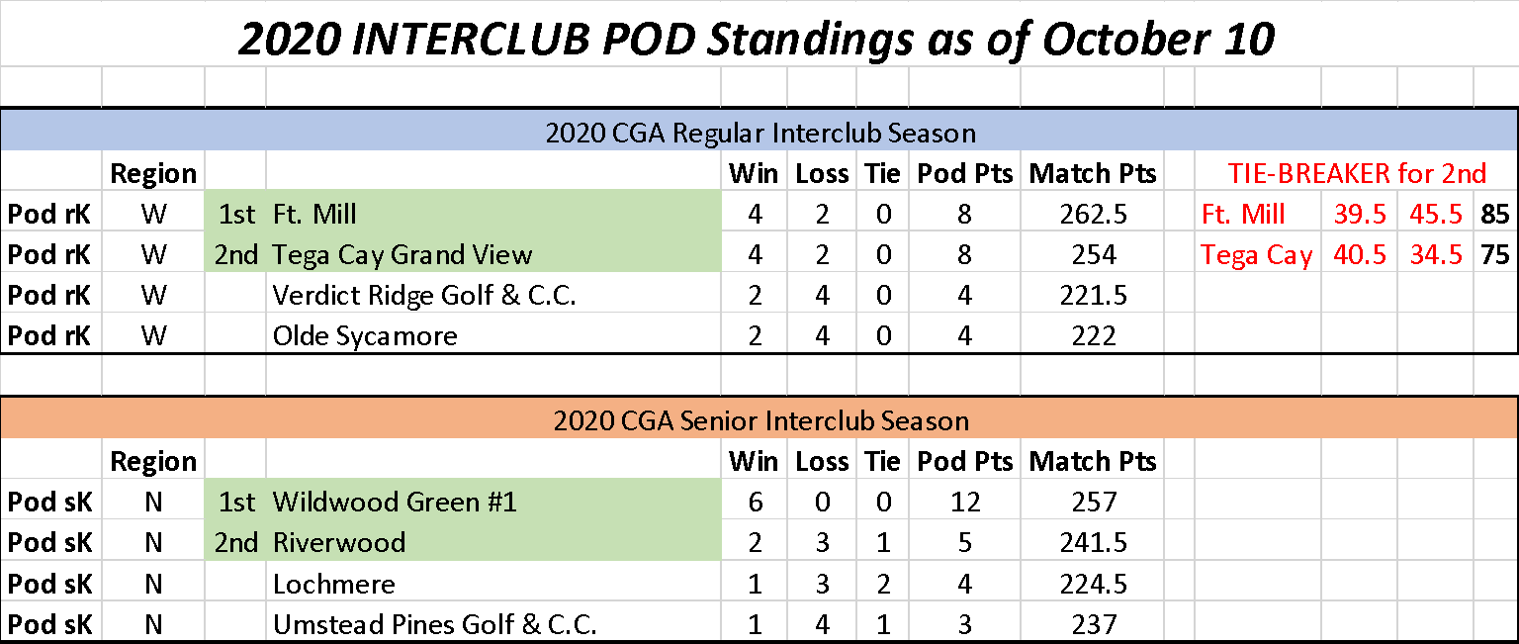
2026 CGA Interclub Characteristics cont’d
A TEAM win equals 2 pts in the Pod Standings.
Ties (40-40 or 20-20) earns each team 1 point.

Slide 15
2026 CGA Interclub Characteristics cont’d
Regular season:
  Sunday, March 1 – Sunday, July 26 (NO EXTENSIONS PERMITTED)
  Lineups listed from Low to High using each player’s Low Handicap Index (All Divisions) – subject to change for Gross in 2027
  No Sudden Death playoff if Team vs Team match ends in a tie
Playoff matches begin Monday, August 3:
  The Top 64 teams in each division qualify (Carolinas, Sr. & Super Sr.).
  Matchups based on Pod standings/Record + Accumulated Match Pts by REGION
  Single elimination (On-Course Playoff if 40-40 tie)
  Playoff matches involve both courses until the Final Four
  Captains determine lineups from lowest 4 & highest 4

Slide 16
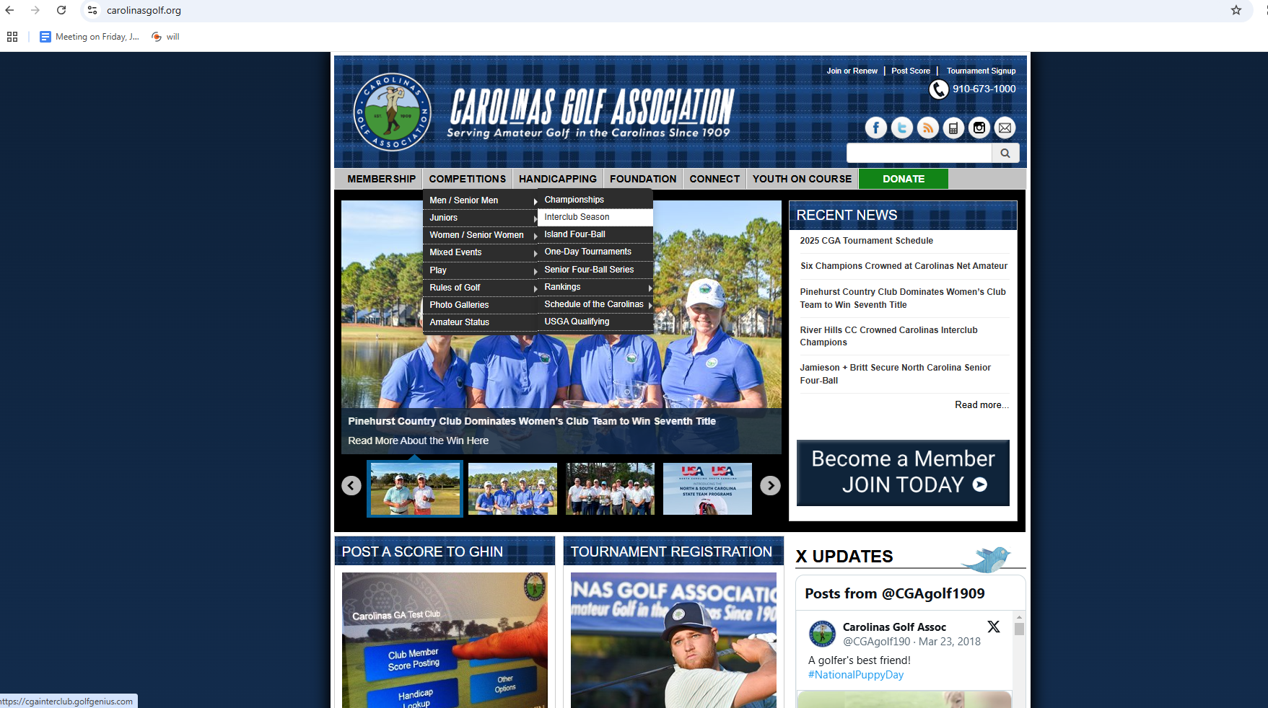
Follow these steps to access the 2026 Captains Manual AND 2026 Golf Genius Manual

Slide 17
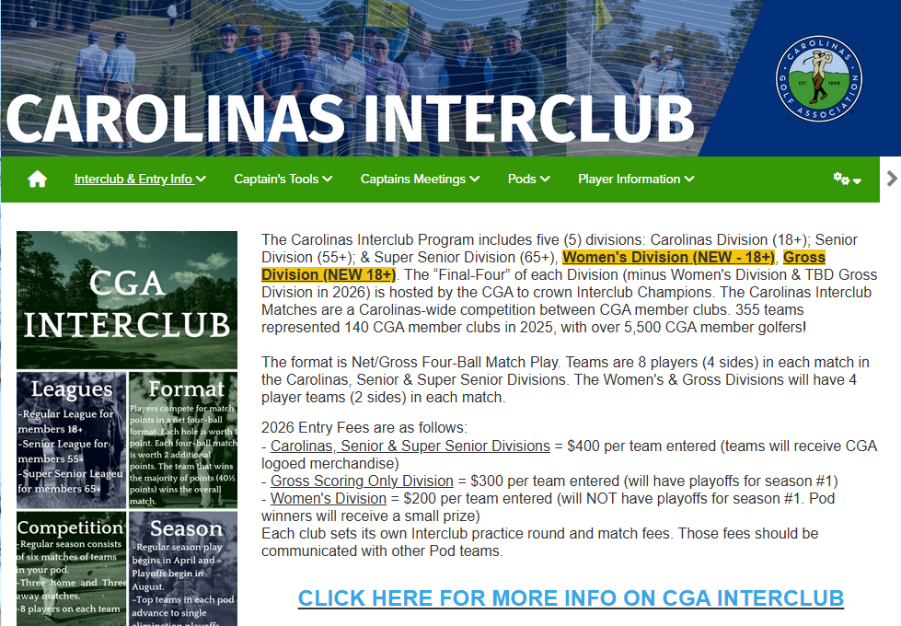
Available under the ‘Interclub Documents’ section

Slide 18

LOOK for the LINKS to these Two Documents +
Official Interclub Golf Genius Manual

Slide 19

Questions

Slide 20
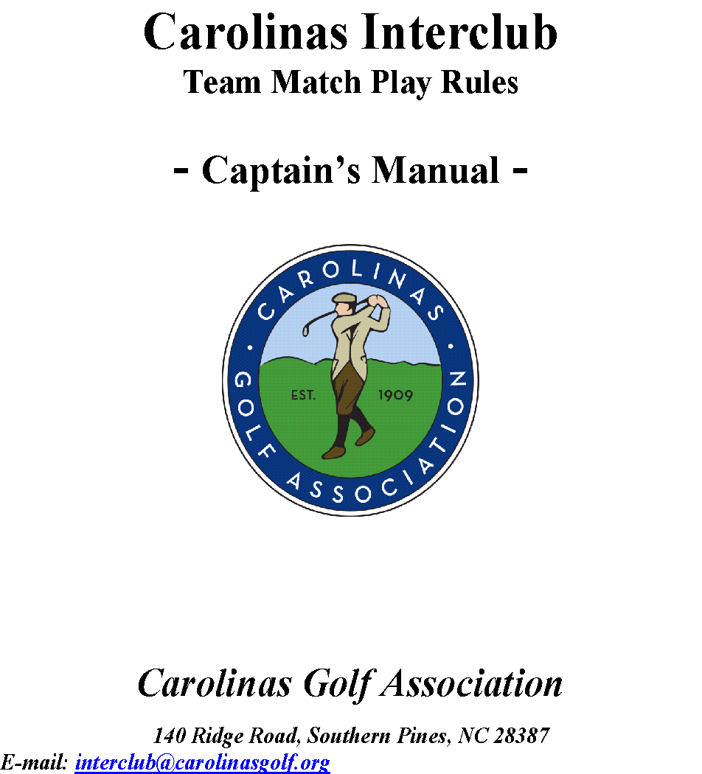

Slide 21
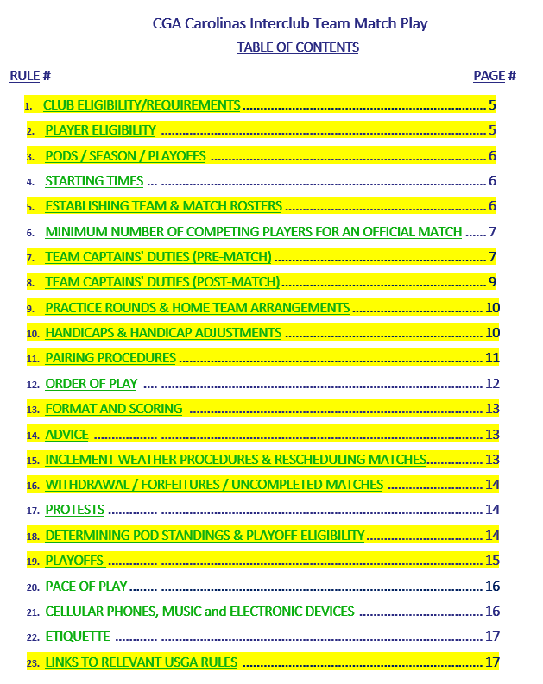

Slide 22
(Rule #1) CLUB ELIGIBILITY/REQUIREMENTS
ALL CLUBS:
Must be members and in good standing with the Carolinas Golf Association
Must be a Type 1 Club as of 2023 (Refer to USGA Club Explanations)
Must be authorized to issue a Handicap Index® and have a formal Handicap Committee established. It is recommended that the Committee be comprised of at least three and be an odd number of volunteers. The Handicap Committee should be chaired be a member of the golf club. A club employee is encouraged to serve on the Committee or participate in an advisory role but should not serve as chair.
Must have a regulation length golf course with a valid Course Rating™ and Slope Rating™ (see Interclub Rule 7.D for yardage requirements)
Have the option to offer practice rounds (See Interclub Rule 9)
COURSE USAGE POLICY: Shall make course available for regular season matches, make-up matches, and potential Playoff matches

Slide 23
(Rule #2) PLAYER ELIGIBILITY – Carolinas, Senior & Super Senior Divisions
Must be male members of a CGA member club AND in good standing with the CGA
Must be an amateur golfer (with the exception of NON-AMATEURS below)
MUST be actively listed on the club’s GHIN handicap roster
MUST have an established Low Handicap Index (Low H.I.)
  NOTE: It takes 20 posted scores in GHIN to establish a Low H.I.
MUST have 10 posted scores in GHIN within the past 12 months from match date
  CANNOT POST SCORES MORE THAN ONE (1) WEEK OLD IN ORDER TO BECOME ELIGIBLE
Must be age eligible
    •18+ (CAROLINAS Division) • 55+ (SENIOR Division) • 65+ (SUPER SENIOR)
Restricted to 1 team PER DIVISION in the current season
  May compete for a different club in a different division
Multi-Club Members may play for multiple teams, but NOT within the same division
NON-AMATEURS:
Club staff/employees/members with non-amateur status are eligible to compete in Interclub competition but MUST meet the above player eligibility requirements. The included (but not limited to) Golf Professionals and Members who have maintained professional status.
NOTE – Players may become eligible mid-season (i.e. turning 65 May 1)

Slide 24
(Rule #2) PLAYER ELIGIBILITY – Women’s Division
Must be female members of a CGA member club AND in good standing with the CGA
Must be an amateur golfer (with the exception of NON-AMATEURS below)
MUST be actively listed on the club’s GHIN handicap roster
MUST have an established Low Handicap Index (Low H.I.)
  NOTE: It takes 20 posted scores in GHIN to establish a Low H.I.
MUST have 10 posted scores in GHIN within the past 12 months from match date
  CANNOT POST SCORES MORE THAN ONE (1) WEEK OLD IN ORDER TO BECOME ELIGIBLE
Must be age eligible – 18+ years old as of the applicable match date
Restricted to competing for 1 team in the current season
NON-AMATEURS:
Club staff/employees/members with non-amateur status are eligible to compete in Interclub competition but MUST meet the above player eligibility requirements. The included (but not limited to) Golf Professionals and Members who have maintained professional status.
NOTE – Players may become eligible mid-season (i.e. turning 18 May 1)

Slide 25
(Rule #2) PLAYER ELIGIBILITY – Gross Division
Must be male members of a CGA member club AND in good standing with the CGA
Must be an amateur golfer (with the exception of NON-AMATEURS below)
MUST be actively listed on the club’s GHIN handicap roster
MUST have an established Low Handicap Index (Low H.I.)
  NOTE: It takes 20 posted scores in GHIN to establish a Low H.I.
MUST have 10 posted scores in GHIN within the past 12 months from match date
  CANNOT POST SCORES MORE THAN ONE (1) WEEK OLD IN ORDER TO BECOME ELIGIBLE
Must be age eligible
    •18+ years old as of the applicable match date
Restricted to 1 team PER DIVISION in the current season
  May compete for a different club in a different division
Multi-Club Members may play for multiple teams, but NOT within the same division
NON-AMATEURS:
Club staff/employees/members with non-amateur status are eligible to compete in Interclub competition but MUST meet the above player eligibility requirements. The included (but not limited to) Golf Professionals and Members who have maintained professional status.
NOTE – Players may become eligible mid-season (i.e. turning 18 May 1)

Slide 26
(Rule #3) PODs / Season / Playoffs
PODs may consist of 3, 4, 5, or 6 teams that reside in close proximity
Teams pre-form their own Pod
If in a non-4 team Pod, please send us your match schedule (no dates). Can request Interclub Committee to randomize the schedule.
REGULAR SEASON:
The Regular Season begins Sunday, March 1 and ends Sunday, July 26
CAROLINAS & GROSS Division matches are primarily played on weekends but may be played on weekdays if agreed upon
WOMEN’S, SENIOR & SUPER SENIOR Division matches are primarily played on weekdays but may be played on weekends (clubs with a team in multiple divisions may host/play matches on the same day. Players limited to one (1) match per day)
Captains (with Club assistance) determine practice round/match dates and match fees & any post-match activities

Slide 27
3, 5, and 6 Team Pods
Captains Choose a Letter or CGA will assign
In each Formula, teams choose a letter. Each Team will have 3 home & 3 away matches
3 Team POD | A | @ | B |  | B | @ | A |  | C | @ | A
 | A | @ | C |  | B | @ | C |  | C | @ | B
 | A | @ | B |  | B | @ | C |  | C | @ | A
In addition to the 4 matches "Home & Home", each Team will play the other two teams as 1 at home and 1 away
5 Team POD | A | vs | B |  | B | vs | A |  | C | vs | B |  | D | vs | C |  | E | vs | D
 | A | vs | E |  | B | vs | C |  | C | vs | D |  | D | vs | E |  | E | vs | A
 | A | @ | B |  | B | @ | A |  | C | @ | B |  | D | @ | C |  | E | @ | D
 | A | @ | E |  | B | @ | C |  | C | @ | D |  | D | @ | E |  | E | @ | A
 | A | vs | C |  | B | vs | D |  | C | @ | A |  | D | @ | B |  | E | vs | B
 | A | @ | D |  | B | @ | E |  | C | vs | E |  | D | vs | A |  | E | @ | C
Each Team will play two other teams "Home & Home" and then play the remaining two teams as 1 at Home and 1 Away.
6 Team POD | A | vs | B |  | B | vs | A |  | C | vs | A |  | D | vs | E |  | E | vs | F |  | F | vs | E
 | A | vs | C |  | B | vs | C |  | C | vs | B |  | D | vs | F |  | E | vs | D |  | F | vs | D
 | A | vs | D |  | B | vs | E |  | C | vs | F |  | D | vs | A |  | E | vs | B |  | F | vs | C
 | A | @ | B |  | B | @ | A |  | C | @ | A |  | D | @ | E |  | E | @ | F |  | F | @ | E
 | A | @ | C |  | B | @ | C |  | C | @ | B |  | D | @ | F |  | E | @ | D |  | F | @ | D
 | A | @ | D |  | B | @ | E |  | C | @ | F |  | D | @ | A |  | E | @ | B |  | F | @ | C
Pick 3 teams for division1 and 3 teams for division2. Within each division teams will play "Home & Home".
Then each team in division A will play 1 team in division 2 “Home & Home”
Available on the Interclub website under ‘Pods’ section

Slide 28
Continued - (Rule #3) PODs / Season / Playoffs
PLAYOFFS (Carolinas, Senior & Super Senior Divisions):
Playoffs begin Monday, August 3rd and are single elimination
The Top 64 teams in each of the Men’s Carolinas, Senior & Super Senior divisions will qualify. Pod winners automatically qualify. 2nd place teams in 5 & 6 team pods will also automatically qualify. Any remaining spots are determined by record then accumulated match points (Interclub Rule 18.2).
First/second round matchups are based on region assignment, record/pod standing and accumulated match points. Any variations will be determined by the Interclub Committee.
The Semi-Finals and Finals matches for each division will be hosted simultaneously at the same site in late October/early November.
Playoff structure subject to change in 2027. TBD.

Slide 29
(Rule #5) ESTABLISHING TEAM & MATCH ROSTERS
Carolinas, Senior & Super Senior Divisions
TEAM ROSTERS:
  No limit as to the number of eligible players listed
  MUST have a minimum of 12 players
  Please upload all your players at the start of the season (or on Sundays for handicap update on Mondays)
MATCH ROSTERS (Regular Season & Playoffs)
  Consist of 8 competing players from each team
  Minimum of 4 players (per team) for an official match
  Alternate player allowed (if eligible, already on roster & readily available) Interclub Rule 11 Notes 1-4
PLAYOFF ELIGIBILITY: MUST compete in 1 regular season match
  If a player was listed on the match roster of a forfeited match, he is eligible for the playoffs (must be listed in the pairings prior to forfeit)
CLUB(s) may sponsor more than one team in a division with;
  Separate entry form, Team Roster, balanced HDCPs
  Pod availability
  NOTE: Players may only represent ONE team PER division

Slide 30
(Rule #5) ESTABLISHING TEAM & MATCH ROSTERS
Women’s & Gross Divisions
TEAM ROSTERS:
  No limit as to the number of eligible players listed
  MUST have a minimum of 6 players
  Please upload all your players at the start of the season (or on Sundays for handicap update on Mondays)
MATCH ROSTERS (Regular Season & Playoffs)
  Consist of 4 competing players from each team
  Minimum of 2 players (per team) for an official match
  Alternate player allowed (if eligible, already on roster & readily available) Interclub Rule 11 Notes 1-4
CLUB(s) may sponsor more than one team in a division with;
  Separate entry form, Team Roster, balanced HDCPs
  Pod availability
  NOTE: Players may only represent ONE team PER division

Slide 31

Rule #7 TEAM CAPTAINS' DUTIES – Pre Match
C. Setting Match Rosters
  Captains prepare their match rosters in Golf Genius
  Lineups are set in Low to High, Low H.I. order for ALL DIVISIONS
  NEW for 2026 - MUST be entered at least 24 hours before the first tee time of the applicable match, or a 4-point reduction from the violating team’s match point total will be applied in the applicable match. The 4-points will be awarded to the opposing team, if they are not in violation.
  Last minute lineup changes are permitted under acceptable circumstances (i.e. player falls ill; player has family emergency)
  Team captains are responsible for reviewing, verifying and accepting their own lineup, and their opponent’s lineup and handicaps for the applicable match (both Low H.I. and Playing Handicaps).

Slide 32
Rule #7 TEAM CAPTAINS' DUTIES – Pre Match
C. Setting Match Rosters
  NEW for 2026 – It a team’s match roster is found to be played out of handicap order (except in the cases of very last-minute lineup changes), the team in violation will lose 8 points from the applicable match, and the points will be awarded to the opposing team. This pertains whether this is discovered during or after the match.
  Team captains are responsible for reviewing the Handicap Analysis page within Golf Genius to ensure the accuracy of each player’s Low H.I., Playing Handicap, and any reductions to a player’s Playing Handicap
  Any claims regarding a team’s lineup or player handicaps must be made prior to the start of the match

Slide 33

Rule #7 TEAM CAPTAINS' DUTIES – Pre Match: (cont’d)
D. SELECT TEE PLACEMENT
MUST be a CGA rated set of tees
MUST adhere to yardage guidelines related to par (next screen & on Interclub website)
Clubs with a rated tee set that falls within +/- 100 yards outside of the established parameters may use those tees for their home matches. ALL Pod members must agree to play at a yardage that may fall slightly outside of the parameters
Tees used during the Regular Season must be used in the Playoffs
Clubs with more than 18 holes may use multiple courses if necessary to host a match, but MUST play to a similar yardage
Tees MUST not change during season
      Except under special circumstances
      MUST be discussed with CGA Interclub Committee

Slide 34
Rule #7 TEAM CAPTAINS' DUTIES – Pre Match: (cont’d)
  SELECT TEE PLACEMENT
    CAROLINAS Interclub Tees: must adhere to the following yardage guidelines related to par;
    Par 68 – minimum 5600--maximum 6100
    Par 69 – minimum 5700--maximum 6150
    Par 70 - minimum 6000--maximum 6500
    Par 71 - minimum 6000--maximum 6700
    Par 72 - minimum 6000--maximum 6900
    SENIOR Interclub Tees: must adhere to the following yardage guidelines related to par;
    Par 68 – minimum 4800--maximum 5400
    Par 69 – minimum 5000--maximum 5800
    Par 70 - minimum 5100--maximum 6000
    Par 71 - minimum 5200--maximum 6200
    Par 72 - minimum 5400--maximum 6400
    SUPER SENIOR Interclub Tees: must adhere to the following yardage guidelines related to par;
    Par 68 – minimum 4400--maximum 5200
    Par 69 – minimum 4500--maximum 5300
    Par 70 - minimum 4600--maximum 5400
    Par 71 - minimum 4800--maximum 5600
    Par 72 - minimum 5000--maximum 5800
Can be found on the Interclub website under ‘Captain Tools’ Tab

Slide 35
Rule #7 TEAM CAPTAINS' DUTIES – Pre Match: (cont’d)
  SELECT TEE PLACEMENT
    WOMEN’S Interclub Tees: must adhere to the following yardage guidelines
    minimum 4700--maximum 5300, regardless of Par
    GROSS Interclub Tees: must adhere to the following yardage guideline
    As close as possible to 6,400 yards, regardless of Par
Can be found on the Interclub website under ‘Captain Tools’ Tab

Slide 36
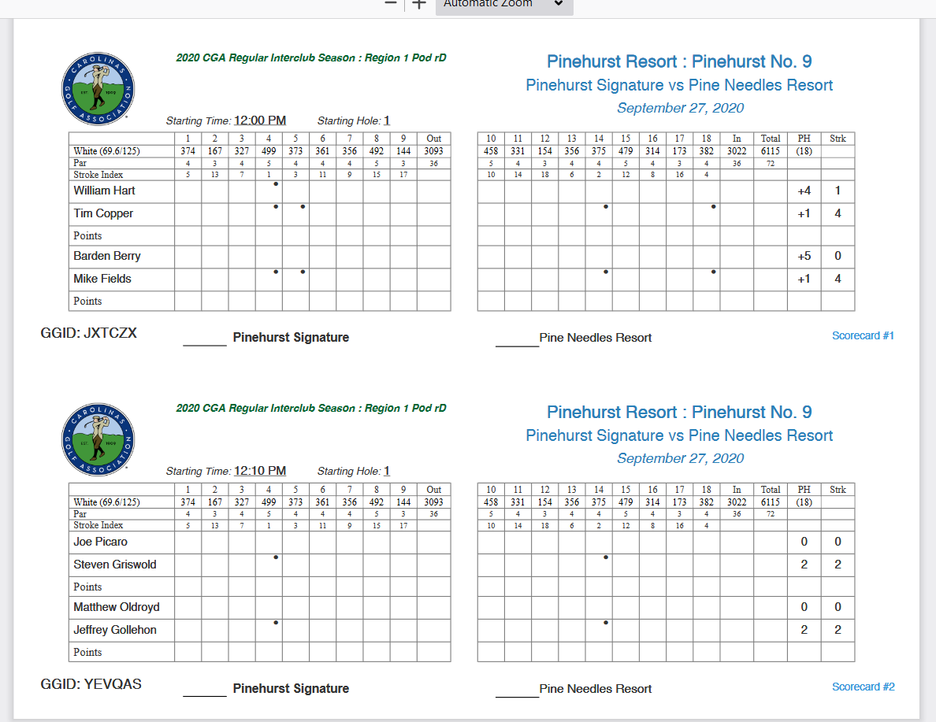
Rule #7 TEAM CAPTAINS' DUTIES – Pre Match: (cont’d)
vii. Home team captain prints scorecards (GG TM)
    Make 2 sets for each foursome
    LIVE SCORING AVAILABLE and RECOMMENDED on GG mobile app
    Remind players the importance of listing their “Most Likely Score”

Slide 37
Questions

Slide 38
Rule #8 TEAM CAPTAINS' DUTIES (Post Match):
RECORD MATCH RESULTS in Golf Genius:
  Both captains collect paper scorecards
  Agree on hole-by-hole scores and point totals for the team match
ENSURE POSTING OF INDIVIDUAL GROSS SCORES
  VERIFY 18 HOLE GROSS SCORES FOR EACH PLAYER
  Paper scorecards are OFFICIAL scores to go in Golf Genius
  Tell players of most likely score method for if/when they do not complete a hole
  Do NOT fill in blank holes
  Set ‘Round Status’ to COMPLETED once ALL scores are verified

Slide 39
Rule #8 TEAM CAPTAINS' DUTIES (After Match & Accurate Scorecards):
After VERIFYING 18 HOLE GROSS SCORES;
  HOME TEAM CAPTAIN to ensure all hole-by-hole scores are entered
      Performed in Golf Genius in ‘Enter Hole-by-Hole Scores’
      Scores get automatically posted to GHIN at 11:00pm, the day of the match. NO LONGER NEED TO MANUALLY POST TO GHIN THROUGH GOLF GENIUS
      Scores MUST be entered in GG prior to 11pm, or scores will not get automatically posted
        If it is discovered that scores were not posted the day of the match, the Home team will receive a 10-point deduction from their season-long match point total
      ESC will be applied automatically
      Make sure the match date is correct
    IMPORTANT!!: Each player in each group must:
      Verify each hole-by-hole score on the paper scorecards are accurate
      Have a score for EACH hole (use most likely method if did not complete a hole - I.e. X7)
      Do NOT fill in blank holes (Can still be posted to GHIN)
      Posted scores that reflect the paper scorecard WILL NOT be adjusted unless a serious inputting error has occurred.

Slide 40
Rule #8 TEAM CAPTAINS' DUTIES (After Match & Accurate Scorecards):
3.3 When a Hole is Started But Player Does Not Hole Out
There are circumstances that might result in a player starting a hole but not holing out.
For example, when:
The result of the hole has already been decided,
A hole has been conceded in match play,
A player’s partner has already posted a better score and the player picks up, or
When a player starts a hole but does not hole out for a valid reason, the player must record their most likely score or net double bogey, whichever is lower!
The most likely score is:
The number of strokes already taken to reach a position on a hole, plus
The number of strokes the player would most likely require to complete the hole from that point.
Scores can be recorded on scorecards and Golf Genius as, for example, "X6".

Slide 41
Rule #8 TEAM CAPTAINS' DUTIES (After Match & Accurate Scorecards):
3.3 When a Hole is Started But Player Does Not Hole Out
Most likely scores should be determined on any hole using the following guidelines:
Position of the Ball | Strokes to be Added
If the ball lies on the putting green, and is no more than 5 feet from the hole: | Add one additional stroke.
If the ball lies between 5 feet and 20 yards from the hole: | Add 2 or 3 additional strokes, depending on the position of the ball, the difficulty of the green and the ability of the player.
If the ball lies more than 20 yards from the hole: | Add 3 or 4 additional strokes, depending on the position of the ball, the difficulty of the green and the ability of the player.

Slide 42
Rule #8 TEAM CAPTAINS' DUTIES (After Match & Accurate Scorecards):
  NOTE: LI’s, HDCP STROKES and OPPOSING PLAYER ELIGIBILITY MAY NOT BE QUESTIONED ONCE A MATCH HAS STARTED UNLESS INFORMATION GIVEN WAS DIFFERENT THAN THAT WAS APPROVED PRIOR TO THE START OF EACH MATCH. 3.2c(1)/1 – Declaring a Higher Handicap is a breach even if affected hole has not been played
  BOTH CAPTAINS SHOULD
  DOUBLE CHECK the SCORECARDS and LINEUPS THE DAY PRIOR TO THE MATCH.

Slide 43
Questions

Slide 44
Rule #9 PRACTICE ROUNDS:
  Goal = Equal opportunity to be competitive
  Regular Season & Playoffs - at the discretion of each club
  Practice rounds should be;
    pre-arranged by both captains
    scheduled date/time agreeable by host club
  Not allowed on host course on the day of a match
Rule #9 HOME TEAM ARRANGEMENTS:
  Home teams determine rates for their matches
  Post match social (up to Host Club)
  Players to honor Club’s Policies (I.e., Cart Path Only, Pace of Play, etc.)
  Eligible players may play in only one (1) match per day
  Practice on the course prior to a match is not permitted

Slide 45
Rule #10 HANDICAPS AND HANDICAP ADJUSTMENTS
Carolinas, Senior, Super Senior & Women’s Divisions
INDEXES
  Based on each player’s 12-Month Low Handicap Index (Low H.I.)
  No Minimum or Maximum Low H.I.
  HDCP Allowance = 85% of the Player’s Unrounded Course Handicap
  Maximum strokes allowed to any one player is 18 after being adjusted off of the low player in the group (does NOT apply to the WOMEN’s DIVISION)
  CGA automatically updates indexes each Monday @ 2:30 a.m.
  Matches played Tues – Sun will use Monday’s Index of the same week
  In addition to the valid Low H.I. (20 posted scores), must have 10 posted scores within previous 12 months of match date
B. HANDICAP ADJUSTMENTS
Exceptional Score Recognition List
  Captains of player(s) on CGA Interclub Exceptional Score List are responsible/required to make this adjustment and notify the opposing captain
  All Handicap Reductions will apply for one (1) year from the date of the exceptional score
  The CGA can adjust/withdraw a player’s Playing Handicap (a/o Match Results)
  Handicap Reductions earned in Interclub play ONLY apply to future Interclub matches. Reductions earned apply to play across ALL divisions.

Slide 46

Rule #10 HANDICAPS AND HANDICAP ADJUSTMENTS
CAREER ROUNDS may require PLAYING HANDICAP ADJUSTMENTS
Golf Committee Procedure 5a & Rules of Handicapping 7.2b
A player’s Playing Handicap may be adjusted by the CGA during the season for an exceptional score
Both Captain & Club will be notified of an adjusted Handicap and its application in CGA Interclub Matches
Failure to apply the required handicap adjustment will result in a 20-point reduction from the team’s season-long point total

Slide 47
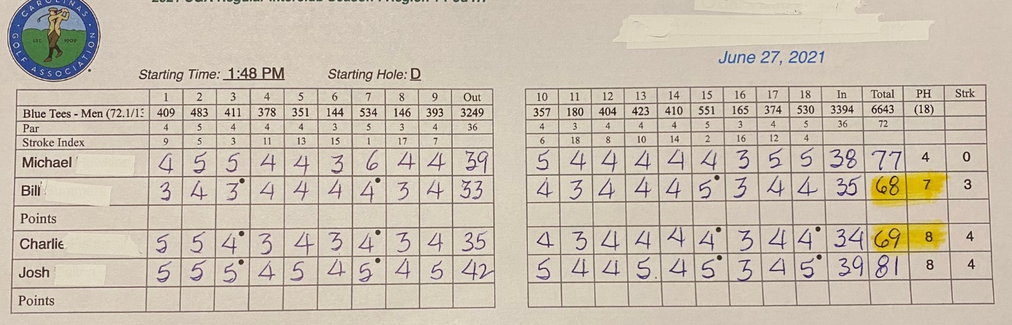
Rule #10 HANDICAPS AND HANDICAP ADJUSTMENTS
HANDICAP ADJUSTMENTS
  Exceptional Score Low Net Differential Handicap Adjustment Table
    Players playing better than the low net differential table below will have their “playing handicap” adjusted prior to each match
      -5 to -6.9 is 2 shots off their playing handicap after it is adjusted to net off of zero,
      -7 to -8.9 is 3 shots off their playing handicap after it is adjusted to net off of zero,
      -9 to -10.9 is 4 shots off their playing handicap after is adjusted to net off of zero,
      any differential beyond -10.9 may result in possible suspension for the remainder of the season and beyond
NOTE:
If the player being adjusted is the low ball in the group, or receives zero (0) shots, add to each of the other 3 players.
Multiple Handicap adjustments will be added together (regardless of division).
If a player has not followed the Rules of Handicapping, the CGA will adjust any previous match scores from that player to a DQ. The full team match results will also be updated.

Slide 48
Rule #10 HANDICAPS AND HANDICAP ADJUSTMENTS
Low Net Differential Handicap Adjustment (cont’d)
    Net Scoring Differential formula:
    (113/Slope) x (Adjusted Gross Score - Course Rating - PCC) - (LHI)
    (PCC Stands for Playing Conditions Calculation)
    Player A – Shoots an adjusted gross score of 73 with a 8.8 LHI, Slope 129 and CR 68.5
        (113/129) x (73 - 68.5 – 0) – (8.8)
        Net Scoring Differential =’s -4.9
        This Player did not make the list
        Player B – Shoots an adjusted gross score of 77 with a 11.2 LHI, Slope 130 and CR 70.5
        (113/130) x (77 - 70.5 - 0) – (11.2)
        Net Scoring Differential =’s -5.5
        This Player did make List!!!!
    CGA will contact the Captain/Co-Captain(s), Head Pro and Handicap Chair after reviewing this players GHIN.
    The Exceptional Score List is available on the Interclub Website under the ‘Captain’s Tools’ tab.

Slide 49
HANDICAPPING AND SCORING RECORDS
By competing in the CGA Interclub competition, team captains agree that their CGA Interclub team members will comply, at the highest level, with the Rules of Handicapping.
Compliance with the Rules of Handicapping includes, but is not limited to:
Attempting to make the best possible score at each hole.
Posting all acceptable scores on the day of play, before midnight local time.
Performing peer review (certifying scores) of their fellow golfers.
Ensuring that scores from club events have been accurately posted to their scoring record.
Properly applying Most Likely Score when playing in Match Play or Four-Ball events.

Slide 50
HANDICAPPING AND SCORING RECORDS
The Handicap Committee at the club also agrees to follow their responsibilities, including:
Maintaining accurate scoring records.
Applying penalty scores to golfers who fail to post their scores or post scores inaccurately.
Adjusting the Handicap Index of any member whose Handicap Index does not reflect their demonstrated ability.
Golfers and teams that fail to comply with the Rules of Handicapping may face:
Adjustments to Playing Handicaps for upcoming Interclub matches.
Point deductions for upcoming Interclub matches.
Disqualification.
Suspension.

Slide 51
Rule #11 PAIRING PROCEDURES:
PAIRINGS (Regular Season and Playoffs)
11.1 Regular Season matches (one course involved):
  Applies to ALL DIVISIONS
  List players in low to high order based on each player’s Low H.I.
  Set lineup in GG
11.2 Playoff matches (two courses involved):
  Applies to Carolinas, Senior & Super Senior Divisions ONLY
  List roster in Low to High Index order
  Pick 2 of lowest 4 to play Home, other 2 play Away
  Repeat for highest 4 LHI
  Set lineup in GG
  Alternate Rule: Alternates used MUST be on the team roster in Golf Genius at least 24 hours before the match
  Last minute alternates must play at the lowest Low H.I. (his or the player he is replacing)
  Alternate rule applies to “Sudden Death” play as well

Slide 53
(Rule #14) ADVICE
Four-Ball partners may give each other advice, but not their opponents or other team members
Each team is allowed one (1) advice giver per match, BUT, if the advice giver is competing, they may NOT act in this role while playing their round
Advice givers must be identified prior to the start of the match
In the playoffs (excluding the Final Four), teams may designate two (2) advice givers in order to have one (1) advice giver at each course involved. Teams MAY NOT have more than one advice giver at a course.

Slide 54
(Rule #15) INCLEMENT WEATHER PROCEDURES & RESCHEDULING MATCHES
MATCH POSTPONED
  Reschedule by both captains
SUSPENDED PLAY
  ALL matches NOT completing 9 holes
    entire match to be replayed at a later date
  ALL matches COMPLETING 9 holes (if continuance is not an option)
    Points based on the last completed hole at time play suspended
    Points on unfinished holes are split
    Leave unplayed holes blank in GG (we will manually adjust point totals)
BOTH Regular Season & Playoff Matches
NEW for 2025 - If inclement weather affects play at only one of the two courses involved, it is strongly encouraged all players complete as many holes as possible (at least nine (9) completed) in order to deem the match official and split any points available for the un-played holes. If nine holes are unable to be completed, the result of the completed matches will stand as played and any incompleted matches are to be continued or replayed on a later date. If a new date (within a reasonable timeframe to finish the next round’s match on-time) cannot be agreed upon, then the match results will stand based from the time the match was suspended.

Slide 55
Rule #16 WITHDRAWAL/FORFEITURES/UNCOMPLETED MATCHES
Circumstances causing forfeiture subject to review by the CGA
    45 match points will be awarded to the non-forfeiting team’s season-long point total
  Forfeiting a match may result in the team’s ineligibility for the following season (multiple forfeitures WILL result in ineligibility for the upcoming season)
  Unacceptable forfeiture reasons:
      Mathematically eliminated from a playoff spot
      Inability to field a full team. Minimum of 4 players for an official match (1v2)
      Course unavailability
      Confusion on date/time of match
Any Regular Season match that is NOT completed after July 26 will result in a 40-40 tie, in order for the Interclub Committee to prepare the playoff brackets

Slide 56
Rule #18 DETERMINING POD STANDINGS & PLAYOFF ELIGIBILITY:
  18.1 - Pod Standings
  POD standings are determined by “Pod Points”
  Two (2) points for a win, One (1) point for a tie, zero (0) for a loss
  In the event of a tie:
      Between two (2) teams - Head to head match record THEN match point total in head to head matches
      Between three (3) teams - Accumulated match points in head to head matches
      Between all POD teams - Accumulated match points won in all matches

Slide 57
Rule #18 cont. DETERMINING POD STANDINGS & PLAYOFF ELIGIBILITY:
Carolinas, Senior & Super Senior Divisions
18.2 - Determining Playoff Teams
All Pod winners will automatically qualify for their respective division’s playoffs
2nd place teams in 5 & 6 team Pods will also automatically qualify
3rd place teams in a 7 team Pod will also automatically qualify
Any remaining spots will be determined based on the following criteria:
  Regular Season record
  Regular Season accumulated match points
  Regular Season AWAY record
  Regular Season AWAY match points
  If a tie still exists, the CGA reserves the right to schedule a play-in match(es) as part of the playoff process

Slide 58
(Rule #19) PLAYOFFS: Carolinas, Senior & Super Senior Divisions
Regular Season ends Sunday, July 26th
Playoff Matches May Begin Monday, August 3rd
Teams qualify based on Pod standing & record
Seeding based on record/accumulated match points within each region
Automatic qualifiers:
    1st place team in a 3 or 4 team Pod
    1st & 2nd place teams in a 5 or 6 team Pod
    Remaining spots awarded based on records and accumulated match points (See Interclub Rule 18 for tie-breaking procedures)

Slide 59
(Rule #19) PLAYOFFS: Gross Division
Regular Season ends Sunday, July 26th
Playoff Matches May Begin Monday, August 3rd
Playoff structure is still TBD/TBA, but it may look like this:
  16 team playoff bracket
  All Pod winners automatically qualify
  Remaining spots determined by match record and season-long point total
  “Better seeded” teams will be the Home team (no split format)
  The Semi-Finals and Championship matches will be hosted by the CGA

Slide 60
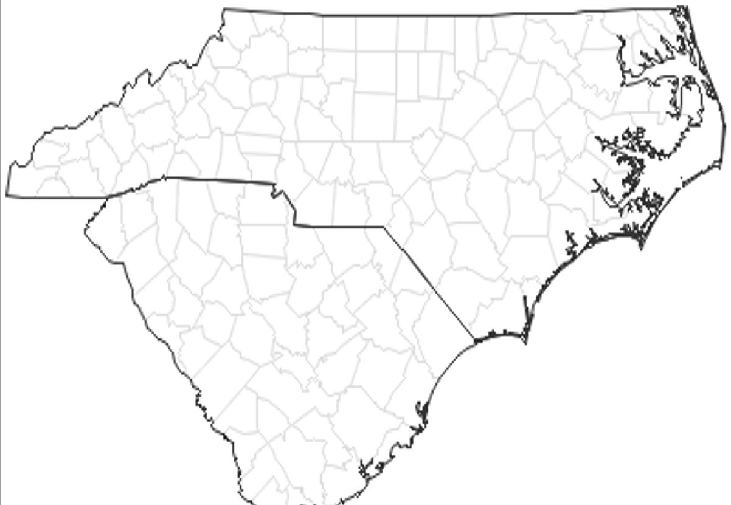
PLAY-OFF REGIONS
B
NC Research Triangle & NE
C
Piedmont Triad
D
Charlotte/Western NC & West/Upstate SC
A
NC Pine & SE
E
WILMINGTON /
NORTH MYRTLE BEACH
F
SOUTH MYRTLE BEACH / PAWLEYS ISLAND
G
CHARLESTON / HILTON HEAD

Slide 61
(Rule #23) LINKS TO RELEVANT USGA RULES
Current USGA Rules of Golf will govern all matches. The host professional staff will help the Interclub Committee administer the Rules of Golf. Understanding Rule 3.2 – Match Play and Rule 23 – Four-Ball are essential to fairly compete and appreciate the format of Interclub competition. The Rules of Golf shall NOT be waived at any time. Captains should encourage players to familiarize themselves with the below relevant Rules of Golf.
A. RULE 1.2 – STANDARDS OF PLAYER CONDUCT
B. RULE 1.3 – PLAYING BY THE RULES
C. RULE 3.2 - MATCH PLAY
D. RULE 4.3 – USE OF EQUIPMENT
E. RULE 5.6 – UNREASONABLE DELAY; PROMPT PACE OF PLAY
F. RULE 6.4 – ORDER OF PLAY WHEN PLAYING HOLE
G. RULE 20 – RESOLVING RULES ISSUES DURING ROUND; RULINGS BY REFEREE AND COMMITTEE
H. RULE 23 – FOUR BALL
I. MODEL LOCAL RULE E-3 – PREFERRED LIES
a. Model Local Rule E-3 should only be in affect if temporary abnormal conditions arise at the course involved (i.e. abnormally wet conditions/cart path only; multiple Ground Under Repair areas in multiple fairways)
J. MODEL LOCAL RULE E-5 – ALTERNATIVE TO STROKE AND DISTANCE FOR LOST BALL OR BALL OUT OF BOUNDS
K. Only golf clubs and balls on the USGA’s latest list may be used. Penalty for use of a brand not on the list is disqualification.
L. USGA RULES OF HANDICAPPING
M. CGA INTERCLUB LOCAL RULES & TERMS OF THE COMPETITION (HARD CARD)
N. Teams/clubs may establish Local Rules, but they must be consistent with the policies established in Section 8, Model Local Rules as defined by the USGA, and clearly communicated to the opponents. CLICK HERE TO VIEW RULES OF GOLF AND MODEL LOCAL RULES, scroll down to COMMITTEE PROCEDURES. Click on #8 MODEL LOCAL RULES.

Slide 62
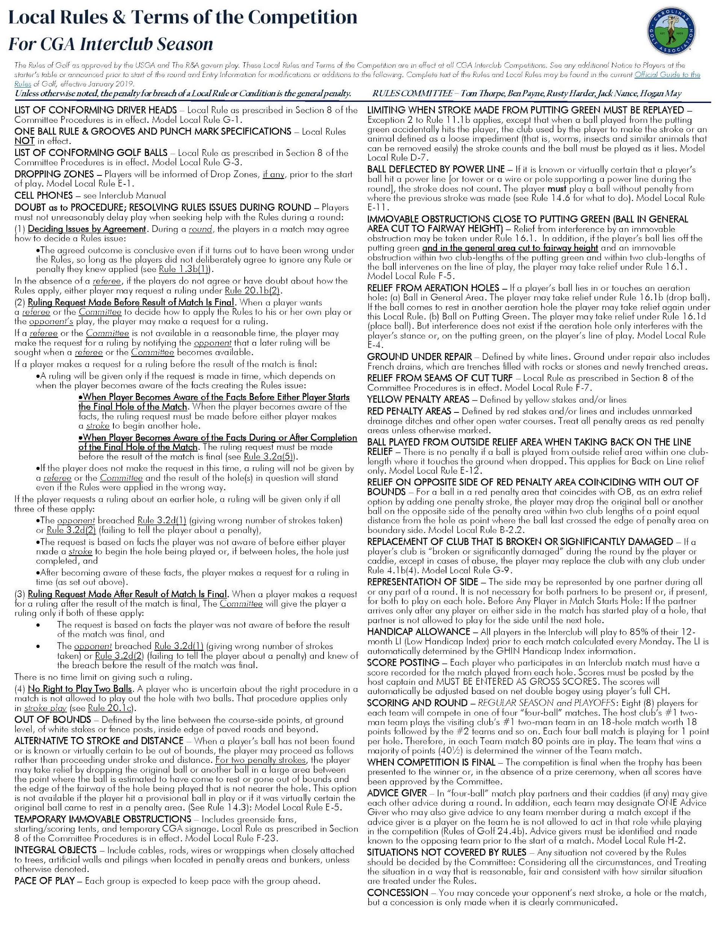

Slide 63
CGA INTERCLUB LOCAL RULES and TERMS of the COMPETITION
Model Local Rule E-5 – Alternative to Stroke and Distance for Lost Ball or Ball Out of Bounds
When a player’s ball has not been found or is known or virtually certain to be out of bounds, the player may proceed as follows for 2 penalty strokes;
  the player may take relief by dropping the original ball or another ball in a large area between the point where the ball is estimated to have come to rest or gone out of bounds and the edge of the fairway of the hole being played that is not nearer the hole (see Rule 14.3)
  Cannot be used for an unplayable ball, or for a ball that is known or virtually certain to be in a penalty area
Model Local Rule F-5.2 - Immovable Obstructions close to putting green (General Area cut to fairway height)
  If the player’s ball lies off the putting green and in the general area cut to fairway height and an immovable obstruction within two club-lengths of the putting green and within two club-lengths of the ball intervenes on the line of play, the player may take relief under Rule 16.1. This Local Rule only applies when both the ball and the obstruction are in part of the general area cut to fairway height or less.

Slide 64
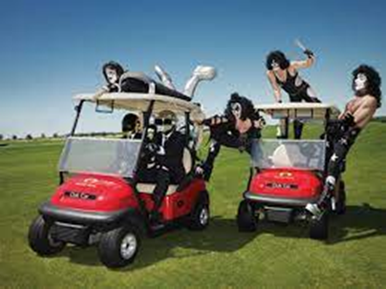
Allowed Uses of Equipment
Rule 4.3a(4) allows “listening to audio or watching video on matters unrelated to the competition being played (such as a news report or background music). But in doing so, consideration should be shown to others (see Rules of Golf 1.2).”
Penalty for 1st Breach = General Penalty (Player’s score cannot count for that hole under Rule 23.9a)
Penalty for 2nd Breach = Disqualification of the player & partner under Rule 23.9b and Rule 4.3
Distance-measuring devices are permitted (i.e. range finders, GHIN app, 18 birdies). Any SLOPE setting MUST be turned OFF during an Interclub match
Penalty for 1st Breach = General Penalty (Player’s score cannot count for that hole under Rule 23.9a)
Penalty for 2nd Breach = Disqualification of the player & partner under Rule 23.9b & Rule 4.3

Slide 65
- Captains Checklist -
BEFORE SEASON BEGINS
Submit Team entry (include other confirmed Pod teams)
Attend Captains Meeting
Meet with Pod Captains to:
  Set regular season schedules
  Coordinate social plans & cart fees
Secure your Golf Genius link to;
  Set-up team & match rosters
  Set regular season match dates
  Set tees used for home matches
Hold team meeting to review: format, match play rules, schedule, etc.

Slide 66
- Captains Checklist -
BEFORE EVERY MATCH
1 Week Prior to a Match;
Confirm match schedule (NOTE: If rescheduled, edit in GG)
Prepare a 4/8 man team match roster in GG (no later than 24 hours prior to a match)
  List players in Low to High handicap order (refer to Rule 9.F)
  Review opponents Match Roster
Verify opposing team’s lineup (eligibility, correct order, etc.)
Contact opposing captain with questions/inquiries
  If necessary, notify CGA Interclub Administrator with questions for resolution
1 or 2 Days Prior to the Match, the Host Captain should;
Coordinate all activities with the host pro:
  Discuss local rules (document & prepare hard copies per group for both teams)
  Ensure tees for the competition have been or will be set correctly
  Discuss social activities (if any) following play
  Provide staff with pairings for scoreboard and (optional) cart signs
Generate scorecards for each foursome
  Four-Ball format (play off the low handicap)
  Make two sets (one for each cart)
  Check Exceptional Score List for possible HDCP reductions

Slide 67
- Captains Checklist -
DAY OF MATCH
Captains re-confirm rosters
Adjust lineups / scorecards accordingly
Communicate local rules
  (i.e., playing the ball down, tees, GUR, etc.)
  to ALL players
  remind players to list hole by hole (ESC) scores on scorecard
  remind players to return scorecards for posting
NOTE: CLAIMS regarding HANDICAPS and PLAYER ELIGIBILITY MUST BE MADE PRIOR to the PLAYER TEEING OFF. ONCE a MATCH has STARTED, HANDICAP and/or ELIGIBILITY CLAIMS are INVALID UNLESS a PLAYER knowingly begins the MATCH with INCORRECT INFORMATION (USGA Rule 6-2a/5).

Slide 68
- Captains Checklist -
At The Completion of Each Match (Host Captain):
  Collect scorecards
  Leave holes with no score blank
  Verify each players adjusted gross score w/ the Player
  List Hole by Hole scores in Golf Genius and
    Submit match results as COMPETITION scores
    SAME DAY OF MATCH
    Scores will be posted to player’s GHIN profile the following day
  Retain scorecards until end of regular season

Slide 69
Questions

Slide 70

CGA Interclub Final Four (CAROLINAS, Senior and Super Senior)
2026
Final Four
River Landing (River)
Practice Rounds
Sunday, November 15
Players Reception
Semi-Finals Matches
Monday, November 16
Championship
Matches
Tuesday, November 17

Slide 71
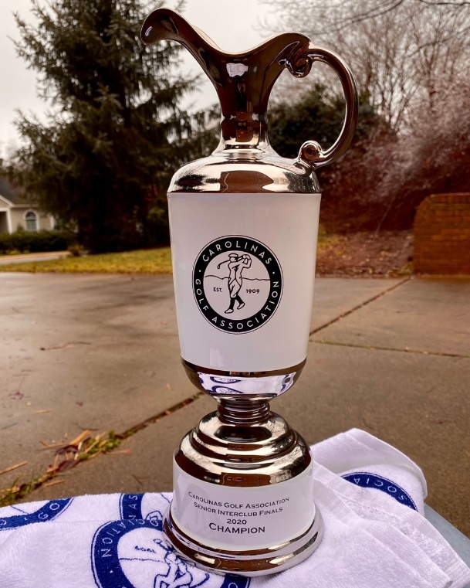

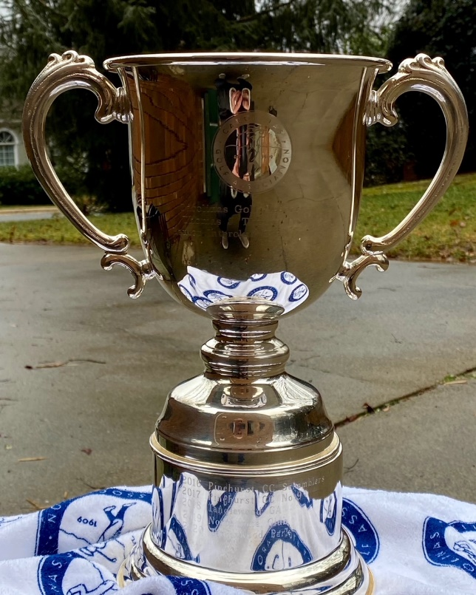
2026 CGA Interclub Competition

